Slide 1


Slide 2

Curiosity
Everyone is open to learning new things about themselves, all that surrounds them and how the two fit together.

Slide 3

Health
Everyone has the skills and tools to maintain a healthy balance of their mental, physical and emotional wellbeing.

Slide 4

Confidence
Everyone believes in themselves, stands up for what is right and has the confidence to reflect and learn from their actions.

Slide 5

Resilience
Everyone keeps trying to better themselves, even when things are difficult or when we make mistakes.

Slide 6

Empathy
Everyone is kind, caring and considerate of the feelings of one another.

Slide 7

Respect
Everyone treats our environment with respect and appreciates the cultures, beliefs and views of one another.

Slide 8
Reminders
Lunch – food in hall.
Year 2 and 3 – not leaving hall until 12.30
Year 5 and 6 – not leaving hall/class until 12.45
Football
Pro social behaviours
Walking in school

Slide 9

What makes us happier?

Slide 10
Study
Gratitude – writing down 3 things they are grateful for
Kindness – doing at least 3 acts of kindness
Diary – write an account of their day
Which group were happier after the study?

Slide 11
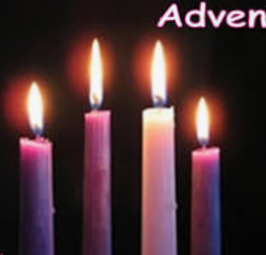
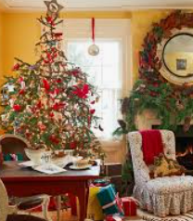

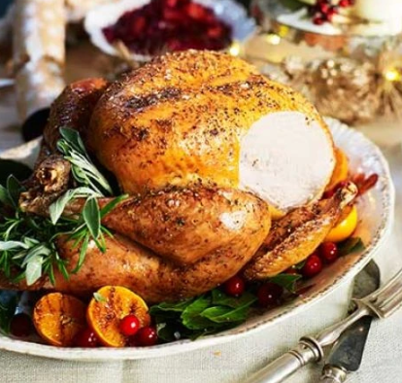

Slide 12
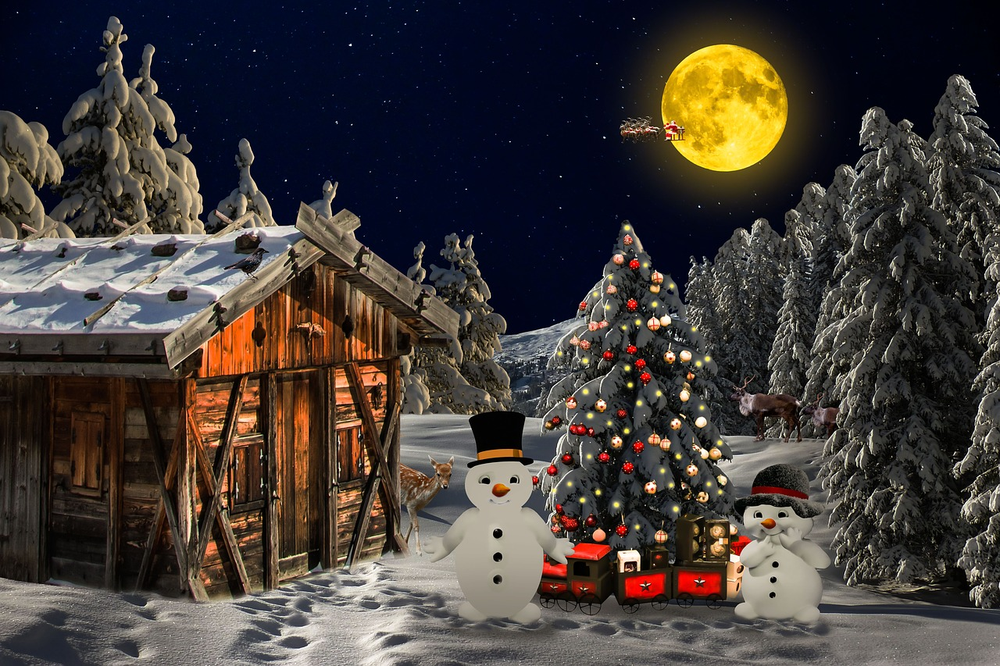
You have two minutes to memorise as much about the image as possible before answering the questions.

Slide 13
Round Ten - Observation
Notes:
Image References:
Image: https://pixabay.com/illustrations/christmas-christmas-landscape-1916050/

Slide 14
Which animal was on the roof of the shed?
What colour was the lights on the tree?
How many snowmen wore top hats?
How many train wheels were visible?
How many mammals were on the ground?
Who was travelling past the moon?
How many buttons did the left snowman have?

Slide 15
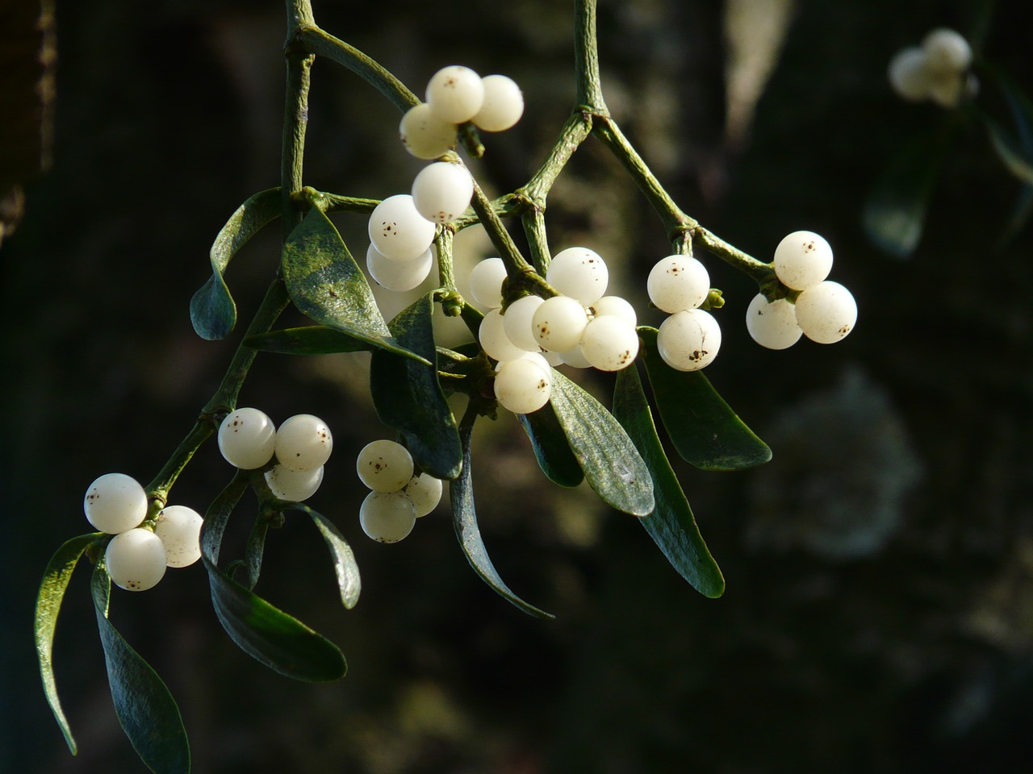
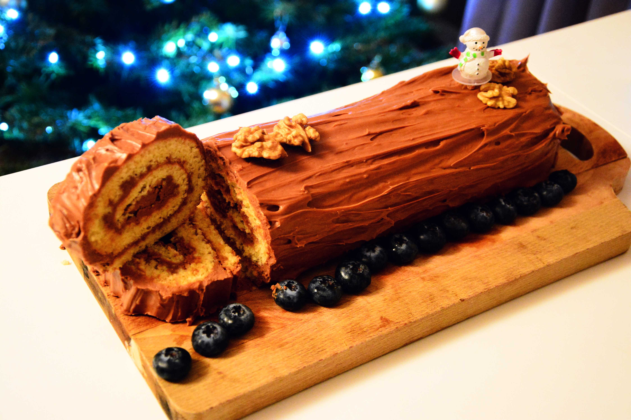

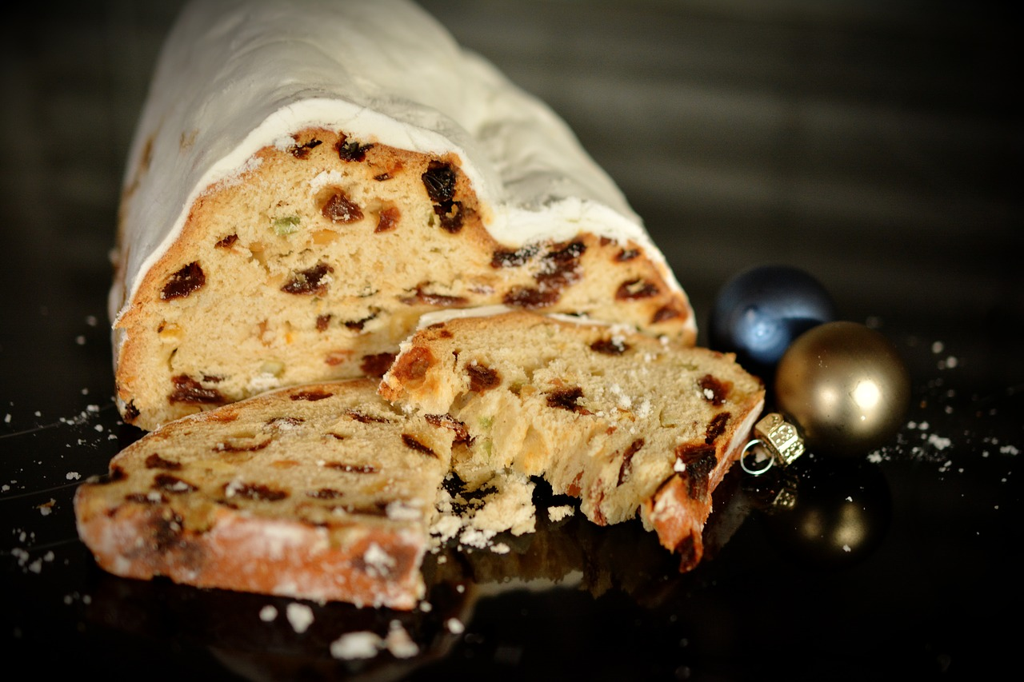
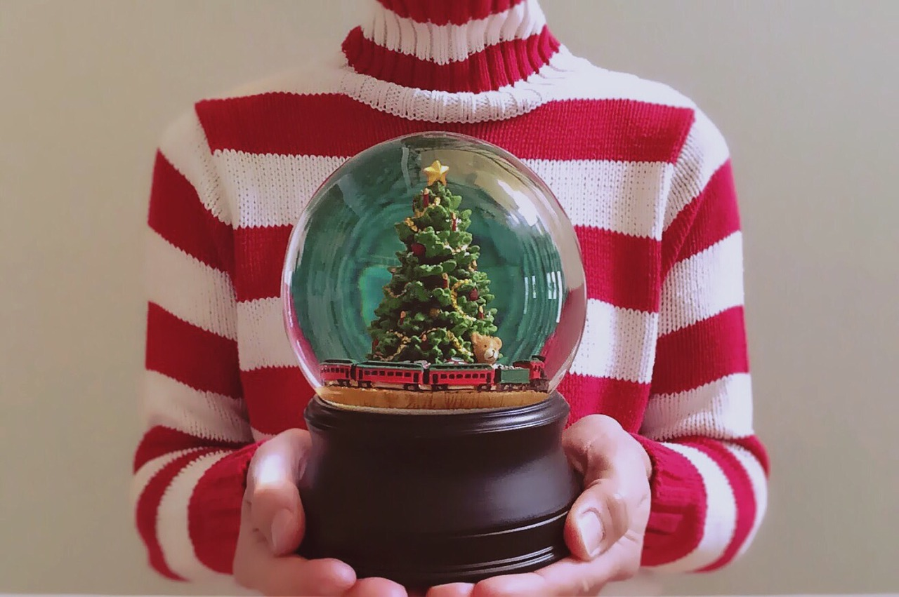
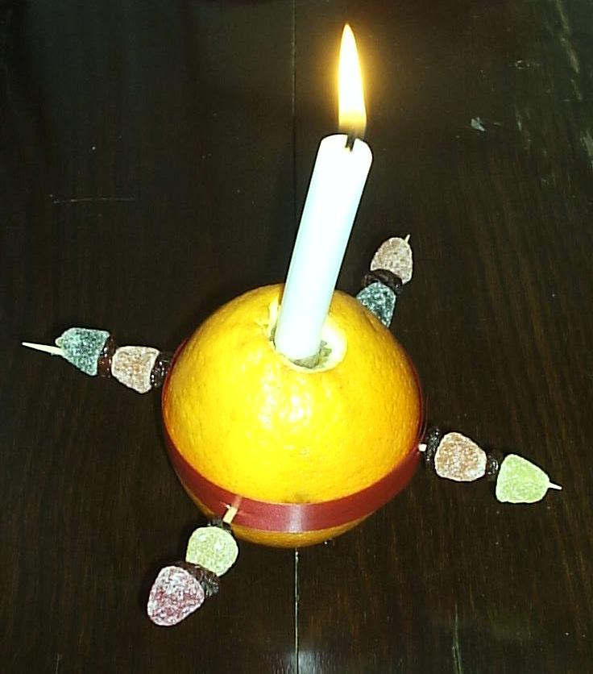
Name The Item
A
B
C
D
E
F
Notes:
Image References
Image A - https://pixabay.com/photos/mistletoe-berries-mistletoe-green-16393/
Image B - https://en.wikipedia.org/wiki/File:Buche_de_Noel_(Yule_Log).jpg
Image C - https://pixabay.com/photos/christmas-wreath-holly-decoration-2975874/
Image D - https://pixabay.com/photos/christmas-stollen-christmas-sweets-1768904/
Image E - https://pixabay.com/photos/holiday-snow-globe-christmas-xmas-1071521/
Image F - https://commons.wikimedia.org/wiki/File:Christingle.jpg

Slide 16
Name The Item
A
B
C
Mistletoe
Yule Log
Holly Wreath
D
E
F
Stollen
Snow Globe
Christingle
Notes:
Image References
Image A - https://pixabay.com/photos/mistletoe-berries-mistletoe-green-16393/
Image B - https://en.wikipedia.org/wiki/File:Buche_de_Noel_(Yule_Log).jpg
Image C - https://pixabay.com/photos/christmas-wreath-holly-decoration-2975874/
Image D - https://pixabay.com/photos/christmas-stollen-christmas-sweets-1768904/
Image E - https://pixabay.com/photos/holiday-snow-globe-christmas-xmas-1071521/
Image F - https://commons.wikimedia.org/wiki/File:Christingle.jpg

Slide 17
Reflection
Feel fortunate and grateful during advent.

Slide 18
How do we prepare for Advent?
Reader 1: We can’t help knowing that it will soon be Christmas. For weeks, the shops have been reminding us of that.
Reader 2: There are carol concerts, nativity plays, Christmas lunches in the stores and maybe in school.
Reader 3: There is shopping to be done.
Reader 4: There is a growing excitement as Christmas gets closer. It’s a welcome mid-winter boost.
Reader 1: Most of us enjoy the preparation for it. If we didn’t prepare, it might not be as good a celebration - the preparation is part of the excitement.
Reader 2: In the Christian calendar, the season of Advent begins around the start of December and lasts until Christmas Eve. It is all about preparing, getting ready, looking back and looking forward. The church uses Advent to help us prepare for and understand the meaning of the birth of Christ. Churches are decorated, Christmas crib scenes are prepared and carols and nativity plays are rehearsed. We begin to feel the excitement building.

Slide 19
How do we prepare for Advent?
Reader 4: The baby who was born in Bethlehem grew up to be a man who showed us what it is like to live as a human being, having fun and caring for others as they care for us. He challenges us to live in the same way.
Reader 1: Christians believe that Jesus came into the world to show us how to live life, enjoy it to the full and help others to do the same.
Reader 2: Advent is a good time to think about how well we are doing that, especially the enjoyment.

Slide 20
How do we prepare for Advent?
Voice 1: I could have stopped and said good morning, but I was in a hurry and moved on.
Voice 2: I could have offered to help, but I was busy with my PlayStation.
Voice 3: I suppose I didn’t have to say that and laugh at her, but . . .
Voice 4: I know 50p isn’t much to give, but I’m saving up for . . .
Reader 3: In the Bible, Jesus says, ‘As you did to one of the least of these, you did it to me.’
Reader 4: It is so easy to help; everyone can make a difference.

