Slide 1
'Meet The Teacher'
September 2023
Welcome to Year 4
Mr Nicholl and Ms Zelinkova
Notes:
Record

Slide 2
Arrival and Dismissal
Morning Drop Off: 8.30am to 8.40am (to allow a natural stagger)
Pupils enter the school via front gate; make their way to their designated doors through the school playground, to their class
Registration is at 8.40am, pupils arriving after 8.40am will be marked as late
Afternoon Collection: 3.00pm
Pupils will be released to attend after school clubs, or be collected from the outside door of the classroom. Pupils can also be collected from the School gates with parental permission.
Notes:
Record

Slide 3
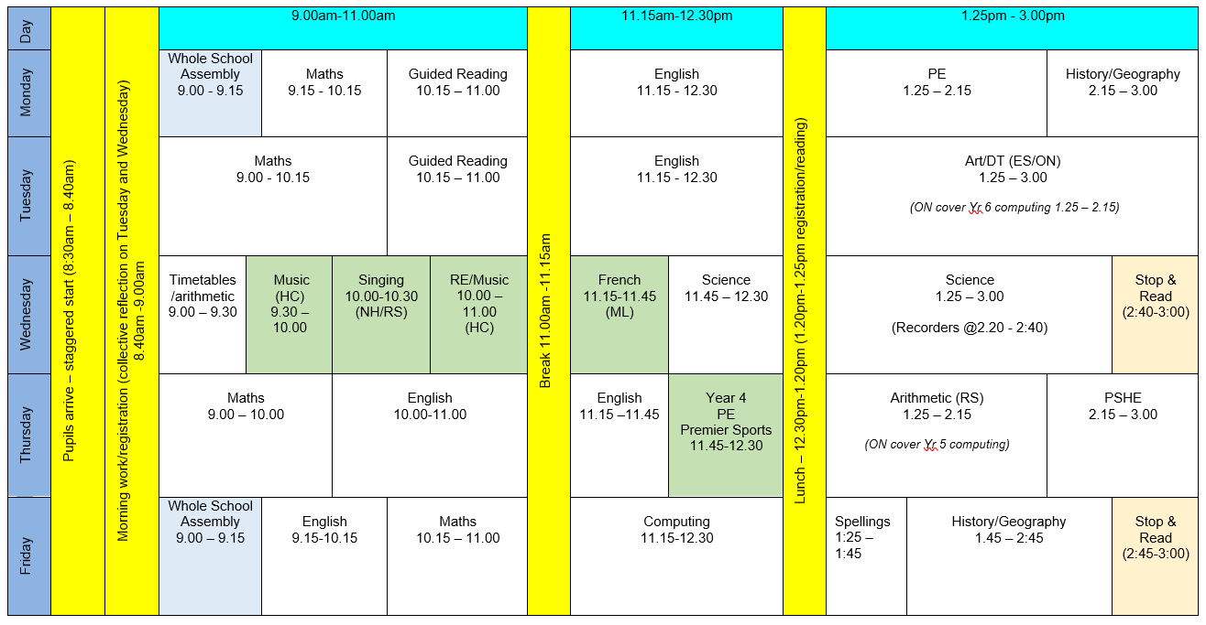
Timetable
Notes:
Record

Slide 4
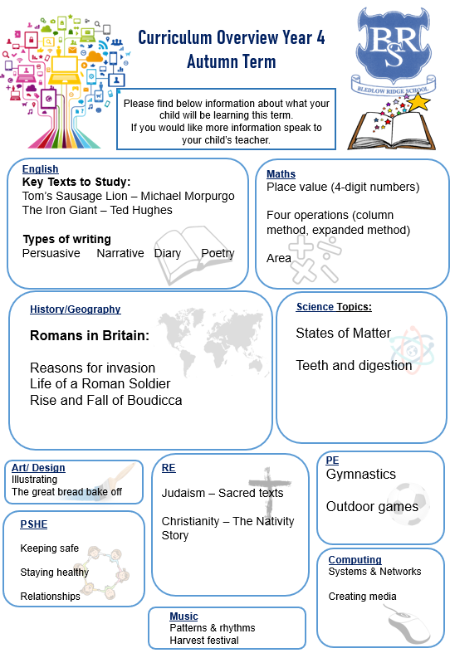
Termly Curriculum Overview
Notes:
Record

Slide 5
Equipment/what to bring to school
In Key Stage 2 (Years 3-6) every child will need to bring in a small clear pencil case with the following items. Please name items where possible.
HB pencil
rubber
glue-stick
ruler
sharpener
Scissors
Colour pencils, felt tips, highlighters etc are optional and should be kept in a separate case
School can supply a whiteboard pen (but only replaced each half term)
Notes:
Record

Slide 6
PE
PE lessons are on Monday and Thursday.
Children can wear their PE kit to school and remain in their PE kit for the duration of the day, only on the days that they have PE
PE Uniform
White polo shirt
Navy blue shorts
Trainers (not plimsoles)
Plain navy-blue tracksuit top
Plain navy blue tracksuit trousers
Swimming is in the Summer term and replaces 1 PE lesson
Notes:
Record

Slide 7
Teaching and Learning
Curricular targets for English (writing) and mathematics
Every child has targets for writing and mathematics.
Writing targets match the year group National Curriculum objectives
Children have a copy of targets in the back of their maths and English books.
When a target is met, the target sheet is ticked and dated to help each child understand the progress they are making.
Copies of your child’s targets will be shared and discussed at parent consultations in October.
Notes:
Record

Slide 8
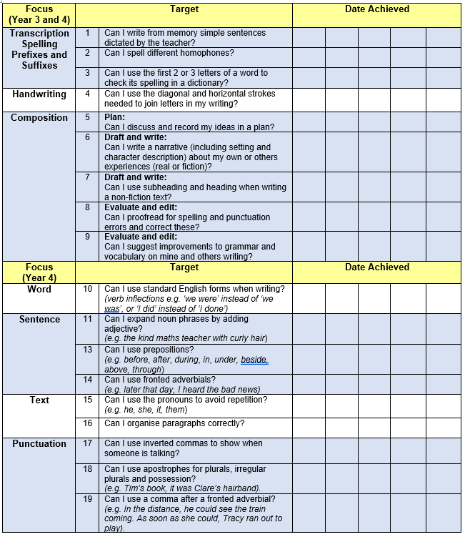

Slide 9
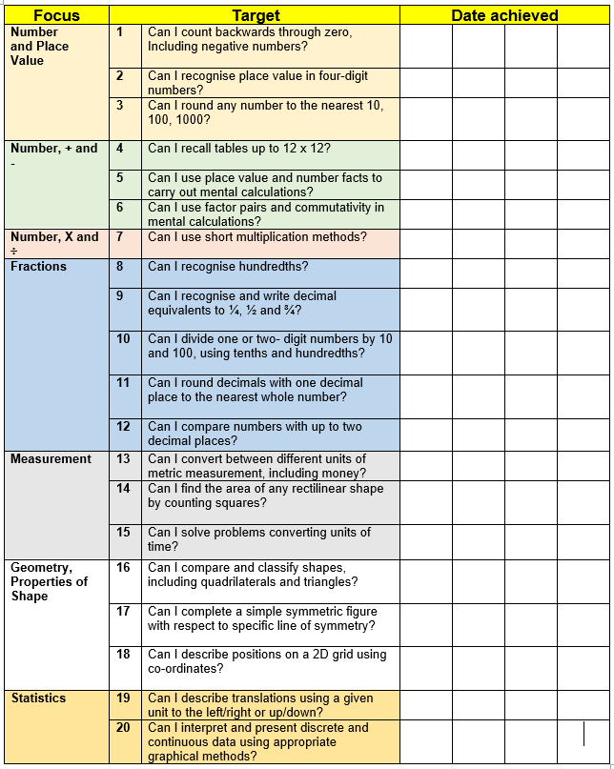

Slide 10
Teaching and Learning
Teacher Feedback
Research shows that the most effective feedback is given verbally, ‘in the moment’ – this will be evidenced as a ‘VF’ in pupils’ books
Adults may also sometimes provide written feedback and modelling in pupils’ books using a green pen
We expect pupils to respond to feedback given by adults. We ask the pupils to do this in purple pen to help them and the adults see the corrections/edits
Notes:
Record

Slide 11
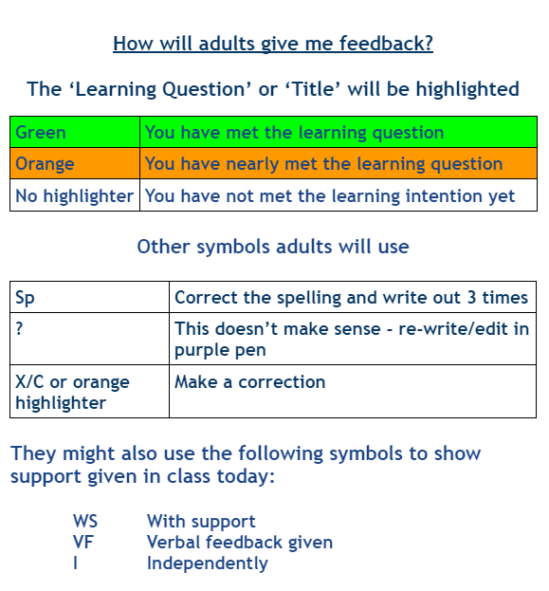

Slide 12
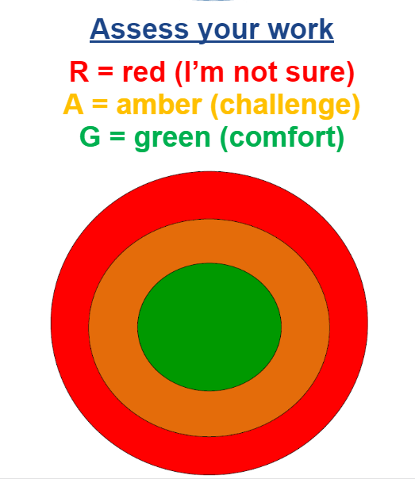

Slide 13
Homework
Homework is set each Friday
Maths homework will be set on Mathletics
Spellings set Friday and the spelling test is on following Friday… pupils will have own personal target
Learning Logs have changed (see Mrs Stanley’s letter)
If you can, please read every day with your child
Reading records should be signed at least 3-5 times each week
Reading records checked in school to earn house points
Notes:
Record

Slide 14
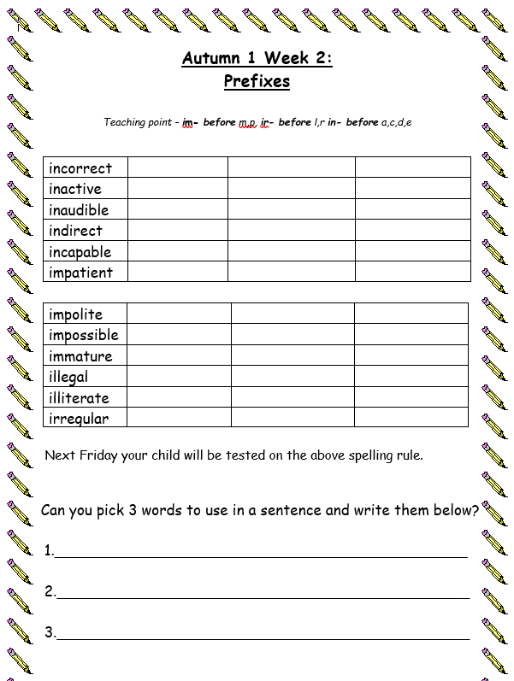
Pupils can choose how many of the set spellings
they feel confident to learn and this can change each week.
The target can be as low or high as they want and should reflect their confidence and ability.
The double-page in the spelling books can be used to practise the words.
Please ensure pupils bring book in each Friday as they will stick new spellings into books and also complete the test in back of book.
They will mark own work to get instant feedback on how they have done.

Slide 15
How can parents help?
In June, Year 4 pupils will complete a Multiplication tables Check (MTC)
The MTC is an on-screen assessment designed to determine whether pupils are able to fluently recall their multiplication tables up to 12, through a set of timed questions
The official check consists of 25 questions. Pupils will have 6 seconds to answer each question, with 3-seconds pause between questions
For more information visit: 2022 Multiplication tables check: administration guidance (publishing.service.gov.uk)
Regular TTRS sessions will help pupils to consolidate their
speed and accuracy of recall
There will be a specific meeting and presentation on the MTC in the Summer term
Notes:
Record

Slide 16
How can parents help?
Read, read and read some more!
Statistic: Parents who read 1 picture book with their children every day provide their children with exposure to an estimated 78,000 words each a year. Cumulatively, over the 5 years, estimated that children from literacy-rich homes hear a cumulative 1.4 million more words during storybook reading than children who are never read to.​
https://schoolreadinglist.co.uk/
https://www.buckinghamshire.gov.uk/libraries/library-membership/join-library/
Notes:
Record

Slide 18
How can parents help?
Number bonds and times tables – practise these everywhere
Practise telling the time (digital/analogue)
Regular attendance is key – 95% is the minimum expectation Pupils whose attendance is of concern will be invited to discuss this in order that the school can support parents and pupils as best possible
Communication! Please come and talk if you have any concerns/questions
Notes:
Record

Slide 19
Any questions
Notes:
Record

