Slide 1

'Meet The Teacher'
September 2023
Welcome to Year 5!
Notes:
Record

Slide 2
Staff
Miss Simms – Class Teacher
Mrs Craven- RE and Music
Mr Nicholls- Computing
Mrs Lyon- French
Mrs Webb- Supporting Mon, Tues, Weds, Thurs, Fri
Notes:
Record

Slide 3
A little bit more about us…
Miss Simms- I joined Bledlow Ridge last year as the Year 5 Class Teacher. It was my first year teaching and I loved every minute. I live in Thame with my parents and little sister, in my spare time I enjoy running, swimming and seeing friends. I have really enjoyed my time at BRS so far, and am looking forward to another great year!
Mrs Webb- I am a full time TA, working every day supporting the children in Year 5. I’ve just started working at Bledlow Ridge this year and am really enjoying my new role. I am a qualified teacher with 7 years experience in primary schools in Hertfordshire and Buckinghamshire. I have a son in Reception and I am delighted to be part of this brilliant school community, both as a staff member and as a new parent in the school.

Slide 4
Arrival and Dismissal
Morning Drop Off: 8.30am to 8.40am (to allow a natural stagger)
Pupils enter the school via front gate; make their way to their designated doors through the school playground, to their class
Registration is at 8.40am, pupils arriving after 8.40am will be marked as late.
Afternoon Collection: 3.00pm-3.10pm
All pupils will be collected from the outside door of their classroom.
Children walking will be sent at 3.00pm.
Notes:
Record

Slide 5
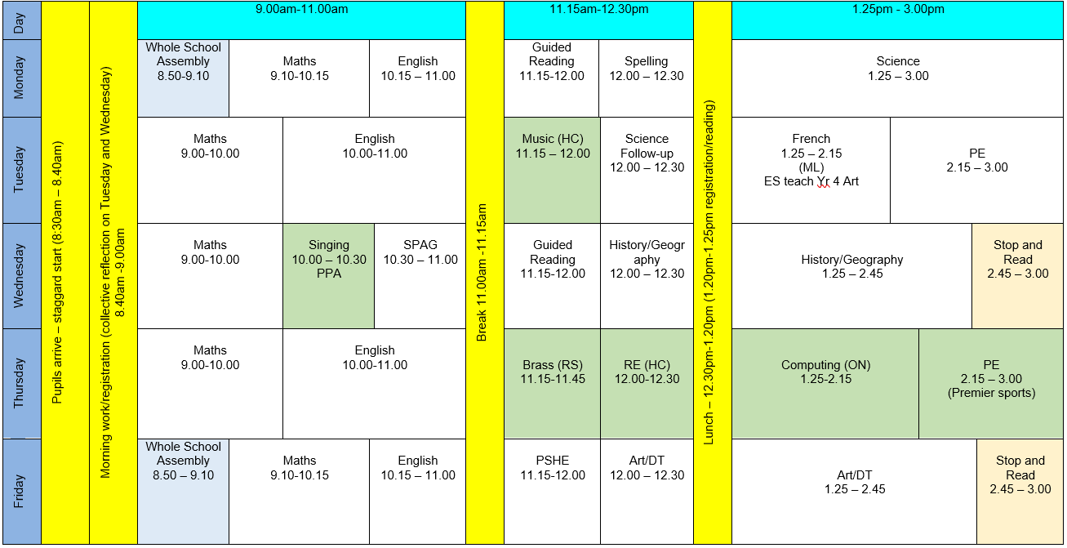
Notes:
Record

Slide 6
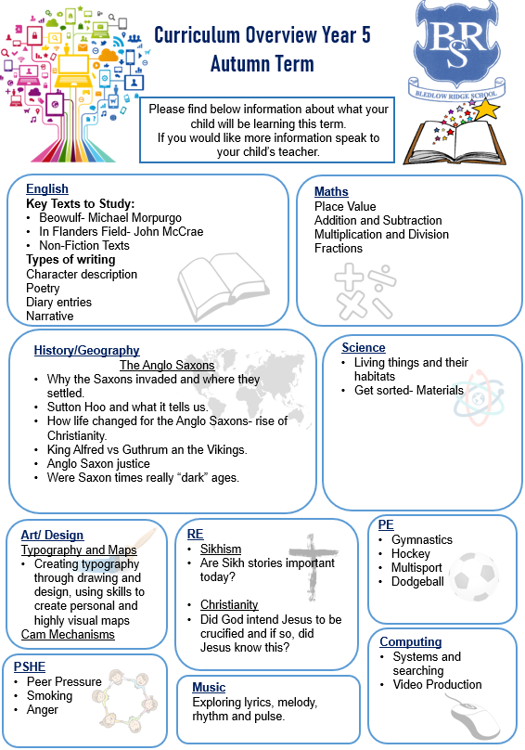
Termly Curriculum Overview
Notes:
Record

Slide 7
Trips
Autumn Term trip:
Earth Trust- Invaders and Settlers
More information will be provided once confirmed closer to the time.
Walks and events in school may also be additional to these trips.
Notes:
Record

Slide 8
Homework
Spellings-
Set each Monday and tested on the following Monday.
Spellings will follow a spelling “rule” that has been taught along with additional statutory Year 5 words.
Maths-
Will be set on Mathletics each Monday and is due in the following Monday.
This will be linked to the weeks learning.
Reading
Children should read at least 3 times a week with a parent or carer.
Reading records should be signed by a parent/carer on these occasions.
Children can add if they have read independently.
We will check these each Friday.
Notes:
Record

Slide 9
Equipment/what to bring to school
In Key Stage 2 (Years 3-6) every child will need to bring in a small pencil case with the following stationery.
Please name items where possible.
    Two blue ink handwriting pens (not biro)
    HB pencils
    Colouring pencils
    Ruler
    A glue-stick
    A rubber
    A sharpener
Notes:
Record

Slide 10
PE
PE lessons are taught on Tuesday and Thursday.
Children can wear their PE kit to school and remain in their PE kit for the duration of the day, only on the days that they have PE
PE Uniform
  White polo shirt
  Navy blue shorts
  Trainers (not plimsoles)
  Plain navy-blue tracksuit top
  Plain navy blue tracksuit trousers
Notes:
Record

Slide 11
Teaching and Learning
Curricular targets for English (writing) and mathematics
Every child has targets for writing and mathematics
Targets match the year group National Curriculum objectives
Children will have a copy of their targets in the back of their maths and English books.
When a target is met, the target sheet is ticked and dated to help each child understand the progress they are making.
Notes:
Record

Slide 12
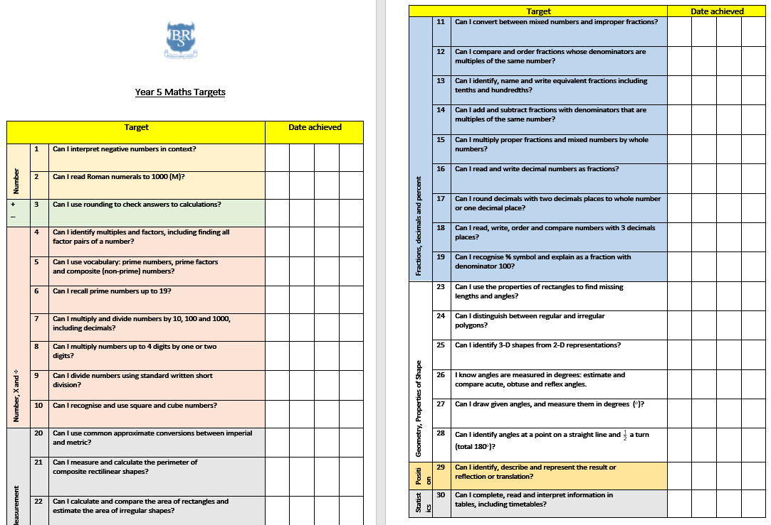

Slide 13
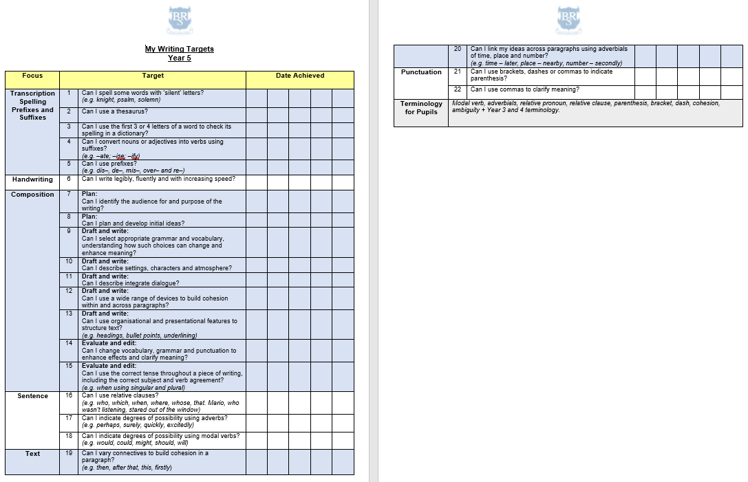

Slide 14
Teaching and Learning
Teacher Feedback
Research shows that the most effective feedback is given verbally, ‘in the moment’ – this will be evidenced as a ‘VF’ in pupils’ books
Adults may also sometimes provide written feedback and modelling in pupils’ books using a green pen
We expect pupils to respond to feedback given by adults. We ask the pupils to do this in purple pen to help them and the adults see the corrections/edits they do.
Notes:
Record

Slide 15
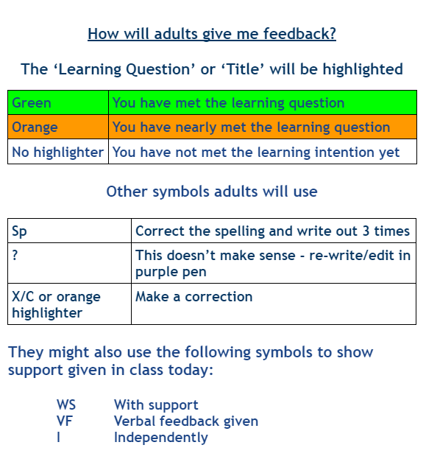
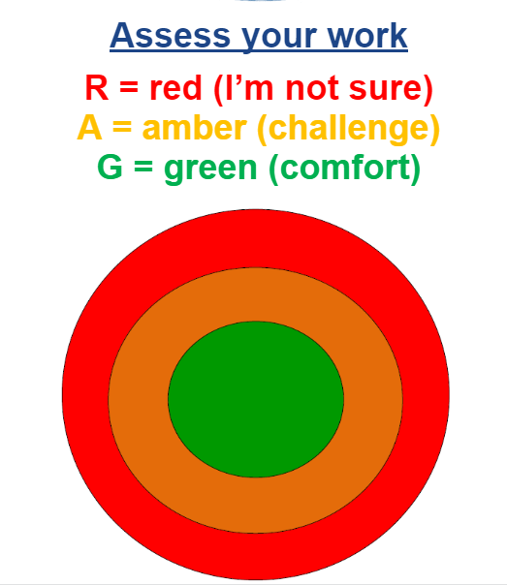

Slide 16

How can parents help?
Read, read and read some more!
Statistic: Parents who read 1 picture book with their children every day provide their children with exposure to an estimated 78,000 words each a year. Cumulatively, over the 5 years, estimated that children from literacy-rich homes hear a cumulative 1.4 million more words during storybook reading than children who are never read to.​
Notes:
Record

Slide 17


Slide 18
How can parents help?
Number bonds and times tables
Telling the time on a clock with hands
Regular attendance is key – 95% is the minimum expectation. Pupils whose attendance is of concern will be invited to discuss this in order that the school can support parents and pupils as best possible.
Communication! Please come and talk to us if you have any concerns/questions
Notes:
Record

Slide 19
Any questions?
Notes:
Record

