Slide 1
Exploring sounds.
Exploring duration.
Rehearsal and performance of Christmas play.
Exploring pulse and rhythm.
Exploring pitch.
Exploring instruments and symbols.
Exploring timbre, tempo and dynamics.
Exploring duration.
Exploring pulse and rhythm.
Rehearsal and performance of the Christmas play.
Exploring pitch (linked to BBC 10 Pieces Lark Ascending – Ralph Vaughan - 1914 )
Exploring instruments and symbols (graphical score).
Exploring timbre, tempo and dynamics.
Exploring sounds.
(linked to BBC 10 Pieces No Place Like Kerry Andrew 2017)
Year One
Year Two
Music planning:
Music Express scheme of work with BBC 10 Pieces.
Exploring rhythmic patterns. Rehearsal and performance of Harvest Festival.
Exploring arrangements. (linked to BBC 10 Pieces Mars – Holst 1914)
Christmas carol performance
Exploring sounds and colours. (Linked to BBC 10 Pieces Anthology of Fantastic Zoology –Bates - 2015)
Exploring singing games
Exploring Rhythmic patterns (linked to Egyptian Musical contexts planning.)
Exploring pentatonic scales
Exploring melodies and scales.
Exploring sounds and colour.
Exploring descriptive sounds (linked to BBC 10 Pieces Hall of the Mountain King – Edvard Grieg -1875)
Exploring signals .
Year Four
Year Three
Exploring descriptive sounds and rehearsal and performance of Harvest Festival.
Exploring arrangements.
(Linked to BBC 10 Pieces Firebird – Stravinsky 1910)
Songwriter - exploring lyrics and melody
Cyclic patterns - exploring rhythm and pulse (linked to BBC 10 Pieces ‘Connect It’ - Anna Meredith)
Who knows? Exploring musical processes (linked to BBC 10 Pieces Rondeau Abdelazer – Henry Purcell - 1695)
Exploring Rounds
Carol for the Christmas concert
Journey - exploring sound sources (Linked to BBC 10 pieces Vivaldi ‘Winter’ )
Cyclic Patterns - rhythm and pulse
Songwriter - exploring lyrics and melody
Stars, Hide your Fires - (linked to End of term performance.)
Roundabout- exploring rounds
Journeys - exploring sounds sources (linked to BBC 10 Pieces Ride of the Valkyries
Richard Wagner
1851)
Year Five
Stars, Hide your fires - performing together (linked to Easter performance)
Who knows? - exploring musical processes
Year Six
Bledlow Ridge Curriculum Road Map-Music March 2022

Slide 2
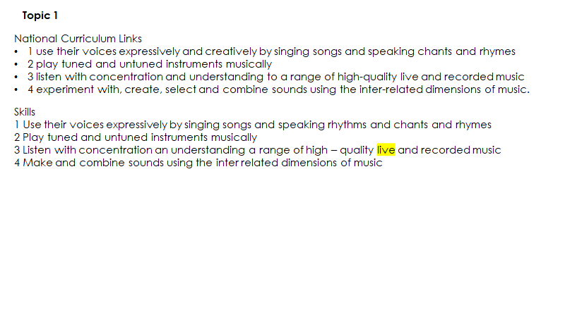
National Curriculum Key Stage 1

Slide 3
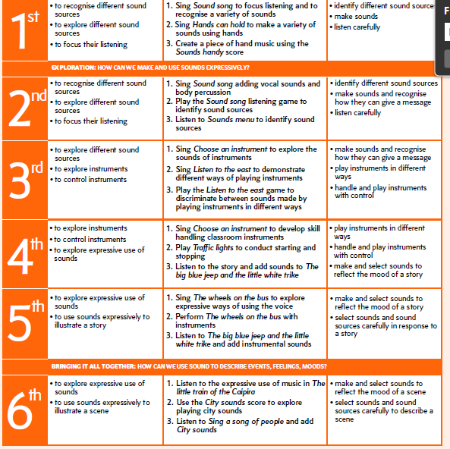
Year 1 Sounds

Slide 4
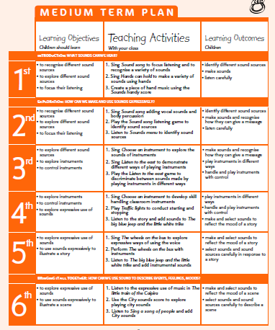
Duration

Slide 5
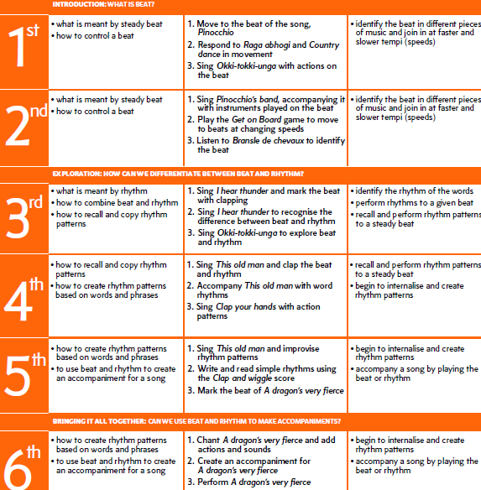
Pulse and Rhythm

Slide 6
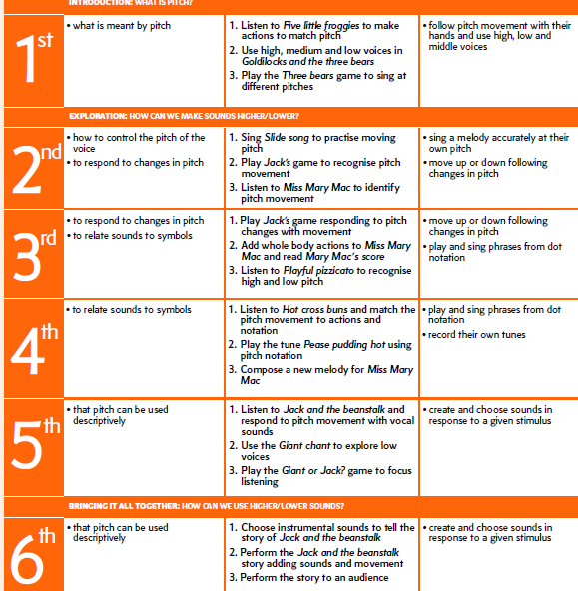
Pitch

Slide 7
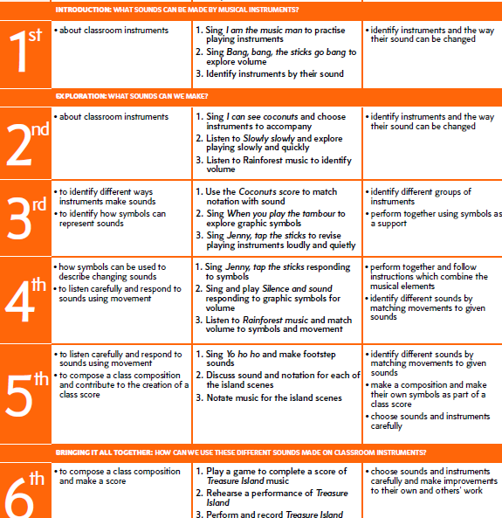
Instruments, symbols

Slide 8
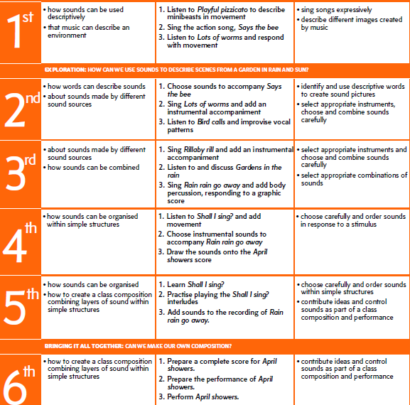
Tembre, tempo, dynamics

Slide 9
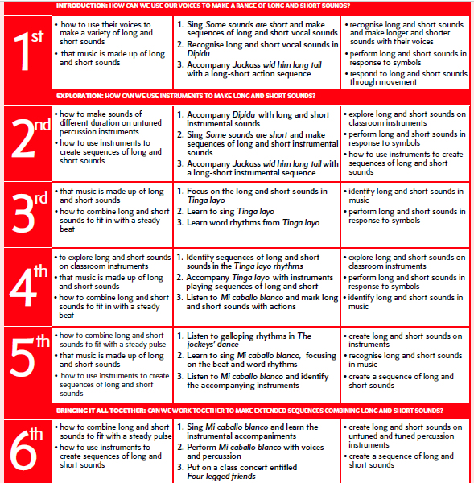
Year 2 Duration

Slide 10
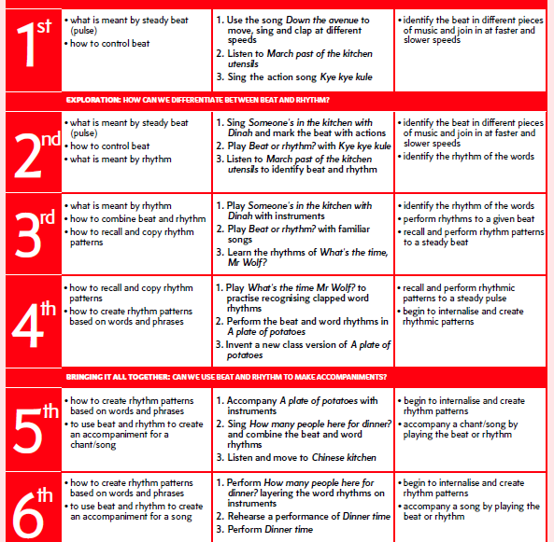
Pulse rhythm

Slide 11
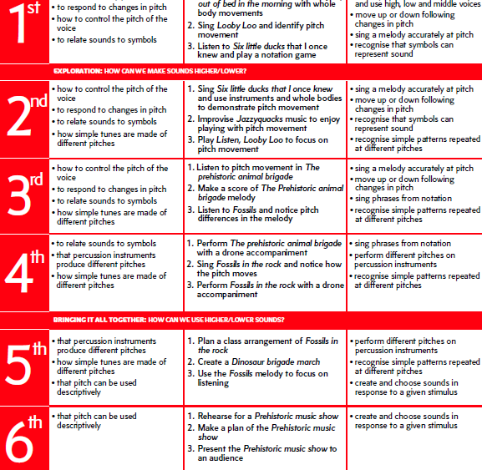
BB Pitch BBC 10 Pieces Lark Ascending

Slide 12
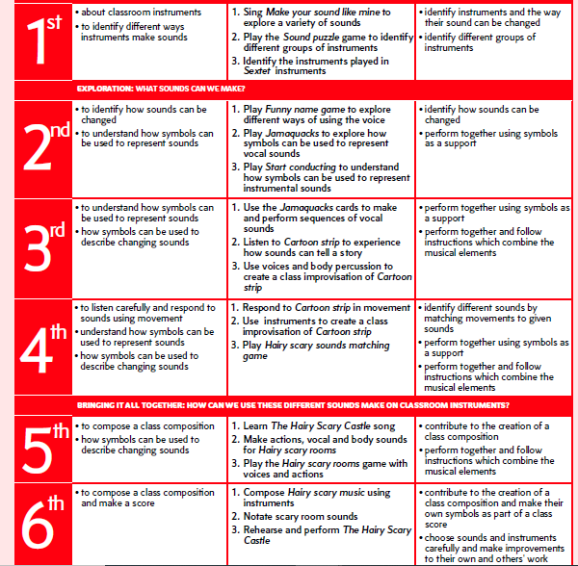
Instruments & symbols

Slide 13
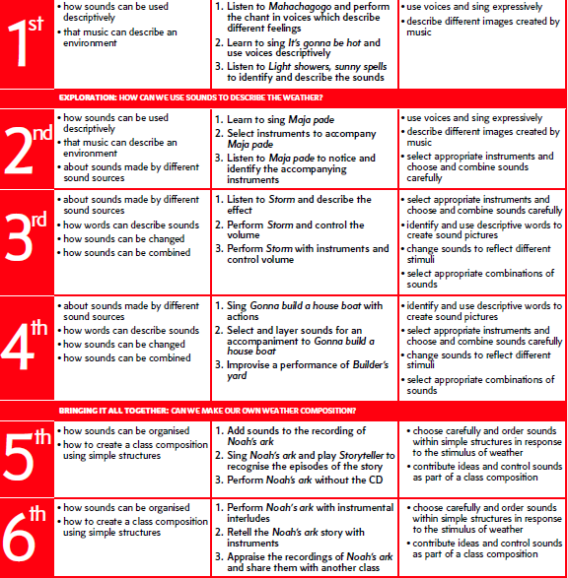
Tembre, tempo, dynamics

Slide 14
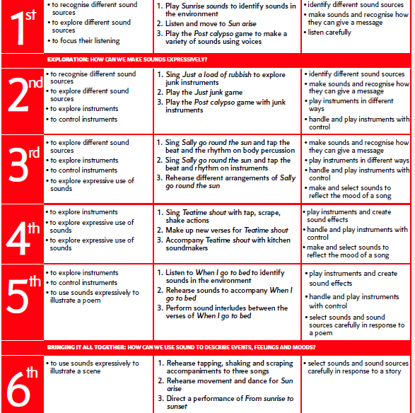
Sounds BBC 10 Pieces No Place Like

Slide 15
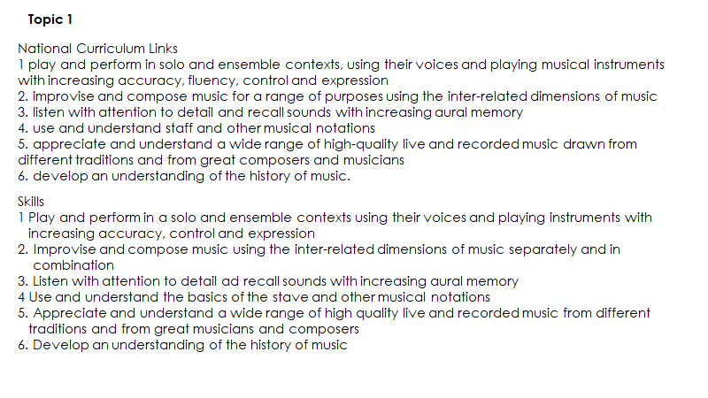
National Curriculum Key Stage 2

Slide 16
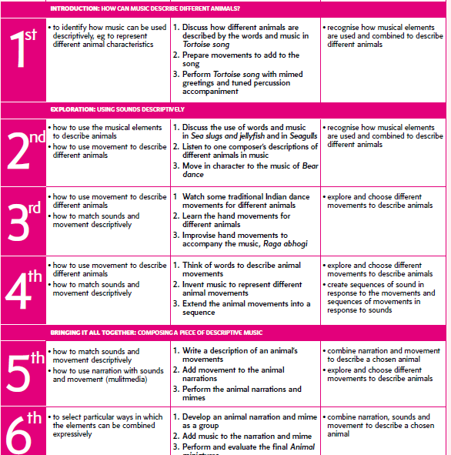
Year 3 descriptive Sounds

Slide 17
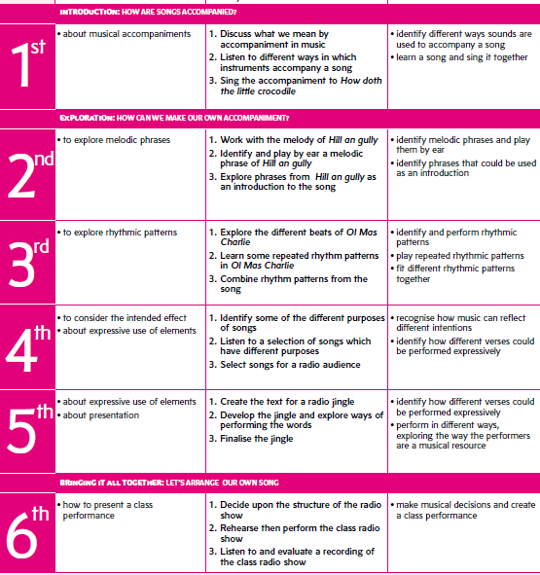
Arrangements The Firebird BBC 10 Pieces

Slide 18
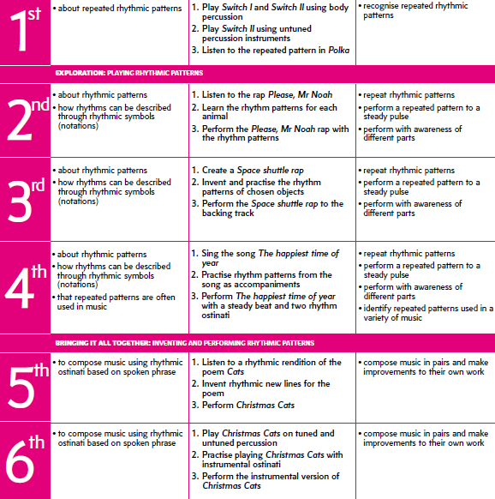
Rhythmic patterns Egyptian Music Project

Slide 19
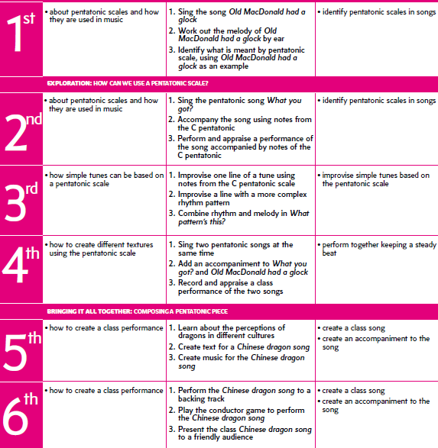
Pentatonic Scales

Slide 20
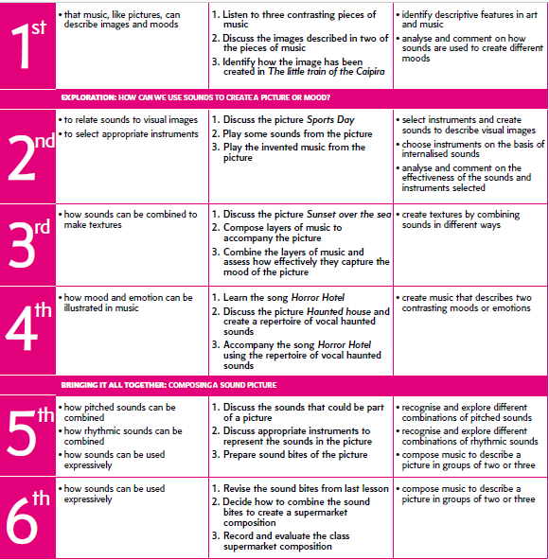
Sounds and colours BBC 10 Pieces Fantastic Zoology

Slide 21
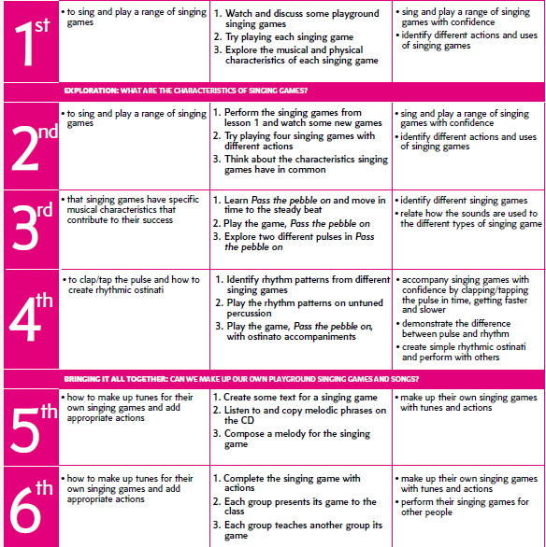
Singing games

Slide 22
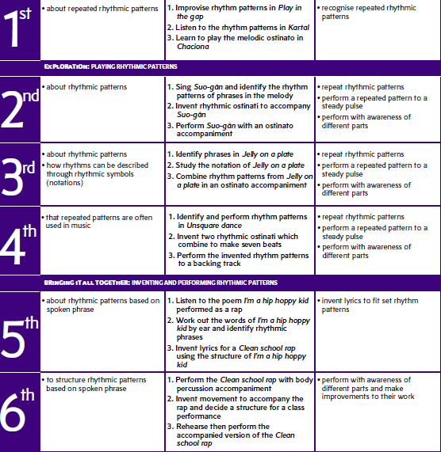
Year 4 Rhythmic patterns

Slide 23
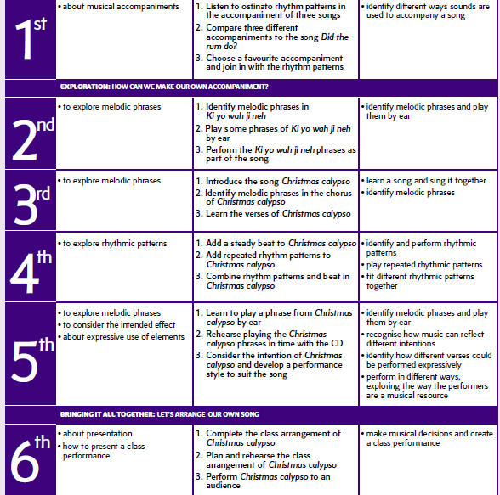
Arrangements BBC 10 Pieces Mars Holst

Slide 24
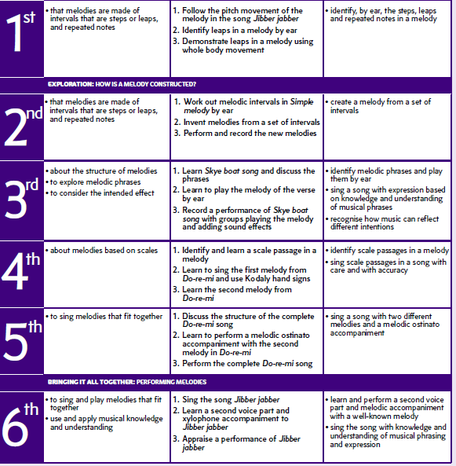
Melodies and scales

Slide 25
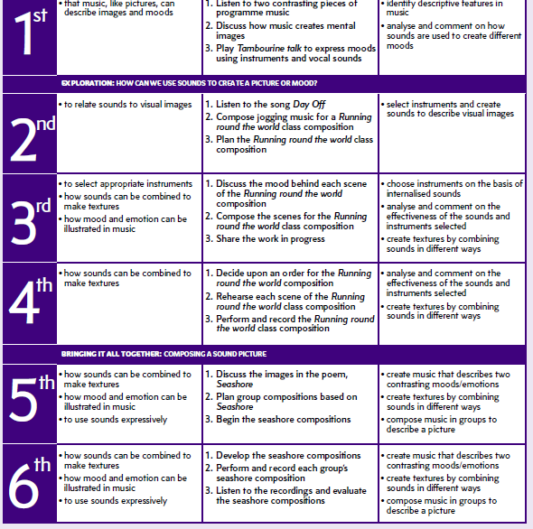
Sounds and colours

Slide 26
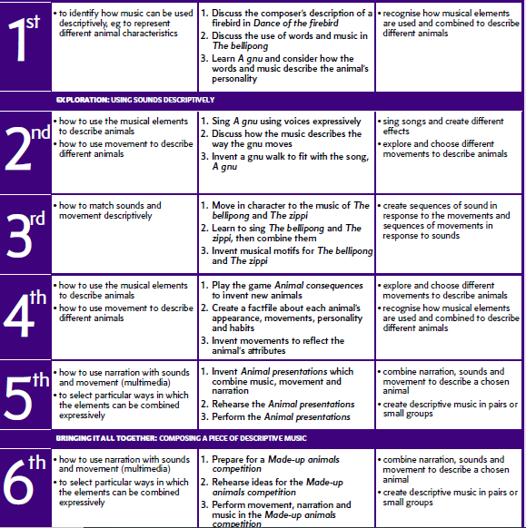
Descriptive sound Hall of the Mountain King

Slide 27
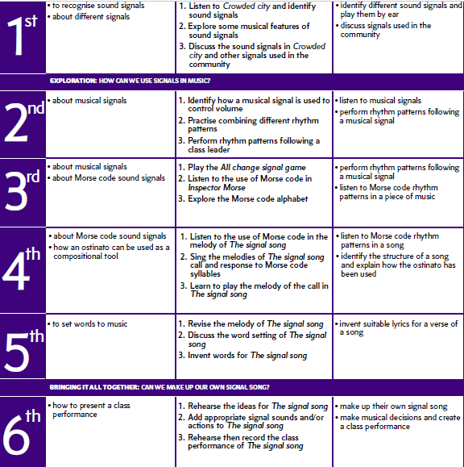
Signals

Slide 28
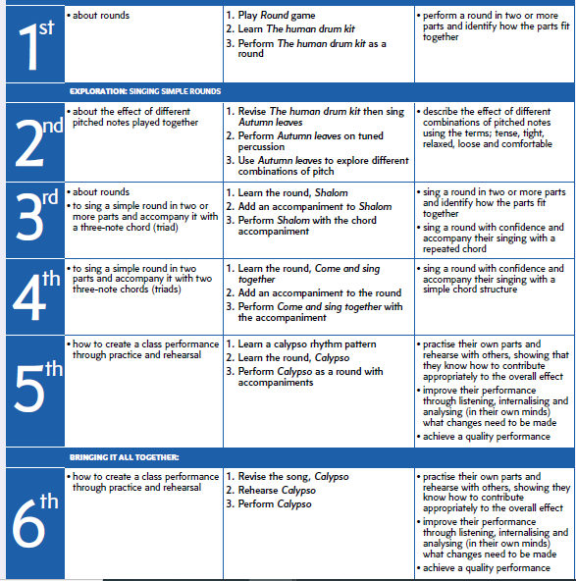
Year 5 Roundabout

Slide 29
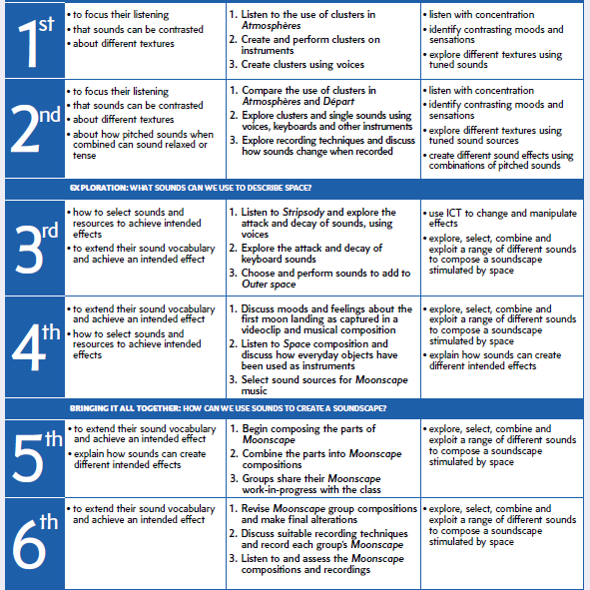
Journeys Ride of the Valkyries

Slide 30
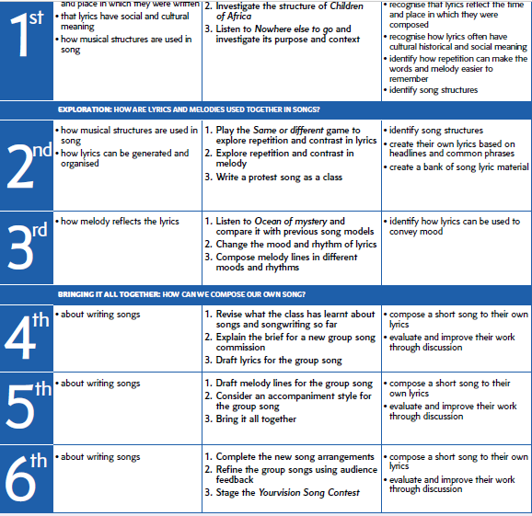
Songwriter

Slide 31
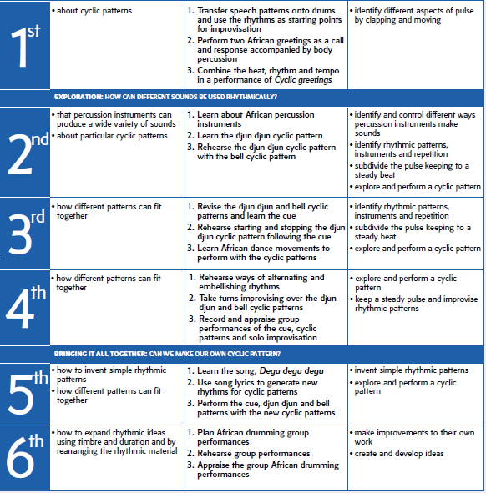
Cyclic Patterns BBC 10 Pieces Connect It

Slide 32
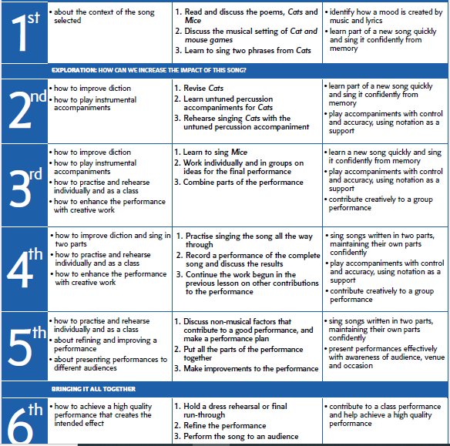
Hide your fires

Slide 33
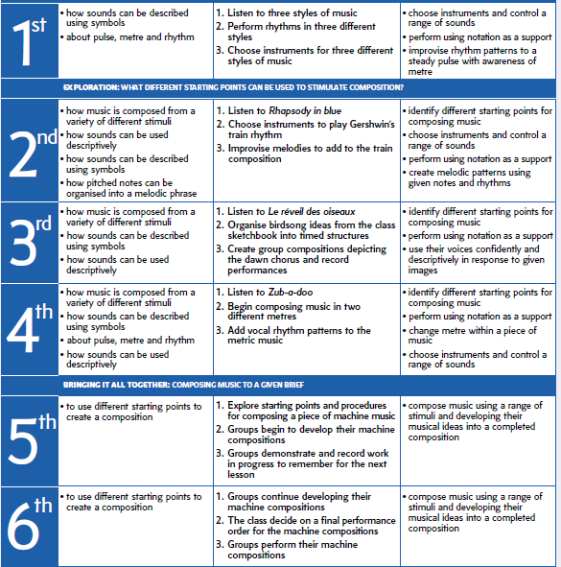
Who knows

Slide 34
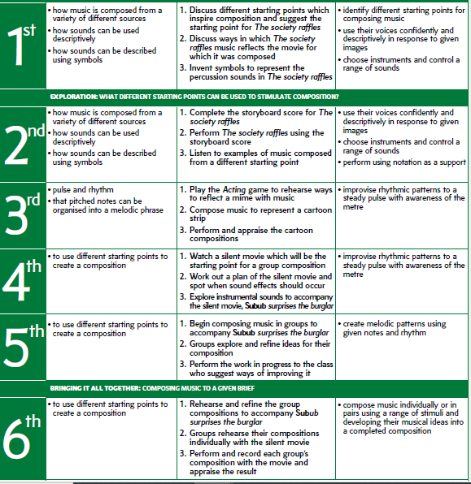
Year 6 Who knows Rondeau Abdelazer

Slide 35
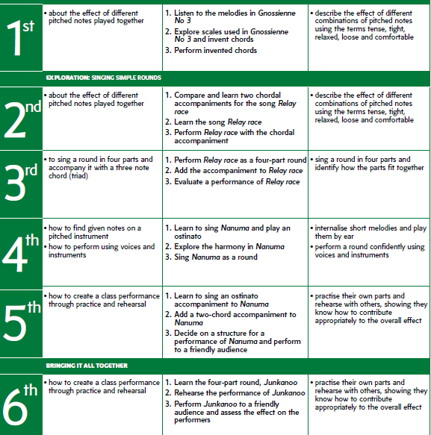
Roundabout

Slide 36
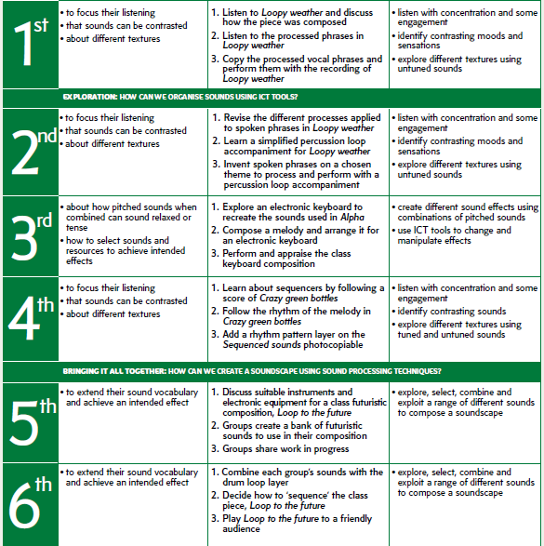
Journey BBC 10 Pieces Vivaldi Winter

Slide 37
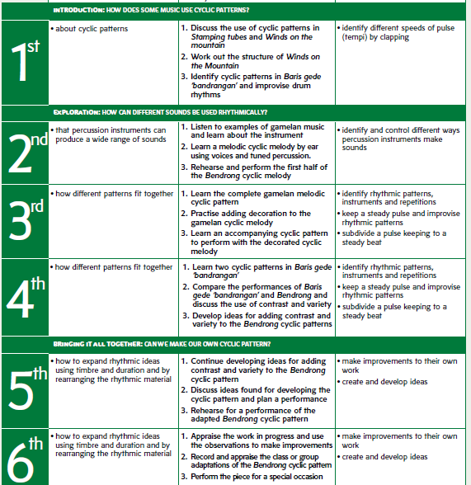
Cyclic patterns

Slide 38
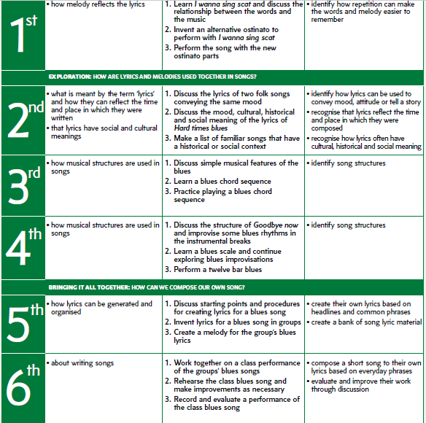
Songwriter

Slide 39
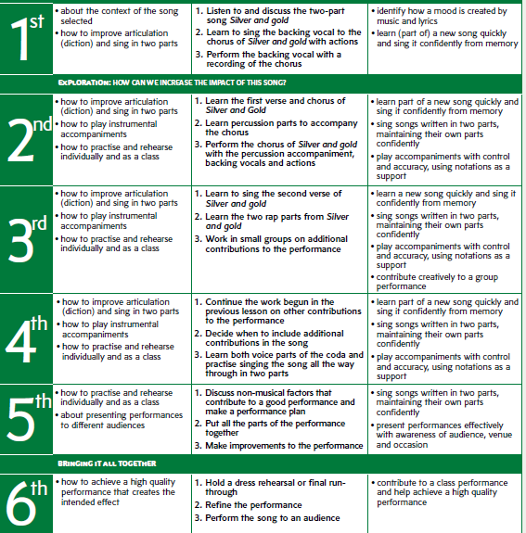
Stars hide your fires

