Slide 1
Our Values
Underpin our teaching and learning and provide an environment which prepare our pupils to be confident and happy citizens

Slide 2
'Meet The Teacher'
September 2023
Welcome to Reception
Miss Stanley & Ingleby
Notes:
Record

Slide 3
Starting School
The children are beginning an amazing learning journey – their first footsteps into independence.
Pre-school experience will help the settling in process, particularly leaving you at the beginning of the day.
Starting school can be difficult for children and parents, but we are here to support you.
The children will get worn out! You may notice a different in behaviour at home the first few weeks, including elevated emotions.
Encourage their ongoing independence as far as possible and praise them for their capabilities.

Slide 4
Structure of our day
Morning Drop Off: 8.30am to 8.40am (to allow a natural stagger)
Pupils enter the school via front gate; make their way to their designated doors through the school playground, to their class
Registration is at 8.40am, pupils arriving after 8.40am will be marked as late
Afternoon Collection: 3.00pm All pupils will be collected from the outside door of their classroom.

Slide 5
Time table

Slide 6
Learning & Teaching in EYFS
Why do we do what we do?
We believe that every child, regardless of ability or advantage is a strong, confident and capable learner, who is able to fulfil his or her potential by connecting with their unique talents to “find their element” to live their life well and thrive.
We want our children to be happy, friendly and respectful members of the Bledlow Ridge School learning community and beyond, with a passion for life-long learning. We want to develop our children into confident risk takers throughout all learning opportunities across the curriculum. We want our children to develop a strong foundation in all areas of learning and development in the Early Years Foundation Stage (EYFS), be curious and inquisitive learners and challenge and be challenged to become the best version of themselves.
“The things [children] love to do and the things they are good at coming together,” in Robinson, K & Aronica, L (2009:xiii), The Element: How Finding Your Passion Changes Everything, Penguin (London.)
Notes:
Record

Slide 7
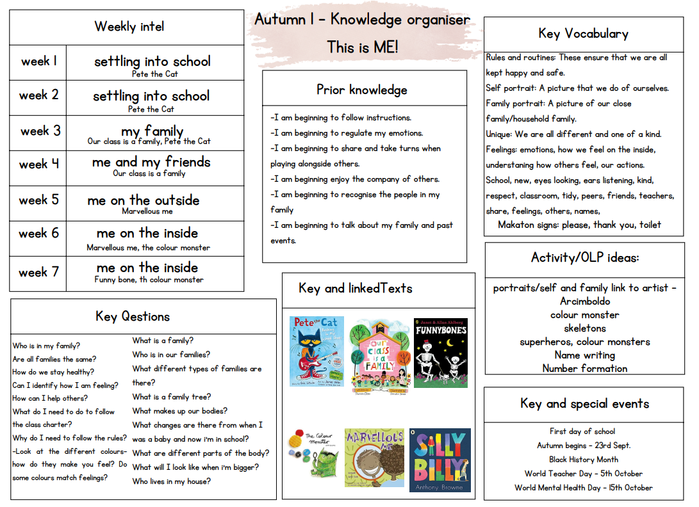

Slide 8
Trips
Autumn Term Trip:
Local Shop
Coggs Farm
Spring Term Trip:
TBC
Summer Term Trip:
Whipsnade Zoo (with Y1)
Notes:
Record

Slide 9
Homework
Please share a story with your child every night.
Individual reading books will be sent out as part of the phonics programme (Little Wandle) when your child is ready.
Reading books should be signed at least 3 x each week.
Shared learning will be sent home as appropriate to the learning undertaken in class.
Notes:
Record

Slide 10
Equipment/what to bring to school
In EYFS, we will provide the stationery your child needs.
Each child has a cubby hole and a coat peg to store his/her belongings. Please bring in:
Water bottle
Wellies
Coat with a hood
Bag with spare clothing (E.g. Underwear, socks, trousers/skirt, T-shirt.)
Notes:
Record

Slide 11
Reception Baseline Assessment
In the first six weeks of Reception, all children must complete the DfE Reception Baseline Assessment.
Further information can be found by following the link: https://assets.publishing.service.gov.uk/government/uploads/system/uploads/attachment_data/file/1074327/2022_Information_for_parents_reception_baseline_assessment.pdf
Notes:
Record

Slide 12
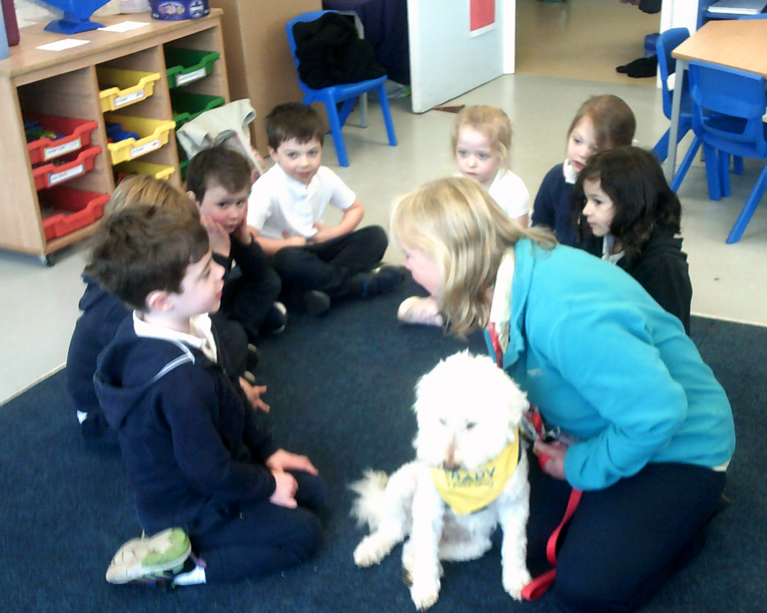
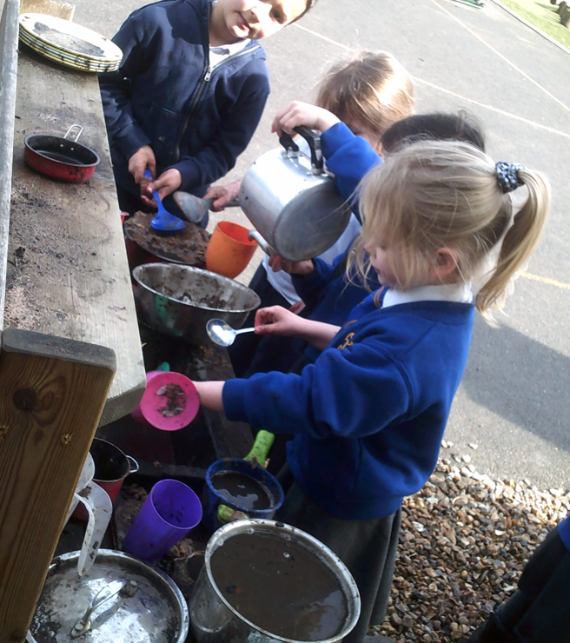
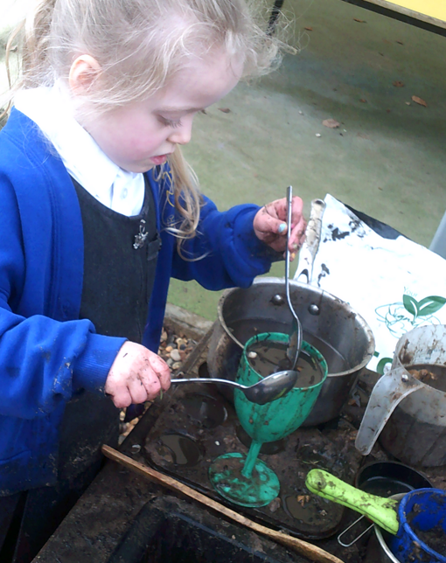
Classroom Life
Reception is an extremely vibrant and fast-paced place to be.
Our day is broken up into short whole class input, group work and child initiated learning, including a daily phonics and mathematics session.
Children learn through play, where they develop and master skills and knowledge linked to the Characteristic of Effective Learning – Playing and Exploring, Active Learning, and Creativity and Critical Thinking.
The EYFS framework places emphasis on Child Initiated play and learning with supplementary adult led sessions.
In early years, they are discovering their interests, capabilities and how they approach challenges. These are facilitated with adult input, but also through child initiated learning. Learning through play ☺

Slide 13
PE & Physical Development
PE lessons are taught on Thursdays at 9am.
Children are also encouraged to spend time learning outdoors through a range of fine and gross motor skills on offer.
Children can wear their PE uniform to school and remain in it for the duration of the day, only on the days that they have PE.
PE Uniform:
White polo shirt
Navy blue shorts
Trainers (not plimsoles)
Plain navy-blue tracksuit top
Plain navy-blue tracksuit trousers
Notes:
Record

Slide 14
Where do we get our assessments of children and how do we use them?
Getting to know the whole child through nursery visits, home visits, and spending time with them creating quality interactions.
Continually building a picture of your child’s learning and development as they make progress throughout the year – photos, observations, physical pieces of work
The observations of every adult who comes in contact with your child.
Working alongside your child during child initiated learning.
As much as possible, all assessments should be child initiated.
Where this is not possible, the children should carry it out as independently as possible.

Slide 15
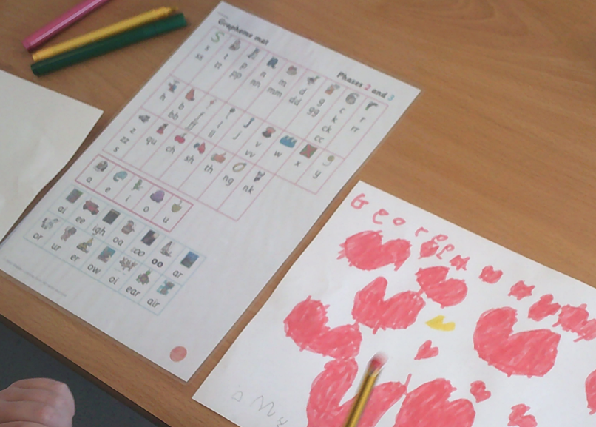
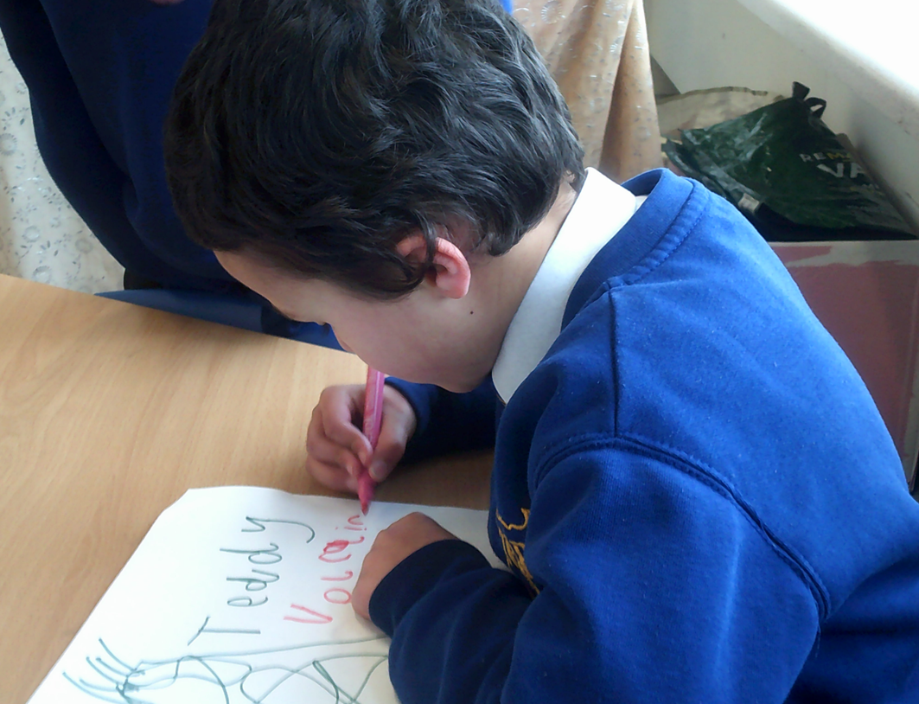
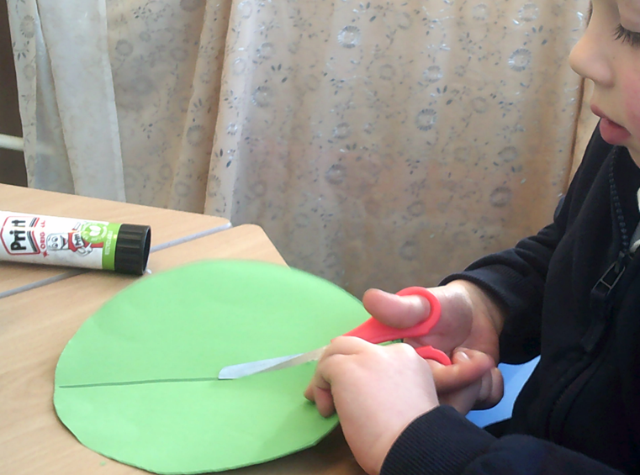
Expectations
We do not expect your children to be able to read and write before they come into school; that’s what we are here for ☺
What would be helpful is:
Recognising their own name.
Knowing basic self-care skills; using the toilet and washing hands
Putting on their coat (not the zip), The superhero method is great!
Following 1 step instructions.

Slide 16
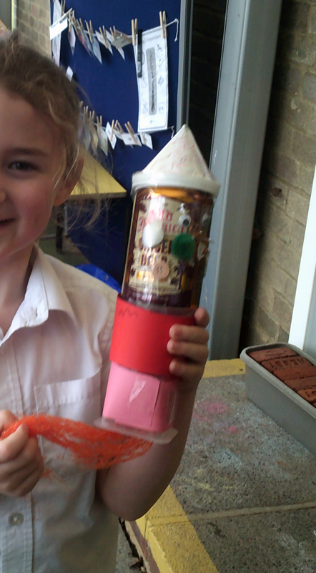
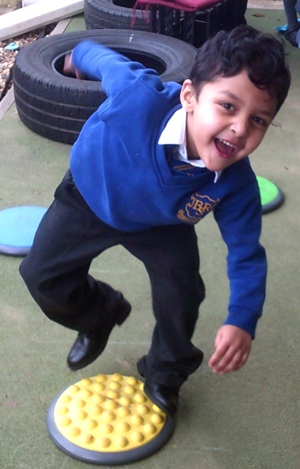
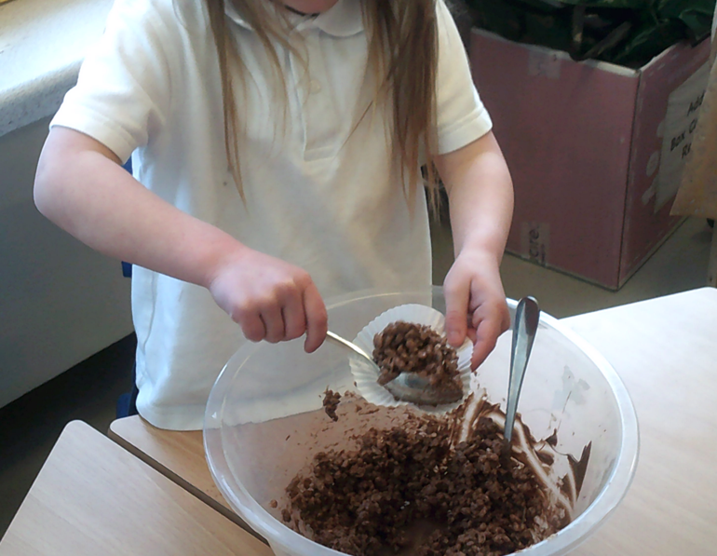
The Curiosity Approach
Aims to give children freedom by igniting their natural curiosity and imagination.
When adopting this teaching method, children are able to think for themselves, make their own choices, and direct their own learning.
The aim is to create 'thinkers & doers' by putting the child at the centre of their own development and education.
A large range of everyday items are placed into the learning environment to encourage children’s natural curiosity and eagerness to explore and create.
Children are able to relate and link experiences back to their world when using real life and familiar objects; making sense of the world around them.
The 7 C’s of the approach: curiosity, confidence, collaboration, communication, creativity, commitment, and craftsmanship. All of which integrate into the characteristics of effective learning.

Slide 17
Reception Baseline Assessment
In the first six weeks of Reception, all children must complete the DfE Reception Baseline Assessment.
Further information can be found by following the link: https://assets.publishing.service.gov.uk/government/uploads/system/uploads/attachment_data/file/1074327/2022_Information_for_parents_reception_baseline_assessment.pdf
Notes:
Record

Slide 18
The Early Years Foundation Stage’s seven areas of learning and development
The Prime areas:
Communication and Language (CL)
Personal, Social and Emotional Development (PSED)
Physical Development (PD)
Literacy (L)
Early Learning Goals (ELGs)
The early learning goals gives an overview of the knowledge, skills and understanding that all young children should have gained by the end of the academic year, in which they turn 5, the Reception year.
They are included here so you can see a child’s expected level of development by the time they turn 5:
https://assets.publishing.service.gov.uk/government/uploads/system/uploads/attachment_data/file/974907/EYFS_framework_-_March_2021.pdf
The early learning goals are not a curriculum but used as an assessment tool during the summer term of the Reception year.
The Specific areas:
Mathematics (M)
Understanding the World (UW)
Expressive Arts and Design (EAD)

Slide 19
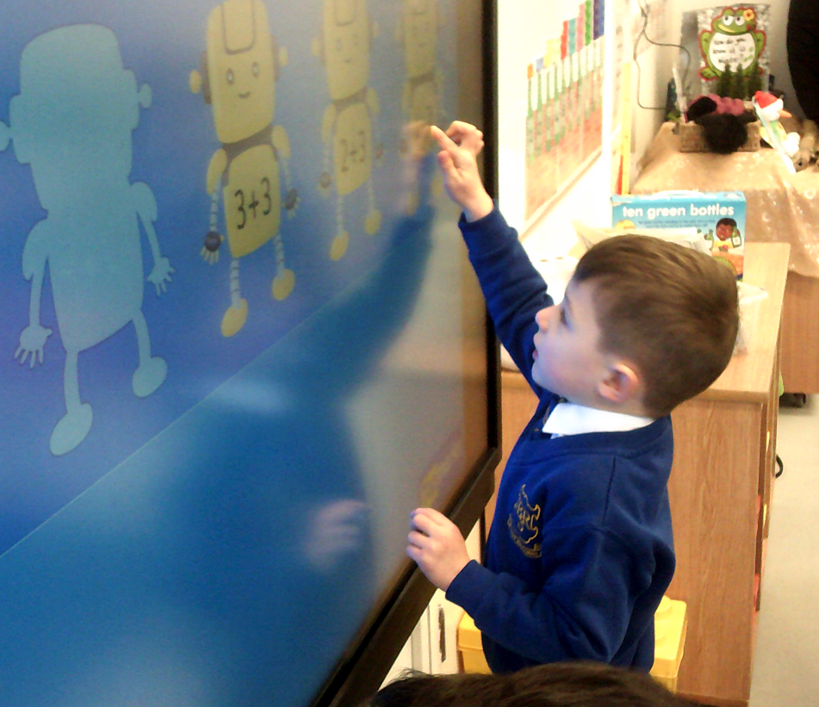
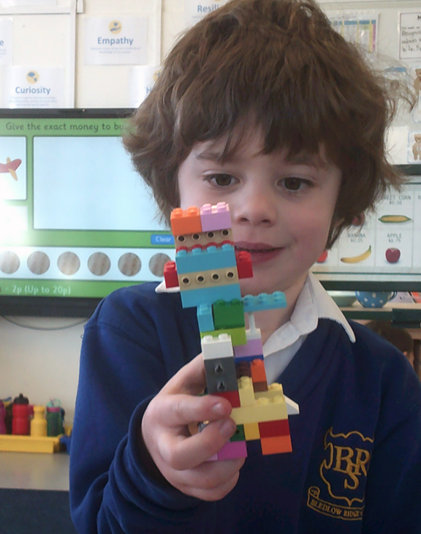
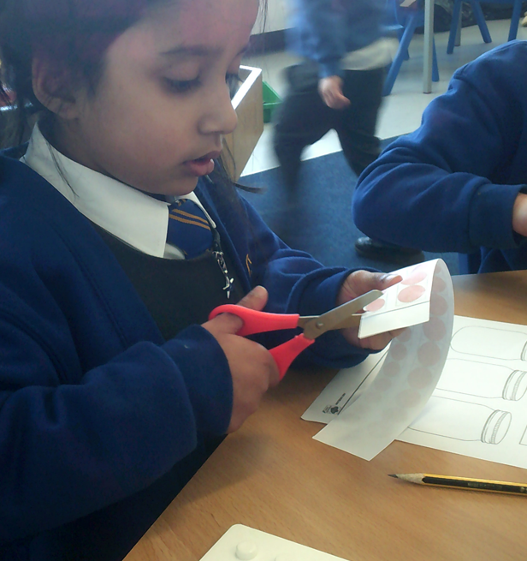
How can you help?
Communication skills are key – talk lots!
Share books with your child.
Foster curiosity in the world around them.
Play board games to develop turn taking.
Gross and fine motor skills – Lego and cooking opportunities are wonderful for this!
Go outdoors and encourage your child to engage with all his/her senses.
Support your child to take risks in their learning
Develop independence by encouraging your child to have a go at dressing themselves and keeping their belongings tidy (!)
Have a regular bed time routine.
Please share your queries and questions and let us know of any change in your personal circumstances. Our door is always open and we are here to help.

Slide 20
How can parents help?
Read, read and read some more!
Statistic: Parents who read 1 picture book with their children every day provide their children with exposure to an estimated 78,000 words each year. Cumulatively, over the 5 years, it is estimated that children from literacy-rich homes hear a cumulative 1.4 million more words during storybook reading than children who are never read to.​
Notes:
Record

Slide 21
Seesaw and eSchools
All communication will be through seesaw, unless urgent or you need to report an illness.
Please do add on your own posts. The children love to share home experiences and it is great for their self-esteem and confidence
There will be times that we send out activities on seesaw. This is to help us address any misconceptions they may have around a certain concept
If you need any help, please let us know
If you already have a child in school, you wont get a new eschools login, everything will be on your eldest child’s login.

Slide 22
Useful Resources
Statutory Framework for the Early Years Foundation Stage:
https://assets.publishing.service.gov.uk/government/uploads/system/uploads/attachment_data/file/974907/EYFS_framework_-_March_2021.pdf
What to Expect When:
https://foundationyears.org.uk/wp-content/uploads/2021/09/What-to-expect-in-the-EYFS-complete-FINAL-16.09-compressed.pdf
Birth to Five Matters:
https://www.birthto5matters.org.uk/wp-content/uploads/2021/04/Birthto5Matters-download.pdf
Development Matters:
https://assets.publishing.service.gov.uk/government/uploads/system/uploads/attachment_data/file/1007446/6.7534_DfE_Development_Matters_Report_and_illustrations_web__2_.pdf

