Slide 1


Kinetic Letters at
Bledlow Ridge School
January 2026

Slide 2
Why handwriting still matters
Help learners - especially young children - understand and remember letter shapes by physically forming them with their bodies or through movement.
Kinetic letters use movement-based learning to support literacy.

Slide 3
Why handwriting still matters
Handwriting underpins writing fluency
Fluent handwriting supports stamina and composition
Children write more confidently when formation is automatic

Slide 4
The Challenge
Learning handwriting is enormously complex -cognitive and physical skills
Many children may not have developed the necessary physical skills and hand-eye coordination to be able to learn to write easily
Writing is often physically uncomfortable – children then ‘don’t like’ writing

Slide 5
Our aim as a school
Consistent handwriting approach across the school
Confident, independent writers
Automatic letter formation to free up thinking for ideas and spelling

Slide 6
What is Kinetic Letters?
A movement-based handwriting scheme
Builds strength, coordination and fine motor control
Teaches letters as movements, not just shapes

Slide 7
The four strands of Kinetic Letters
Making bodies stronger – red strand
Holding the pencil – green strand
Learning the letters – yellow strand
Flow and fluency – blue strand

Slide 8
Making bodies stronger - red strand
Core and shoulder strength are vital for handwriting
Short physical activities prepare the body
Helps children sit comfortably and write for longer

Slide 9
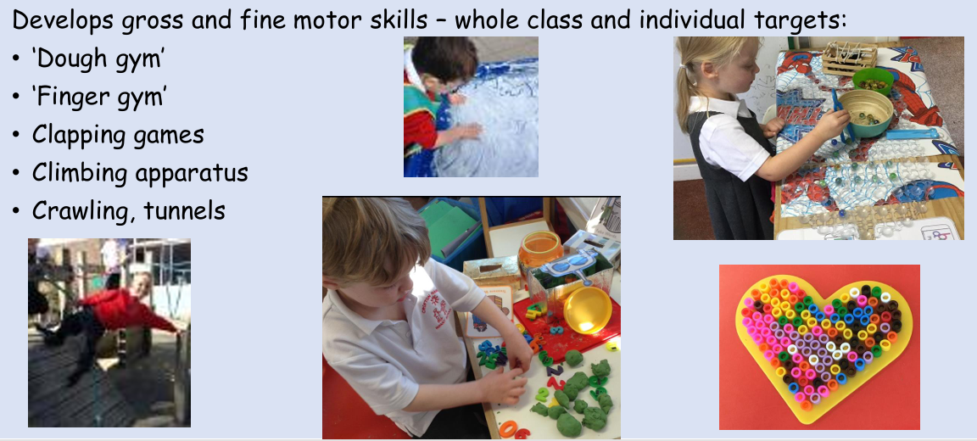
The red strand – making bodies stronger

Slide 10
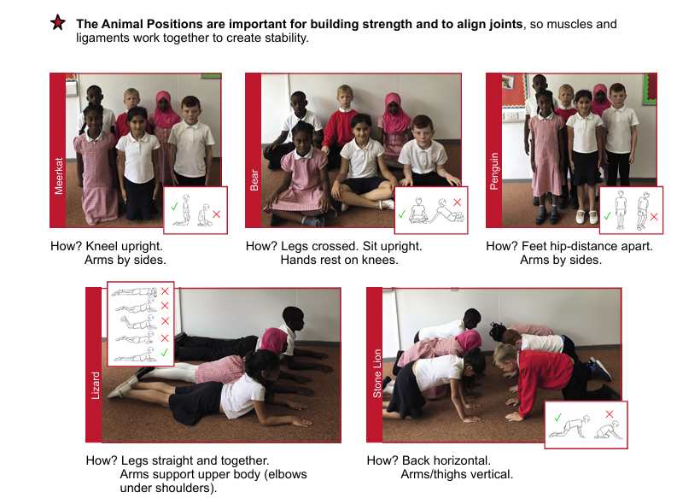
The red strand: Animal poses we use at school to make our bodies stronger
There are lots of opportunities to make our bodies stronger at home using these poses. For example whilst:
• Watching TV/Ipad
• Playing a game
• Reading a book

Slide 11
Pencil grip/posture - green strand
Explicit teaching of correct grip
Focus on posture and paper position
Reduces fatigue and discomfort

Slide 12
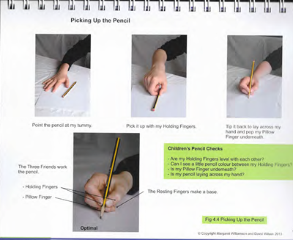
Holding Pencil – green strand
Point the pencil at my tummy
Pick it up with my Holding Fingers
Tip it back to lay across my hand and pop my Pillow Finger underneath

Slide 13
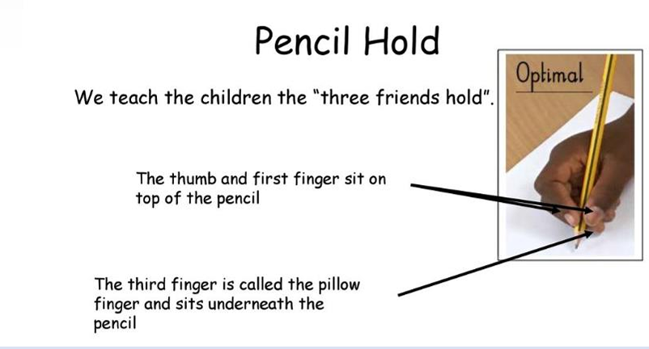
Holding Pencil – green strand

Slide 14
Learning letters as movements
Letters taught in families with shared movements
Encourages consistency and recall
Helps prevent reversals

Slide 15
Learning the Letters
Six movements are learnt
Letters are learnt in groups according to their movements
Letters are taught in a progressive order
The writing tools for handwriting sessions are always pens and whiteboards

Slide 16
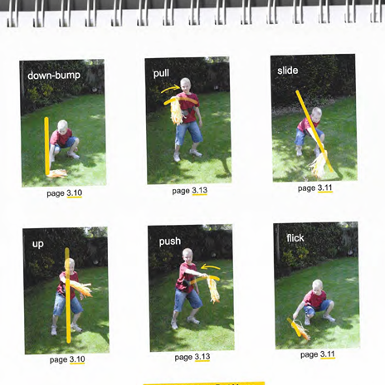
Six Letter Moves
All 26 letters of the alphabet can be re constructed for writing, using different combinations of the six letter parts
Large movements are used to make the letter parts in the air.

Slide 17
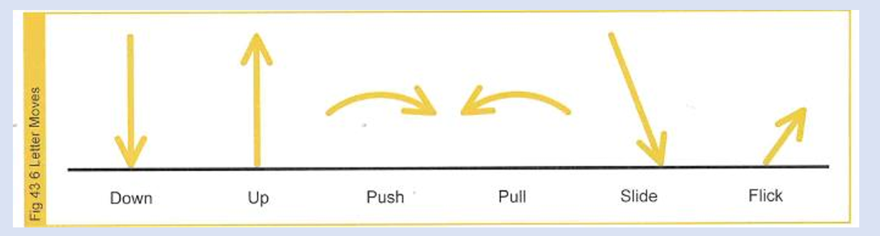
The 6 letter moves:
‘move it, say it’

Slide 18
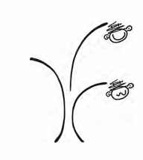
Letter Heights
The Brave Monkey and the Scared Monkey
Children introduced to the two monkeys through the ‘Jumper Family’ story in which children learn the following letters: h, b, r, n, m.
Throughout the programme the other Letter Family stories are introduced.

Slide 19
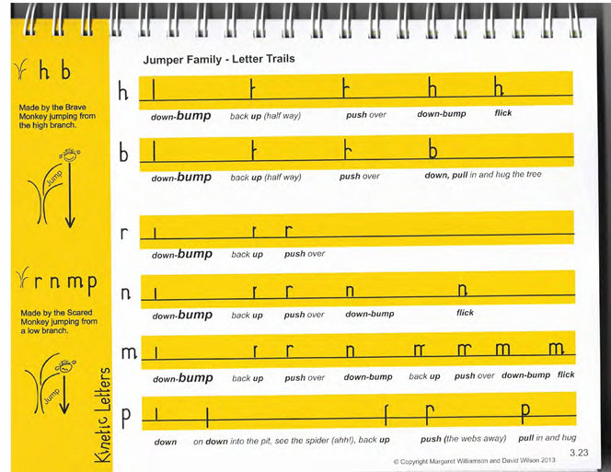
Jumper Family

Slide 20
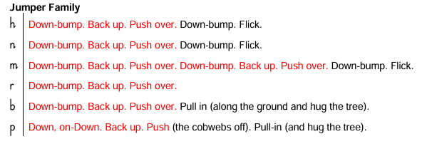
Families

Slide 21
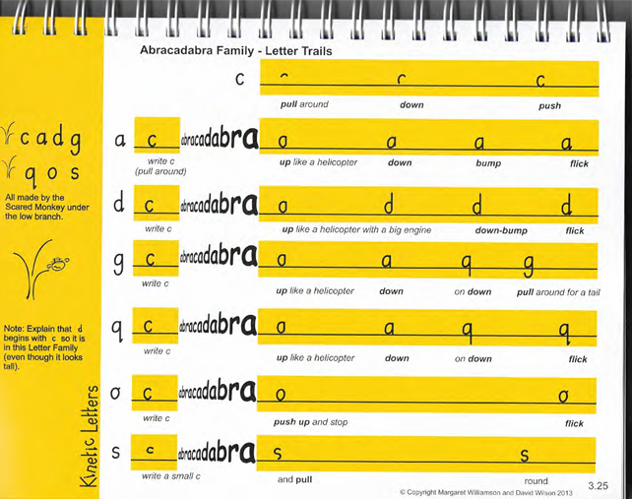
Abracadabra Family

Slide 22
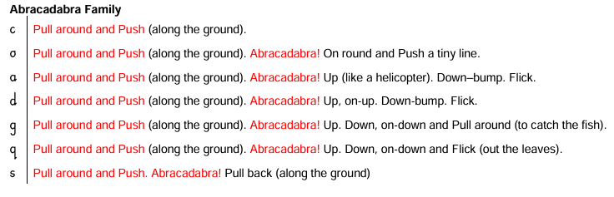
Families

Slide 23
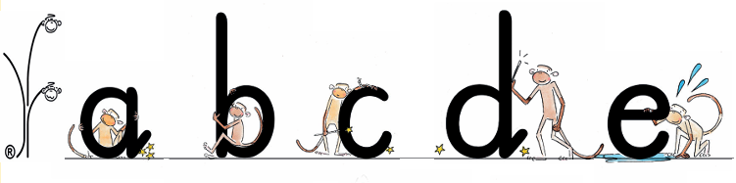

Slide 24
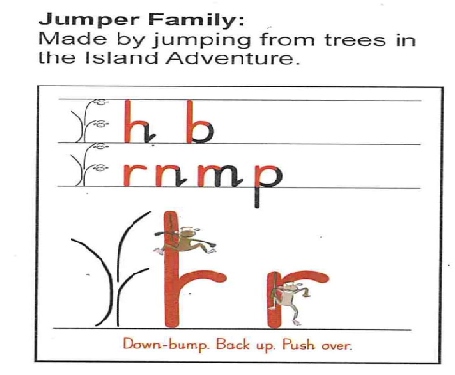
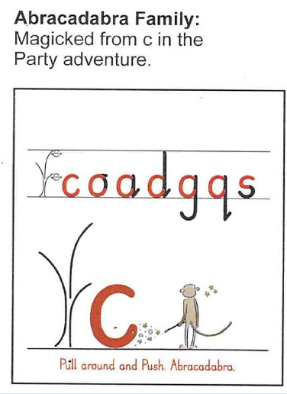
Yellow strand: the letter families

Slide 25
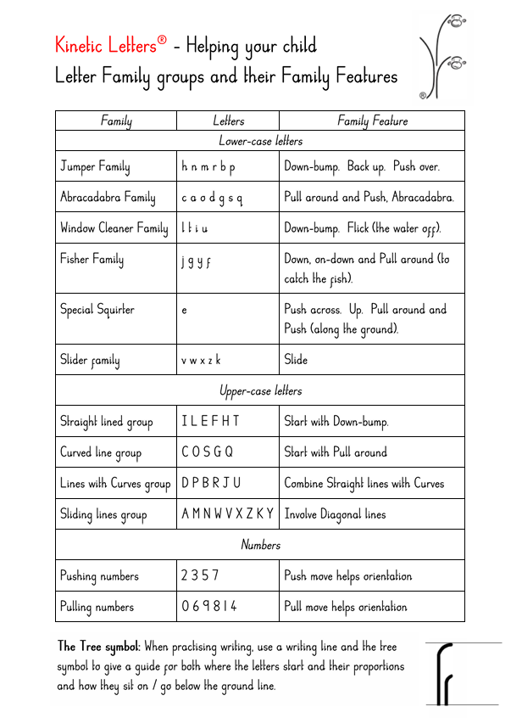
Letter family groups

Slide 26
Flow and fluency – blue strand
Gradual move towards speed with control
Builds stamina
Supports writing across the curriculum

Slide 27
What progress looks like
Reception: secure letter formation
Year 1: consistency and correct orientation
Year 2+: fluency and joined handwriting

Slide 28
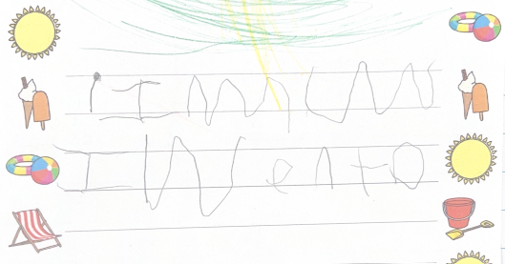
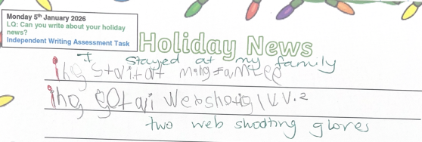
Impact
September 2025
January 2026

Slide 29
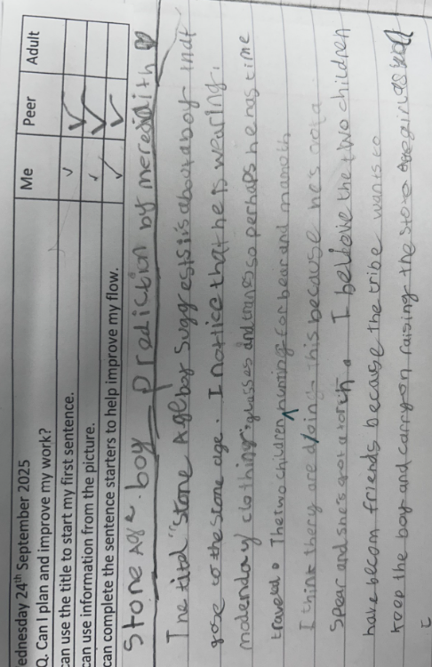
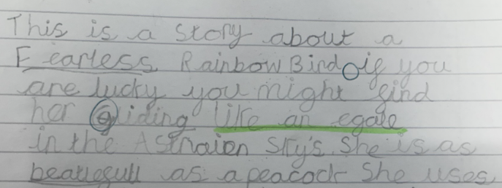
September 2025
December 2025

Slide 30
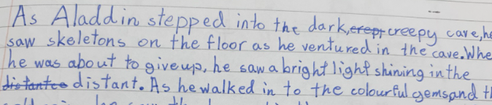
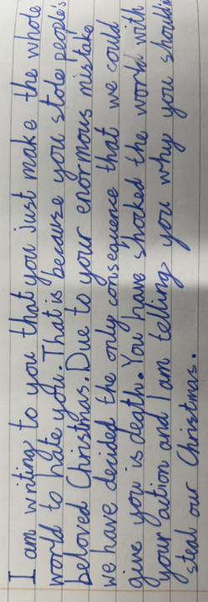
September 2025 - printing
December 2025 - joining

Slide 31
How parents can help at home
Encourage correct pencil hold and posture
Strengthening exercises and activities e.g. trampolining, climbing, jumping, hopping skipping, balancing game
Encourage children to lie in the lizard position

