Slide 1

Meet The Teacher
September 2025
Welcome to Year 1
Miss Grimaldi, Mrs Wells (Mon-Tue AM)
& Miss Metcalfe (Wed-Fri)
Mrs Craven PPA Release time (Wed PM)
Mrs Harrison & Mrs Craven SENDCo Release time (Mon & Thu PM)
Notes:
Record

Slide 2
Arrival and Dismissal
Morning Drop Off: 8.30am to 8.40am (to allow a natural stagger) Pupils enter the school via front gate; make their way to their designated doors through the school playground, to their class.
Registration is at 8.40am, pupils arriving after 8.40am will be marked as late.
Afternoon Collection: 3.00pm to 3.10pm (to allow a natural stagger)
All pupils will be collected from the outside door of their
classroom.
Notes:
Record

Slide 3
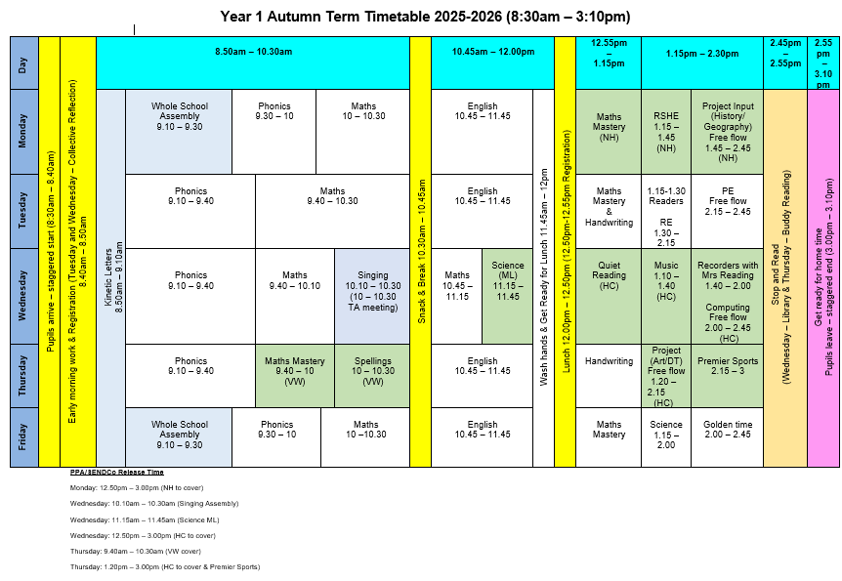
Timetable
Notes:
Record

Slide 4
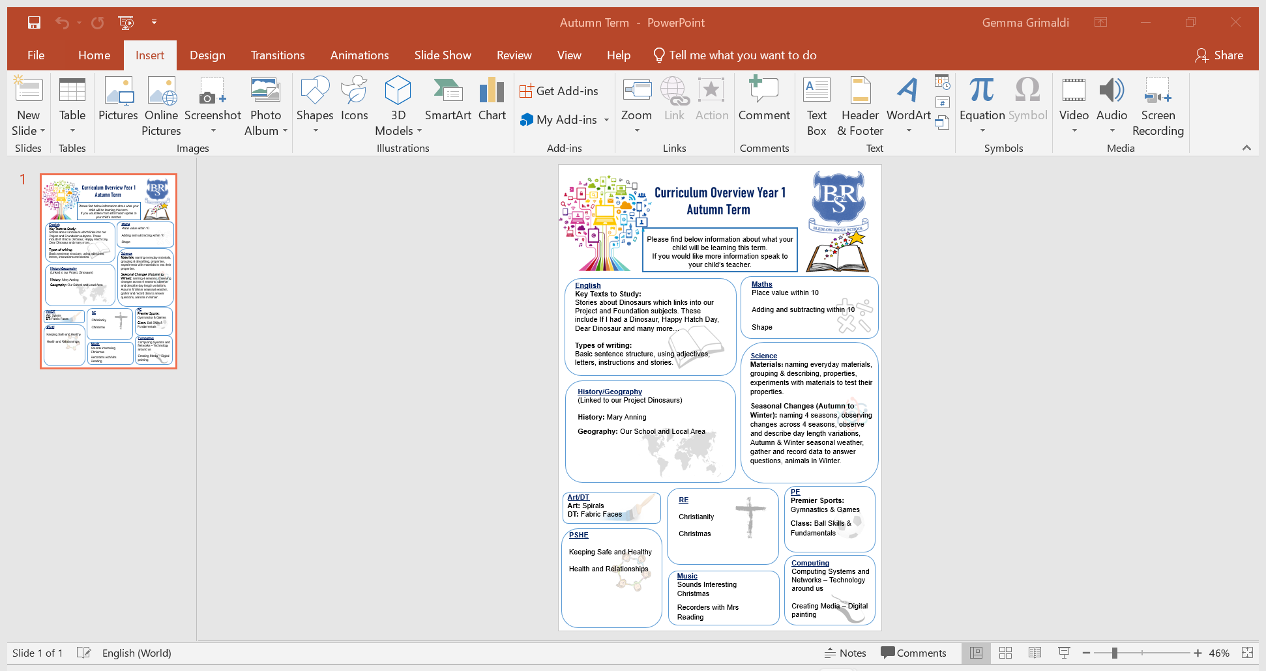
Termly Curriculum Overview
Notes:
Record

Slide 5
Trips and Visitors
Autumn Term trip: Oxford University Museum of Natural History
Spring Term trip: Toy Box and Zoo Lab (visitors into school)
Summer Term trip: Science Oxford
Notes:
Record

Slide 6
Homework
Preview homework is given on a Friday. This tells you what we will be learning the following week.
If you can, please read every day with your child and sign reading records 3x each week. Reading books are changed once a week on a Thursday.
Maths homework will be set on Mathletics termly, this will link to what we are learning in class.
Please also use Reading Eggs to support your child’s learning.
Logins will be given out next week.
Notes:
Record

Slide 7
How We Assess Your Child’s Learning
Formative Assessment – Ongoing and Everyday
Formative assessment happens all the time in the classroom. It helps teachers understand what your child knows and what they need help with.
Examples include:
Marking and feedback
Observing how children work in class
Listening to responses in discussions
Guided reading and group work

Slide 8
How We Assess Your Child’s Learning
Summative Assessment – End of Term/Unit
Summative assessments take place at set points in the year and give a more formal overview of learning.
At our school, we use:
PIRA (Progress in Reading Assessment)
PUMA (Progress in Understanding Mathematics Assessment)
In Year 1 we do these in the Summer term
From Year 2 these take place once a term

Slide 9
What Are PIRA and PUMA?
Nationally standardised tests
Provide a standardised score that shows how your child is performing compared to national expectations
Help us track progress
Support teacher judgements when reporting to you
How Do These Assessments Help?
Identify gaps in learning
Inform planning and support
Contribute to teacher assessment, which includes classwork, effort, and wider knowledge

Slide 10
How We Monitor Your Child’s Learning
At the end of each term, we hold Pupil Progress Meetings with senior leaders (Mrs Harrison, Mrs Stanley, our Deputy Headteacher and Miss Grimaldi our SENDCo).
Every single child is discussed individually
We review:
  Their current attainment
  Whether they are on track with their learning
  What support they may need if they are not on track
  These meetings help us ensure that no child is overlooked and that we can quickly put the right support in place where needed.

Slide 11
Reporting to You
We use both formative and summative assessments to provide a full picture of your child’s learning.
You will hear about your child’s progress through:
Parents' evenings (October and March)
End-of-year reports
Informal conversations and updates
Support Plan reviews and termly meetings for pupils on the Special Educational Needs register

Slide 12
Equipment/what to bring to school
In Key Stage 1, we will provide the stationery your child needs – please bring in reading books, reading record, book bags and a water bottle every day.
A change of clothes can be left in a name bag on your children’s peg if you wish to do so or feel they may need them.
Notes:
Record

Slide 13
PE
PE lessons are taught on Tuesday and Thursday.
Children can wear their PE uniform to school and remain in their PE uniform for the duration of the day, only on the days that they have PE.
PE Uniform
  White polo shirt
  Navy blue shorts
  Trainers (not plimsoles)
  A royal blue round-necked school logo jumper or a plain navy-blue tracksuit top
  Plain navy blue tracksuit trousers
Notes:
Record

Slide 14
Teaching and Learning
Curriculum targets for English (writing) and Mathematics
Every child has targets for writing and mathematics.
Writing targets match the year group National Curriculum objectives.
Children have a copy of their targets in the front of their Maths and English books.
Notes:
Record

Slide 15
Teaching and Learning
Teacher Feedback
Research shows that the most effective feedback is given verbally, ‘in the moment’ – this will be evidenced as a ‘VF’ in pupils’ books.
Adults may also sometimes provide written feedback and modelling in pupils’ books using a green pen.
We expect pupils to respond to feedback given by adults. We ask the pupils to do this in purple pen to help them and the adults see the corrections/edits they are making.
Notes:
Record

Slide 16
How can parents help?
In June, Year 1 pupils will complete a Phonics Screening Check (PSC).
The PSC is 40 words, 20 real words and 20 nonsense (alien words) which the children have to read.
This will take place one to one in a quiet room.
Pass mark has previously been 32/40, you will find out your child’s score when you receive their report at the end of the year.
We will conduct mock tests throughout the year to monitor progress and will feed this back to you during parents evenings.
Notes:
Record

Slide 17
How can parents help?
Number bonds to 10 and 20 – practise these everywhere.
Practise telling the time on a clock with hands.
Regular attendance is key – 95% is the minimum expectation. Pupils whose attendance is of concern will be invited to discuss this in order that the school can support parents and pupils as best possible.
Communication! Please come and talk to us if you have any concerns/questions.
Notes:
Record

Slide 18
How can parents help?
Developing Independence in the Classroom
We gently support children in building independence through everyday routines, such as:
  Organising their own belongings at the start and end of the day
  Handing in reading books independently
  Taking responsibility through class monitor roles
These small steps help children grow in confidence, develop responsibility, and feel proud of what they can do on their own.
To support this, we kindly ask that you say goodbye at the school gate each morning.
This small step helps children develop confidence, responsibility, and a sense of routine. Our staff will be there to greet your child with a warm welcome and help them feel safe and secure.
Thank you for working in partnership with us to support your child’s growing independence!
Notes:
Record

Slide 19
Any questions
Notes:
Record

