Slide 1
Bledlow Ridge School
‘Meet the Teacher’
Year 4
Friday, 14th September 2018

Slide 2
Staff
Class Teacher: Mrs Bulmer
PPA Cover: Ms Dolan
French: Mrs Lyon
Teaching Assistant: Mrs Radnedge

Slide 3
Routines
Mrs Bulmer teaches every day except Wednesday, 8.40am – 11am
Miss Dolan teaches on Wednesday, 8.40am – 11am.
Mrs Radnedge supports on Monday, Tuesday and Wednesday 11.15am – 3pm.
Mrs Lyon teaches French twice/week.

Slide 4
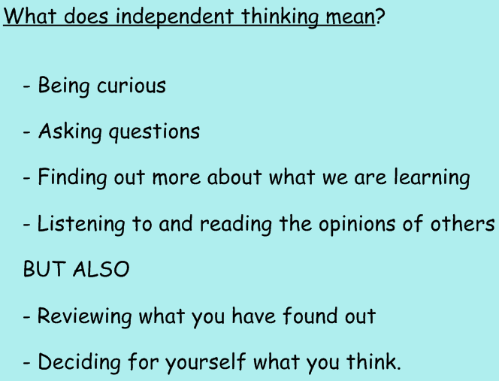
What is Year 4 going to be like?
From Changeover Day:

Slide 5
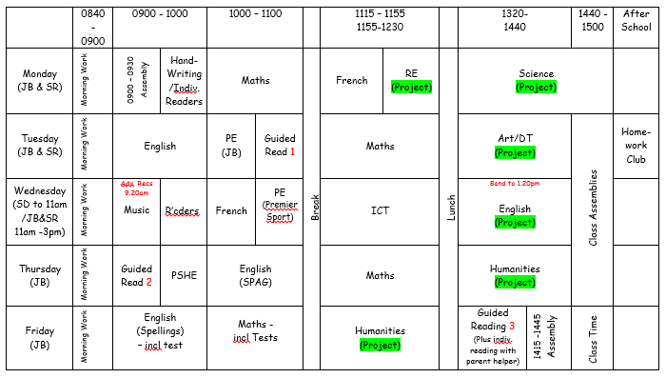
Timetable
(Copies will be provided for you to take home)
Text

Slide 6
Curriculum - Project
Our project this term is Man’s Basic Needs – Surviving his Environment.
This will include work in the following subject areas:
Humanities: How man lived in the Stone Age, Iron Age, Bronze Age – climate, physical landscape, homes, communities, tools & weapons, activities
Science: Finding food to meet our needs (Classifying Trees & Plants) and ‘Where does all the food go?’ (Teeth & Digestion, following on from Nutrition in Year 3)
RE: How do religions start?
Art/DT: Drawing (cave paintings), weaving, clay models, collage, cooking
English: Development of character & narrative, diaries and information texts based around the novel ‘Stig of the Dump’.

Slide 7
Curriculum – Other Subjects
Outside the Project, we will also be covering:
Maths: Place Value, Addition & Subtraction, Multiplication & Division, Measurement
English: Guided Reading, Grammar & Punctuation, Spelling, Handwriting
RE: Judaism – A Special Relationship based on a Covenant, followed by Christianity– The Role of Symbolism in the Christmas Story
ICT: ‘We are software developers’, ‘We are toy designers’
PSCHE: Active Learning
PE: Invasion Games and Gym Skills

Slide 8
Equipment
School has equipment available but it would be helpful if your child could bring in the following items:
Pencils for writing (pens only once a pen licence has been awarded)
Colouring Pencils
Sharpener & Rubber
Ruler
Glue Stick and Whiteboard Pen
Home reading book
PE kit with trainers, in PE bag

Slide 9
PE Days
We have:
PE on Tuesdays and Wednesdays
Outdoor before half term/Indoor after half term
Children need to have suitable PE kit
Long hair must be tied back
Earrings should be covered with tape or removed

Slide 10
Und
Curriculum Events & Visits
Friday 5th October, 9.30am
Year 3 and 4 Harvest Performance
Thursday 11th October, 3.30-6pm
Parents Meeting
Tuesday 16th October, 4.30-8pm
Parents Meeting

Slide 11
Und
Curriculum Events & Visits
Monday 19th November, all day
Visit to The Chiltern Outdoor Museum with Year 3
Date tbc
Schools Linking Network: Understanding Diversity - activity day with Year 4 from Hamilton Academy, High Wycombe
Thursday 13th December, time tbc
Carol Service

Slide 12
Homework
Homework will be set as follows:
Maths: Tasks to be completed online via Mathletics. Set on Friday, for the following Thursday.
English: Task set weekly, with one week to complete.
Spellings: A spelling ‘rule’ and example words will be given out on Friday, for testing the following Friday.
Learning logs: Tasks set 4 times/term, with 2 weeks to complete.

Slide 13
Other Useful Information
Teacher Availability
If you need to speak to a teacher, it is best to arrange an after-school appointment. We will be able to give you quality time then, rather than a rushed meeting before school.
Of course, if there is an emergency, we will speak to you at any time.

Slide 14
Questions
Thank you for coming. Are there any questions?

