Slide 1

Meet The Teacher’
Welcome to Year 2
September 2025 –July 2026
Mrs. Rankin (M-TH) – Class teacher
Mrs. Craven (F) – Class teacher
Mrs. Parke (W,TH,F) - Teaching asst.
Mrs. White (M,Tu) - Teaching asst.
Mrs. Reading (W) – Recorder teacher
Notes:
Record

Slide 2
Arrival and Dismissal
Morning Drop Off: 8.30am to 8.40am
Pupils enter the school via front gate; make their way to their designated doors through the school playground, to their class.
Registration is at 8.40am. Pupils arriving after 8.40am will be marked as late.
Afternoon Collection:3.00pmto 3:10pm
All pupils will be collected from the outside door of
their classroom.
Notes:
Record

Slide 3
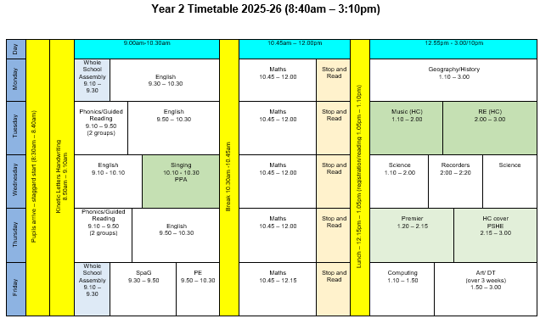

Slide 4

Termly Curriculum Overview
Notes:
Record

Slide 5
Trips
Half termly – nature walk around local area.
January – Science Oxford date tbc
Summer term – visit to Claydon House (National Trust property with strong ties to Florence Nightingale).
Notes:
Record

Slide 6
Homework
Maths homework will be set on Mathletics each Friday.
Please read with your child every day.
Reading books will be changed on a Tuesday, but it would be helpful if reading packets are always kept in bag.
Spellings
Notes:
Record

Slide 7
Equipment/what to bring to school
In EYFS and Key Stage 1, we will provide the stationery your child needs.
Each day your child should bring in their:
reading packet
water bottle
…and on Wednesdays, a recorder.
Notes:
Record

Slide 8
P.E.
PE lessons are taught on Thursday and Friday.
On these days, children can wear their PE kit to school and remain in their PE kit for the duration of the day
If your child is part of a morning sports club (Mon – Weds) they will be expected to change into their uniform before registration.
Notes:
Record

Slide 9

PE Uniform
White polo shirt
Navy blue shorts
Trainers (not plimsoles)
Plain navy-blue tracksuit top
Plain navy blue tracksuit trousers
Long hair should be tied back and any earrings taped over.

Slide 10
Teaching and Learning
Teacher Feedback
Research shows that the most effective feedback is given verbally, ‘in the moment’ – this will be evidenced as a ‘VF’ in pupils’ books
Adults may also sometimes provide written feedback and modelling in pupils’ books using a green pen
We expect pupils to respond to feedback given by adults. We ask the pupils to do this in purple pen to help them and the adults see the corrections/edits they are making.
Notes:
Record

Slide 11
Spelling
We use the No Nonsense Spelling scheme to support children in becoming confident, accurate spellers.
What is No Nonsense Spelling?
A structured programme that teaches spelling patterns, rules, and strategies
Focuses on understanding spelling, not just memorising words
Lessons include investigation, discussion, and practical activities
Our Aim:
To help pupils apply their spelling knowledge in their writing — not just learn words for a test.

Slide 12
How We Assess Your Child’s Learning
Formative Assessment – Ongoing and Everyday
Formative assessment happens all the time in the classroom. It helps teachers understand what your child knows and what they need help with.
Examples include:
Marking and feedback
Observing how children work in class
Listening to responses in discussions
Guided reading and group work

Slide 13
How We Assess Your Child’s Learning
Summative Assessment – End of Term/Unit Summative assessments take place at set points in the year and give a more formal overview of learning.
At our school, we use:
PIRA (Progress in Reading Assessment)
PUMA (Progress in Understanding Mathematics Assessment)
These will be complete WB: 24th November

Slide 14
What Are PIRA and PUMA?
Nationally standardised tests
Provide a standardised score that shows how your child is performing compared to national expectations
Help us track progress across the year
Support teacher judgements when reporting to you
How Do These Assessments Help?
Identify gaps in learning
Inform planning and support
Contribute to teacher assessment, which includes classwork, effort, and wider knowledge

Slide 15
How We Monitor Your Child’s Learning
At the end of each term, we hold Pupil Progress Meetings with senior leaders (Mrs Harrison, Mrs Stanley, our Deputy Headteacher and Miss Grimaldi our SENDCo).
Every single child is discussed individually
We review:
  Their current attainment
  Whether they are on track with their learning
  What support they may need if they are not on track
  These meetings help us ensure that no child is overlooked and that we can quickly put the right support in place where needed.

Slide 16
Reporting to You
We use both formative and summative assessments to provide a full picture of your child’s learning.
You will hear about your child’s progress through:
Parents' evenings (October and March)
End-of-year reports
Informal conversations and updates
Support Plan reviews and termly meetings for pupils on the Special Educational Needs register

Slide 17

How Can Parents Help?
Read, read and read some more!
Statistic: Parents who read 1 picture book with their children every day provide their children with exposure to an estimated 78,000 words each a year. Cumulatively, over the 5 years, estimated that children from literacy-rich homes hear a cumulative 1.4 million more words during storybook reading than children who are never read to.​
Notes:
Record

Slide 18
How Can Parents Help?
Practise number bonds and times tables (2x,3x,5x,10) regularly.
Be seen writing and reading yourselves.
Regular attendance is key – 95% is the minimum expectation. Pupils whose attendance is of concern will be invited to discuss this in order that the school can support parents and pupils as best possible.
Communication! Please come and talk to us if you have any concerns/questions
Notes:
Record

Slide 19
Class 2 Matters
Local history
Parent helpers
Notes:
Record

Slide 20
Any questions ?
Notes:
Record

