Slide 1

'Meet The Teacher'
September 2025
Welcome to Year 5!
Notes:
Record

Slide 2
Staff
Miss Simms – Class Teacher
Mrs Webb- HLTA
Mr Nicholls- Computing
Mrs Lyon- French
Mrs Stanley- Music
Notes:
Record

Slide 3
Arrival and Dismissal
Morning Drop Off: 8.30am to 8.40am (to allow a natural stagger)
Pupils enter the school via front gate; make their way to their designated doors through the school playground, to their class
Registration is at 8.40am, pupils arriving after 8.40am will be marked as late.
Afternoon Collection: 3.00pm-3.10pm
All pupils will be collected from the outside door of their classroom or by the gate if arranged.
Children walking will be sent at 3.00pm.
Notes:
Record

Slide 4
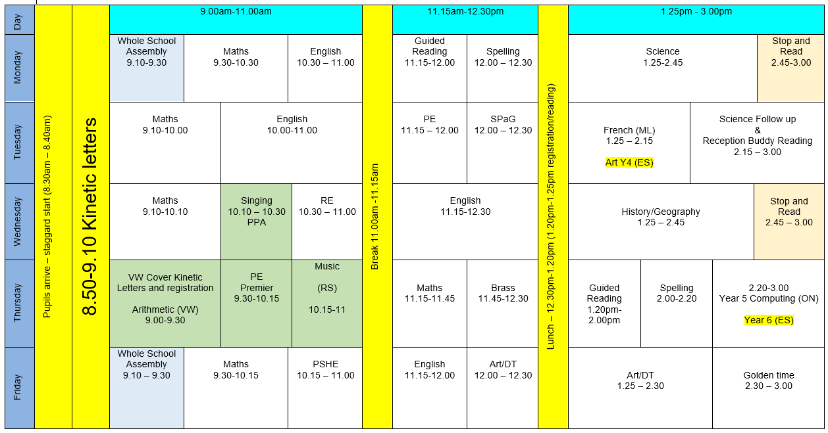
Notes:
Record

Slide 5
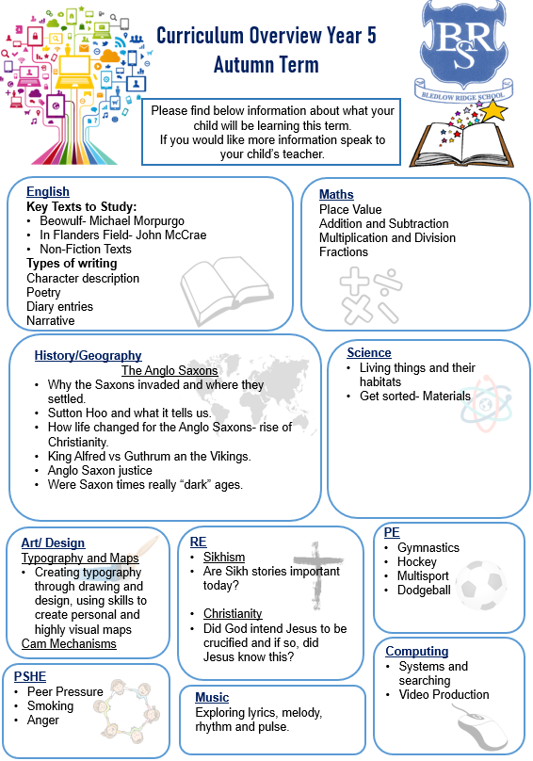
Termly Curriculum Overview
Notes:
Record

Slide 6
Equipment/what to bring to school
In Key Stage 2 (Years 3-6) every child will need to bring in a small pencil case with the following stationery.
Please name items where possible.
    Two blue ink handwriting pens (not biro)
    HB pencils
    Colouring pencils
    Ruler
    A glue-stick
    A rubber
    A sharpener
Notes:
Record

Slide 7
Homework
Maths-
Mathletics set each Monday and is due in the following Monday.
This will be linked to the weeks learning.
Reading
We will check reading records every Monday.
Children should read at least 3 times a week with a parent or carer.
Reading records should be signed by a parent/carer on these occasions.
Children can add if they have read independently.
Spellings-
Spelling task set on Monday is due the following Monday
Children will no longer receive a weekly spelling test.
Notes:
Record

Slide 8
Spelling
We use the No Nonsense Spelling scheme to support children in becoming confident, accurate spellers.
What is No Nonsense Spelling?
A structured programme that teaches spelling patterns, rules, and strategies
Focuses on understanding spelling, not just memorising words
Lessons include investigation, discussion, and practical activities
Our Aim:
To help pupils apply their spelling knowledge in their writing — not just learn words for a test.

Slide 9
How We Assess Your Child’s Learning
Formative Assessment – Ongoing and Everyday
Formative assessment happens all the time in the classroom. It helps teachers understand what your child knows and what they need help with.
Examples include:
Marking and feedback
Observing how children work in class
Listening to responses in discussions
Guided reading and group work

Slide 10
How We Assess Your Child’s Learning
Summative Assessment – End of Term/Unit Summative assessments take place at set points in the year and give a more formal overview of learning.
At our school, we use:
PIRA (Progress in Reading Assessment)
PUMA (Progress in Understanding Mathematics Assessment)
These will be complete WB: 24th November

Slide 11
What Are PIRA and PUMA?
Nationally standardised tests
Provide a standardised score that shows how your child is performing compared to national expectations
Help us track progress across the year
Support teacher judgements when reporting to you
How Do These Assessments Help?
Identify gaps in learning
Inform planning and support
Contribute to teacher assessment, which includes classwork, effort, and wider knowledge

Slide 12
How We Monitor Your Child’s Learning
At the end of each term, we hold Pupil Progress Meetings with senior leaders (Mrs Harrison, Mrs Stanley, our Deputy Headteacher and Miss Grimaldi our SENDCo).
Every single child is discussed individually
We review:
  Their current attainment
  Whether they are on track with their learning
  What support they may need if they are not on track
  These meetings help us ensure that no child is overlooked and that we can quickly put the right support in place where needed.

Slide 13
Reporting to You
We use both formative and summative assessments to provide a full picture of your child’s learning.
You will hear about your child’s progress through:
Parents' evenings (October and March)
End-of-year reports
Informal conversations and updates
Support Plan reviews and termly meetings for pupils on the Special Educational Needs register

Slide 14
PE
PE lessons are taught on Tuesday and Thursday.
Children can wear their PE kit to school and remain in their PE kit for the duration of the day, only on the days that they have PE
PE Uniform
  White polo shirt
  Navy blue shorts
  Trainers (not plimsoles)
  Plain navy-blue tracksuit top
  Plain navy blue tracksuit trousers
Notes:
Record

Slide 15
Teaching and Learning
Curricular targets for English (writing) and mathematics
Every child has targets for writing and mathematics
Targets match the year group National Curriculum objectives
When a target is met, the target sheet is ticked to help each child understand the progress they are making.
Notes:
Record

Slide 16
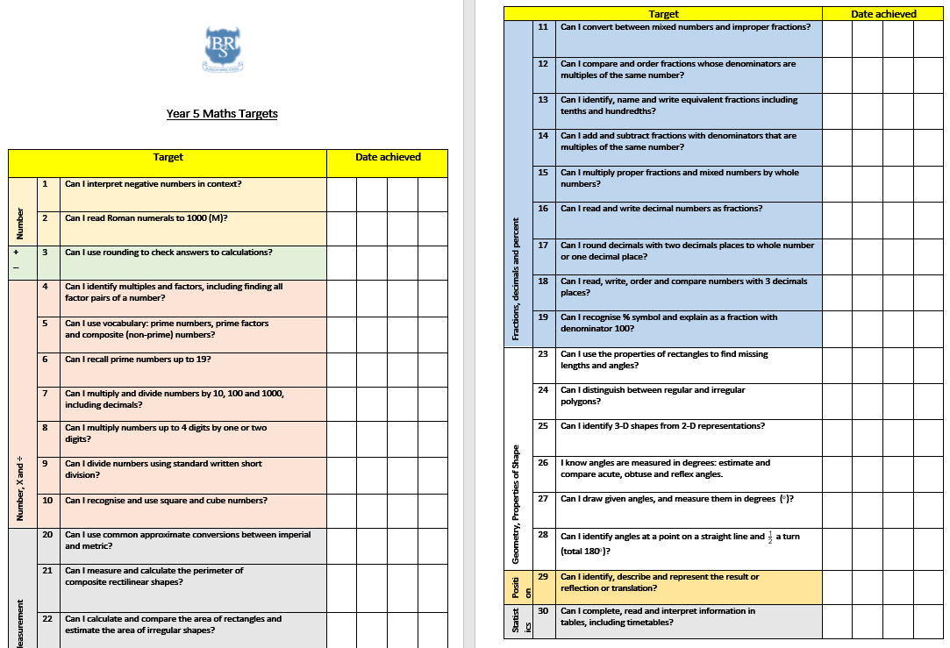

Slide 17
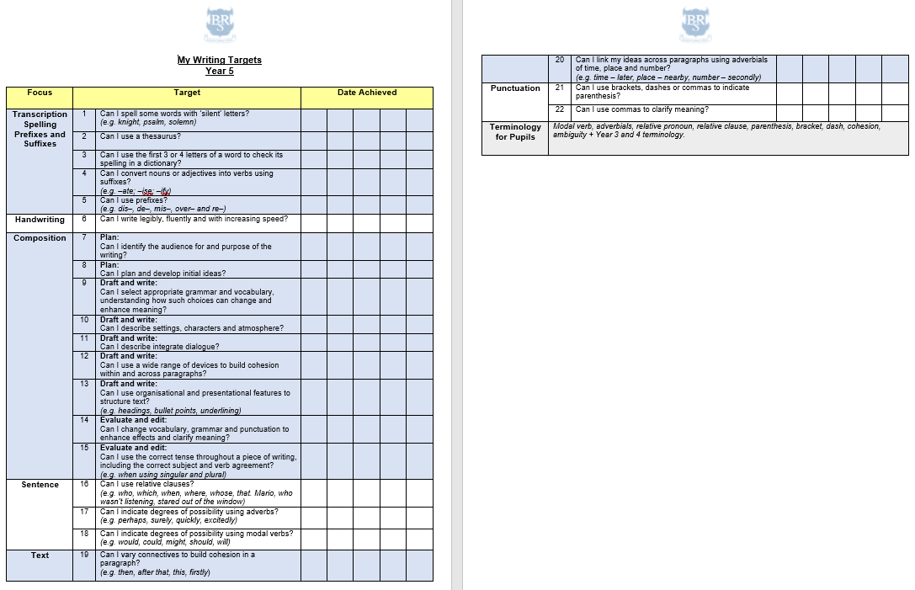

Slide 18
Teaching and Learning
Teacher Feedback
Research shows that the most effective feedback is given verbally, ‘in the moment’ – this will be evidenced as a ‘VF’ in pupils’ books
Adults may also sometimes provide written feedback and modelling in pupils’ books using a green pen
We expect pupils to respond to feedback given by adults. We ask the pupils to do this in purple pen to help them and the adults see the corrections/edits they do.
Notes:
Record

Slide 19
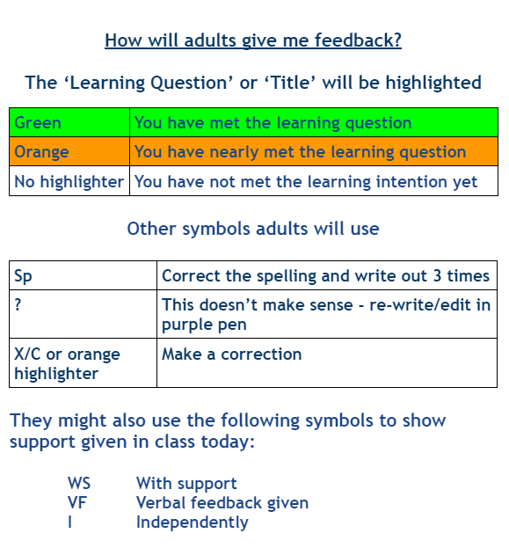
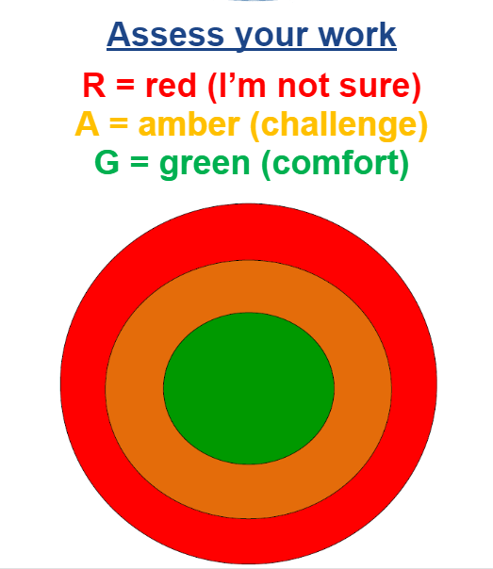

Slide 20

How can parents help?
Read, read and read some more!
Statistic: Parents who read 1 picture book with their children every day provide their children with exposure to an estimated 78,000 words each a year. Cumulatively, over the 5 years, estimated that children from literacy-rich homes hear a cumulative 1.4 million more words during storybook reading than children who are never read to.​
Notes:
Record

Slide 21


Slide 22
How can parents help?
Number bonds and times tables
Telling the time on a clock with hands
Regular attendance is key – 95% is the minimum expectation. Pupils whose attendance is of concern will be invited to discuss this in order that the school can support parents and pupils as best possible.
Communication! Please come and talk to us if you have any concerns/questions
Notes:
Record

Slide 23
Any questions?
Notes:
Record

