Slide 1


Slide 2

Curiosity
Everyone is open to learning new things about themselves, all that surrounds them and how the two fit together.

Slide 3

Health
Everyone has the skills and tools to maintain a healthy balance of their mental, physical and emotional wellbeing.

Slide 4

Confidence
Everyone believes in themselves, stands up for what is right and has the confidence to reflect and learn from their actions.

Slide 5

Resilience
Everyone keeps trying to better themselves, even when things are difficult or when we make mistakes.

Slide 6

Empathy
Everyone is kind, caring and considerate of the feelings of one another.

Slide 7

Respect
Everyone treats our environment with respect and appreciates the cultures, beliefs and views of one another.

Slide 8
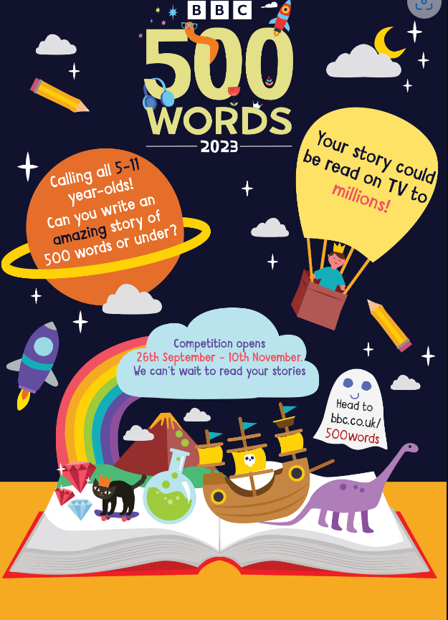
National writing competition
What do I need to do?
Write a story – no more than 500 words.
Type it up and email it to the office
When does it need to be done?
Entries to the office by Monday 6th November

Slide 9
Checklist
The competition is a celebration of children’s creativity, so stories will not be marked on spelling, grammar or punctuation
The story must not contain the child’s name or any information which identifies the child
The story must be written by one person
The story must be an original work of fiction
There’s a 500 word limit (title is not included in the word count) but no rules on theme

Slide 10
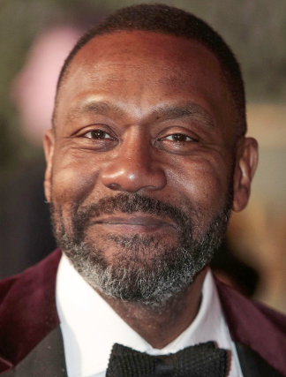
What can I win?!
The grand final will take place in February 2024 at Buckingham Palace! The top 50 finalists will be invited, along with a parent or carer. The event will be featured in a special 500 Word programme with The One Show, on World Book Day on 7 March 2024.
The two gold winners will receive the height of Sir Lenny Henry in books, as well as 500 books for their school – 1.9m!!!

Slide 11
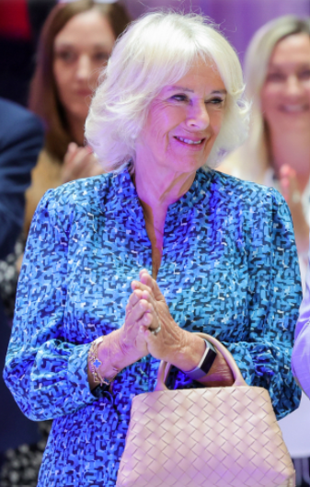
What can I win?!
The two silver winners will receive the height of Her Majesty the Queen in books – 1.7m
The two bronze winners will receive the average height of a 7 or 11 year old in books – 1.4m (approx!)

Slide 12

Reflection
500 Words - BBC Teach

Slide 13
World Dream Day
Dream Poem for World Dream Day
Dreams are like stars, shining so bright,
Guiding us forward, giving us light.
Big dreams, small dreams, all can come true,
If we keep trying in all that we do.
Dreams help us grow, they help us believe,
With courage and kindness, we can achieve.
So hold your dreams close, let them take flight,
Together we’ll make the future shine bright.

Slide 14
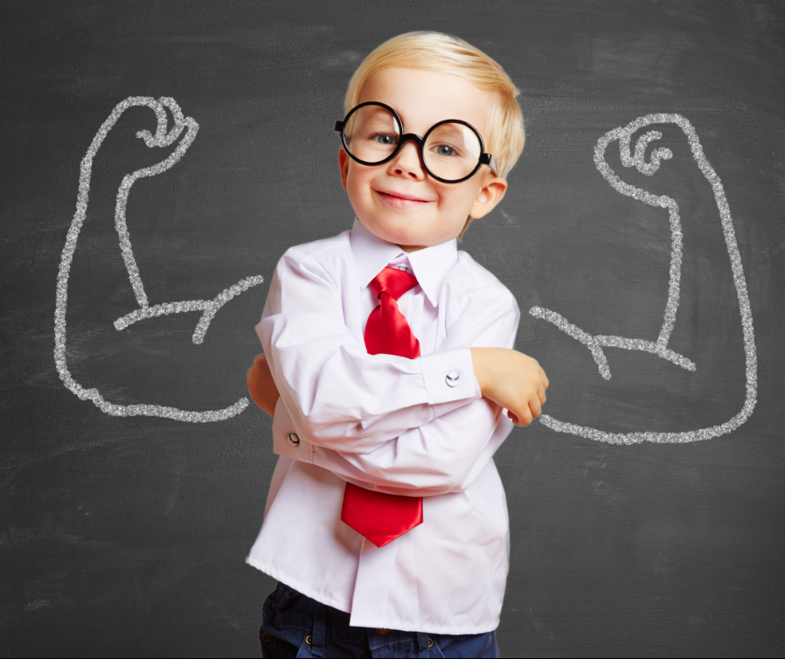
Affirmation
Affirmations are positive sentences we say to ourselves.
They remind us of our strengths and help us believe in ourselves.
“I can do this!”

Slide 15
Why Are They Important?
They Build Confidence
Saying kind words makes us feel brave and strong.

Slide 16
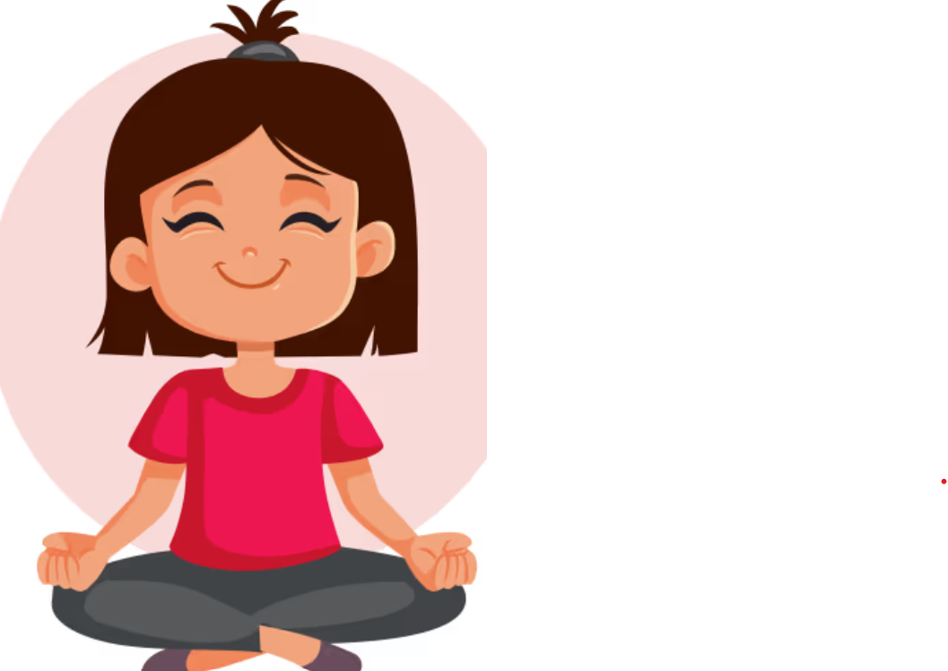
Affirmations Help Us Stay Calm
When we feel worried, affirmations remind us we can cope
They help us concentrate and do our best

Slide 17
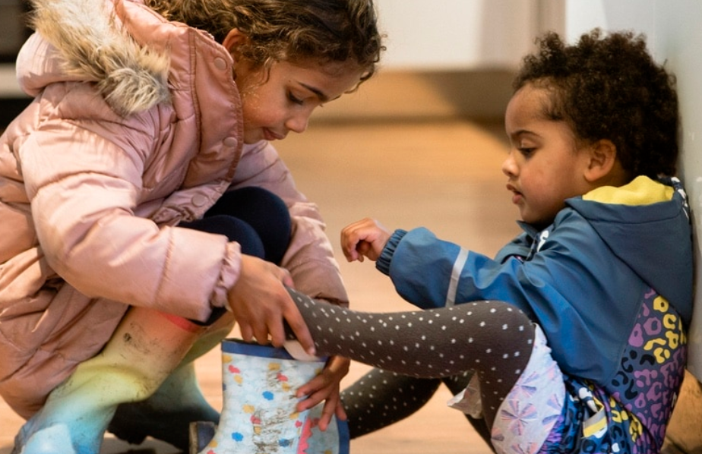
Affirmations Encourage Pro-Social behaviours
Remind us to be kind to ourselves
Remind us to use kind words with others

Slide 18
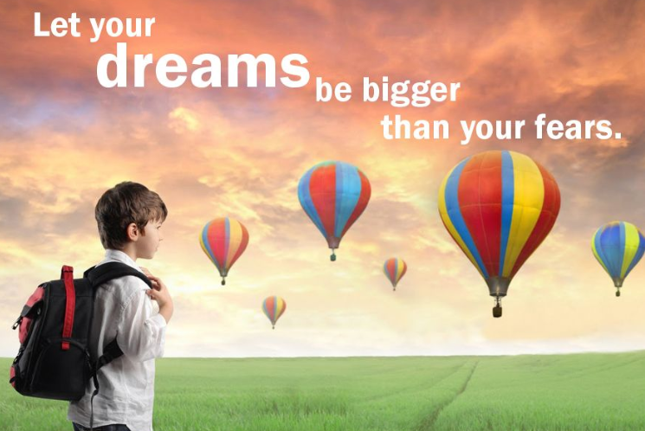
Affirmations Help Us Reach Our Dreams
Affirmations make our goals feel possible
They give us hope for the future

Slide 19
Examples of Affirmations
- I believe in myself
- I am kind
- I can do hard things
- I never stop trying

Slide 20
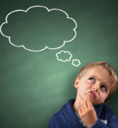
Reflection
When we believe in ourselves and use positive words, we grow stronger, kinder, and more confident.

