Slide 1
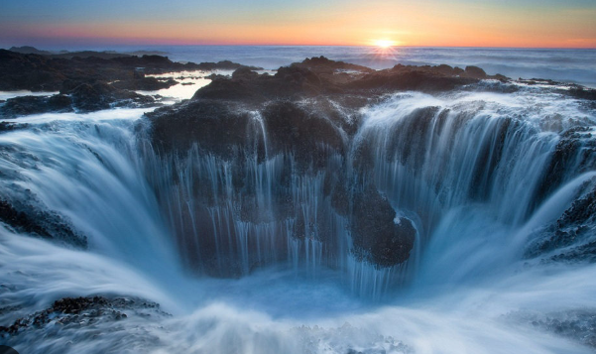
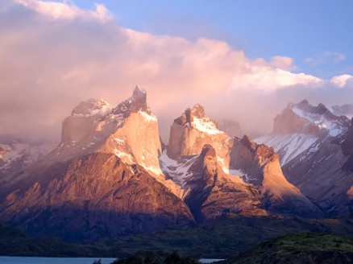
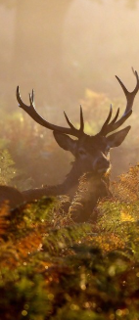
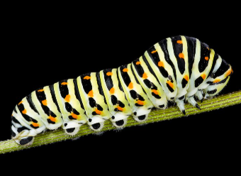
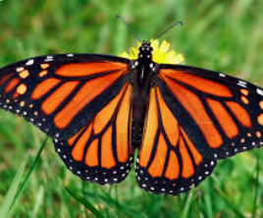
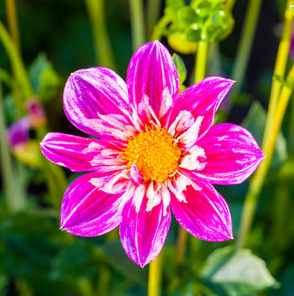
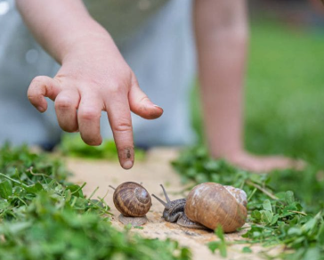
What is “awe”?
Awe is the feeling you get when something makes you go “WOW!” – like seeing a rainbow, a huge mountain, or hearing a beautiful song.

Slide 2
Can you name everyday things around you that you find incredible and awe-inspiring?

Slide 3
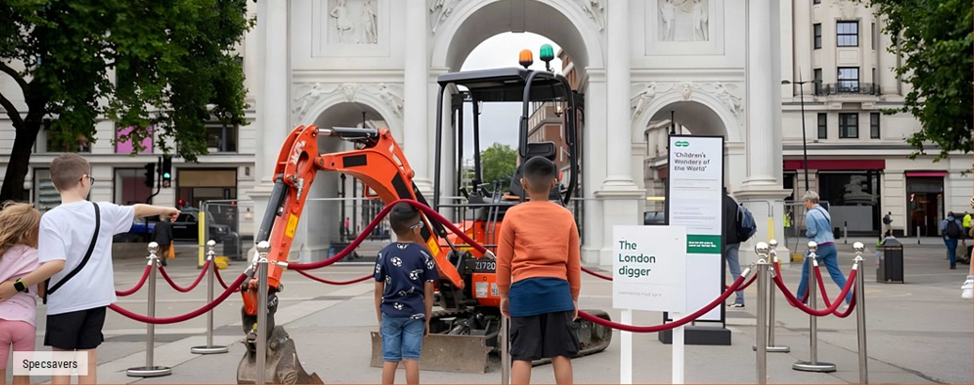
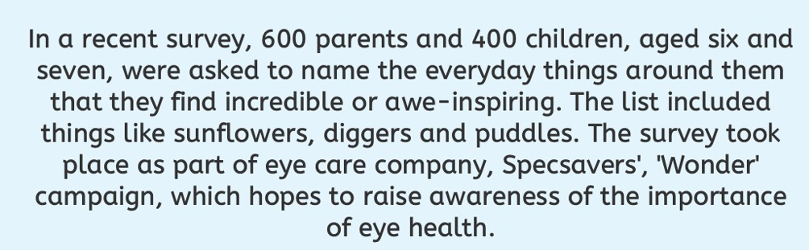

Slide 4
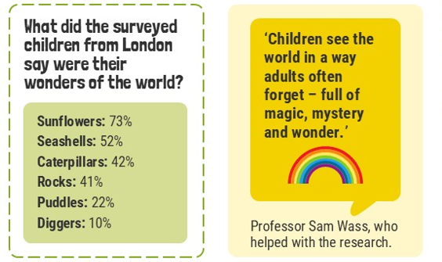

Slide 5
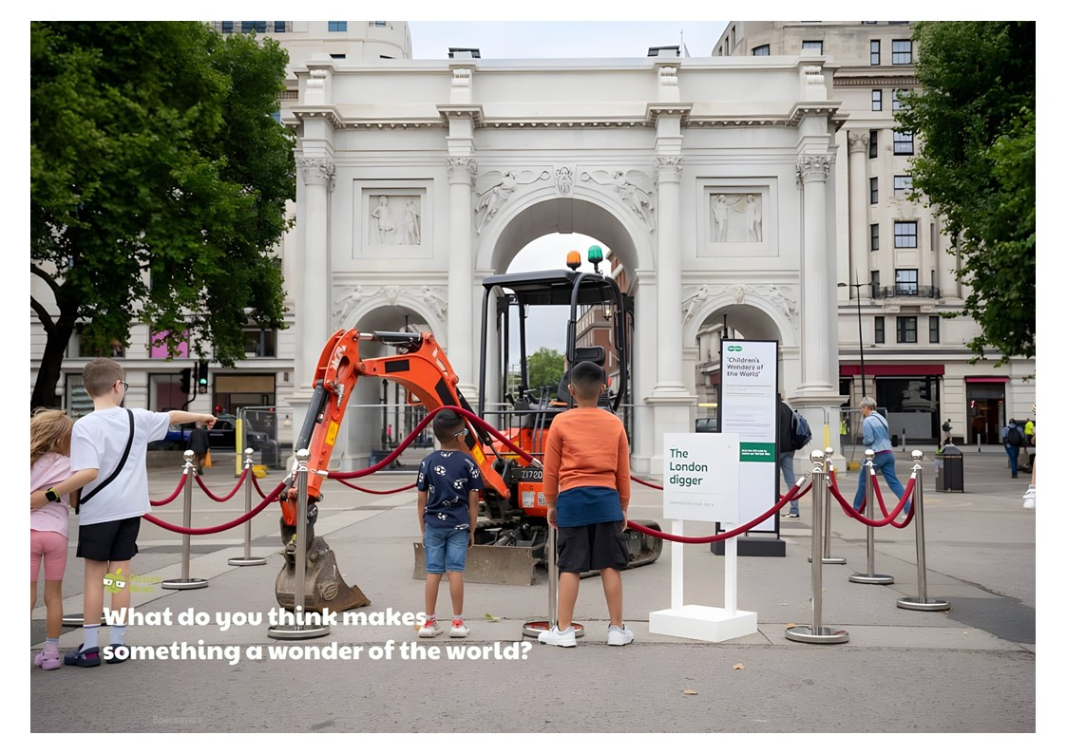

Slide 6
Wonder of Children Seeing | TV Advert | Specsavers UK
What awe-inspiring things can you spot in the video….?

Slide 7
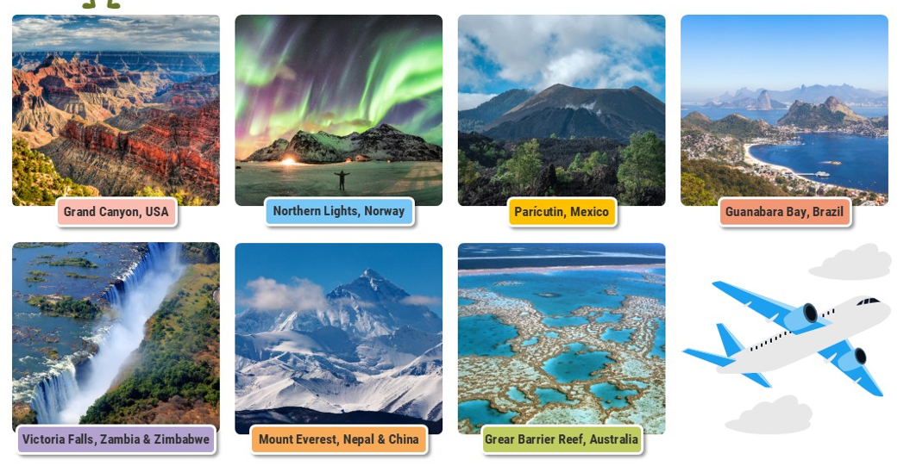

Slide 8
What makes these places wonders of the world? Natural wonders…
Places become "wonders of the world" due to their natural qualities, often being remarkable examples of natural beauty.

Slide 9
Why is it important?
What school value does this link to?
It makes us happy – Awe helps our brains feel calm and joyful.
It helps us learn – When something amazes us, we want to ask questions and discover more.
It makes us kinder – When we feel small in a big, wonderful world, we think more about others, not just ourselves.
It keeps us curious – Awe reminds us the world is full of surprises waiting to be found.

Slide 10
