Slide 1
'Meet The Teacher'
September 2023
Welcome to Year 2
Mrs Rankin and Mrs Craven
Mrs Parke
Mrs Reading
Notes:
Record

Slide 2
Arrival and Dismissal
Morning Drop Off: 8.30am to 8.40am (to allow a natural stagger)
Pupils enter the school via front gate; make their way to their designated doors through the school playground, to their class
Registration is at 8.40am, pupils arriving after 8.40am will be marked as late
Afternoon Collection: 3.00pmto 3:10pm
All pupils will be collected from the outside door of their classroom.
Notes:
Record

Slide 3
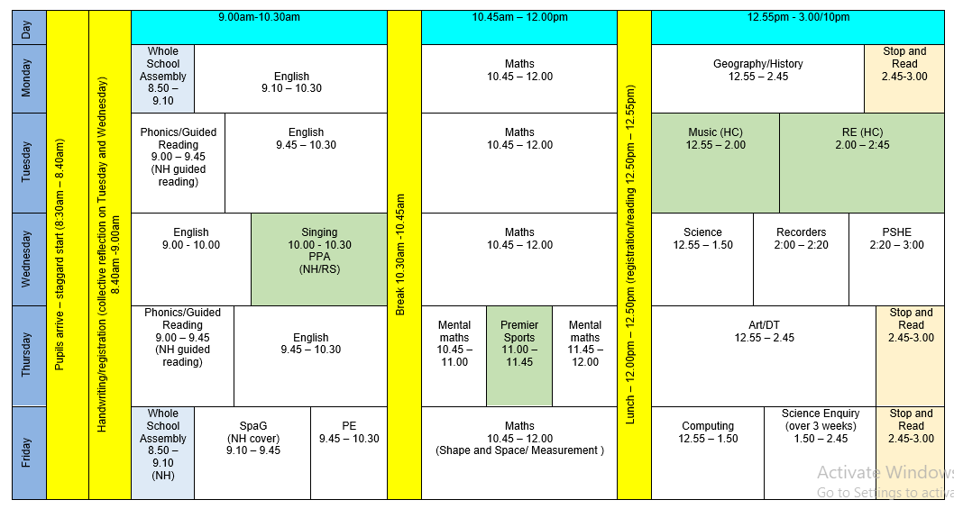
Timetable
Notes:
Record

Slide 4
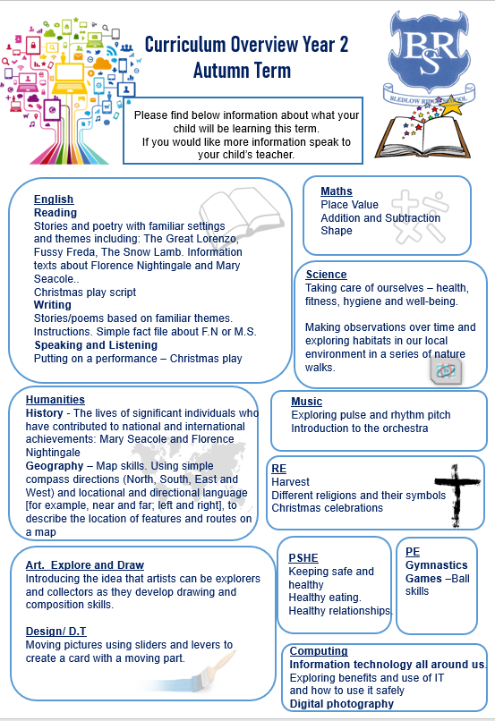
Termly Curriculum Overview
Notes:
Record

Slide 5
Trips
Autumn Term trip:
Claydon House – date tbc
Exploring the connection between Florence Nightingale and Claydon House. Finding out about nursing in the Crimea.
A visit from a Nightingale nurse –
Two nature walks in locality – visiting ‘Fiona’s garden’ to find out how her plants are doing and identify habitats
Spring Term trip:
A trip to Science Oxford – to further our studies about materials.
Two nature walks in locality – visiting ‘Fiona’s garden’ and observing changes in flora and fauna as we go
Summer Term trip: tbc
Notes:
Record

Slide 6
Homework
Maths homework will be set on Mathletics each Friday.
If you can, please read every day with your child(ren).
Reading books will be changed on a Tuesday.
Class 2 will begin each week with a new spelling focus (see list) and a short spelling and dictation test will follow the following Monday.
Each term (instead of doing class Learning Logs ) we will be having 3 House Extended Learning Competitions.
Notes:
Record

Slide 7
Equipment/what to bring to school
In EYFS and Key Stage 1, we will provide the stationery your child needs – bring in reading book and reading packet everyday, water bottle
Recorder
Notes:
Record

Slide 8
PE
PE lessons are taught on Thursday and Friday.
Children can wear their PE kit to school and remain in their PE kit for the duration of the day, only on the days that they have PE
PE Uniform
White polo shirt
Navy blue shorts
Trainers (not plimsoles)
Plain navy-blue tracksuit top
Plain navy blue tracksuit trousers
Notes:
Record

Slide 9
Teaching and Learning
Teacher Feedback
Research shows that the most effective feedback is given verbally, ‘in the moment’ – this will be evidenced as a ‘VF’ in pupils’ books
Adults may also sometimes provide written feedback and modelling in pupils’ books using a green pen
We expect pupils to respond to feedback given by adults. We ask the pupils to do this in purple pen to help them and the adults see the corrections/edits they are
Notes:
Record

Slide 10
End of Key Stage 1 Assessment
Pupils are no longer required to sit national curriculum tests in English and Mathematics (SATs).
To help inform a judgement on how your child is progressing at the end of this key stage the children will now complete PIRA (reading) and PUMA (maths) assessments along with Years 1 – 5.
The results from these tests, along with the work your child has done throughout the year, will help me reach an understanding about how your child is progressing at the end of key stage 1.
Teacher assessment judgements will be reported to you by the end of the summer term.
Notes:
Record

Slide 11
How can parents help?
Read, read and read some more!
Statistic: Parents who read 1 picture book with their children every day provide their children with exposure to an estimated 78,000 words each a year. Cumulatively, over the 5 years, estimated that children from literacy-rich homes hear a cumulative 1.4 million more words during storybook reading than children who are never read to.​
Notes:
Record

Slide 12
How can parents help?
Number bonds and times tables – practise these everywhere
Practise telling the time on a clock with hands
Regular attendance is key – 95% is the minimum expectation. Pupils whose attendance is of concern will be invited to discuss this in order that the school can support parents and pupils as best possible.
Communication! Please come and talk to us if you have any concerns/questions
Notes:
Record

Slide 13
Class 2 Matters
Children as teachers
Local history
Parent helpers
Notes:
Record

Slide 14
Any questions
Notes:
Record

