Slide 1
Kinetic Letters
Training – staff meetings

Slide 2
Kinetic Letters
Programme covers both unjoined and joined writing.
All staff must complete the unjoined training first, then implement this with pupils.
Accelerate the progress of older pupils who may be able to start the Joined Programme after 1 term, although others will not start until Yrs 2 or 3
By Yrs 5/6, National Curriculum requires all pupils to be able to use both unjoined and joined writing.

Slide 3
Kinetic Letters
Writing Questionnaire (6.18)
Think of a child and consider each statement
Useful introduction to the physical and cognitive skills needed or handwriting automaticity

Slide 4
Kinetic Letters - overview
All staff must complete Unjoined Training, as Modules 2 & 3 cover the physical skills for handwriting (Writing Positions and Pencil Hold),
Module 4 covers Letter Formation and Writing Characteristics for lower-case letters, capitals and numbers
Module 5 (in Strand 3) sets out the Fluency Targets necessary for Joined writing.

Slide 5
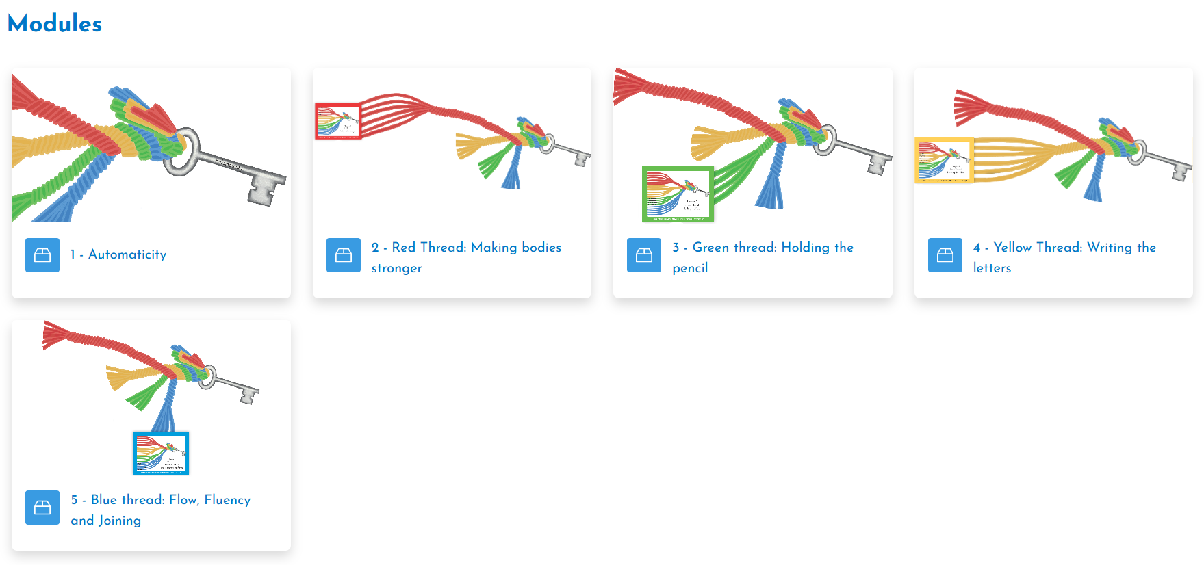
Assessing Kinetic Letters
3 elements of training – slides
Weds 24th – module 1 and 2

Slide 6
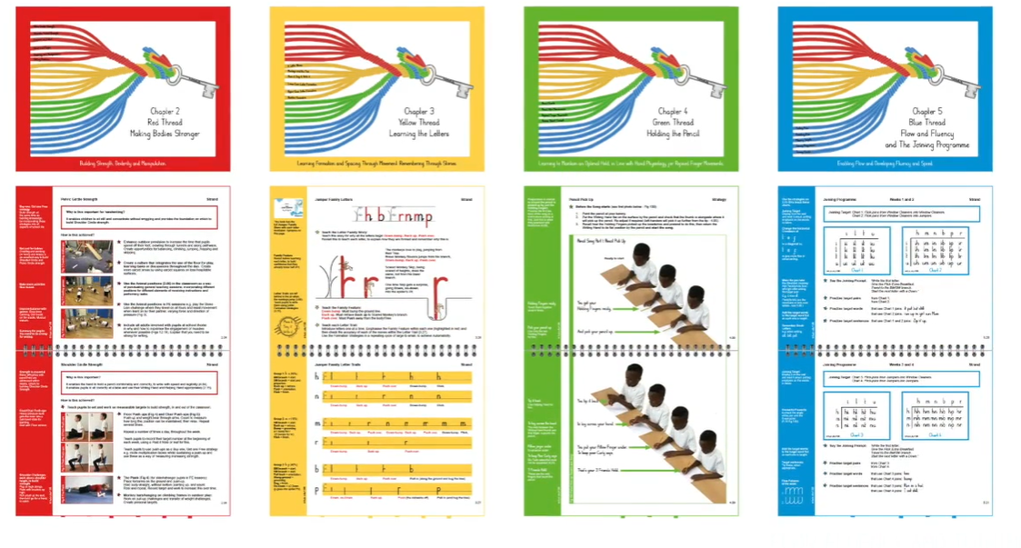

Module 1

Slide 7
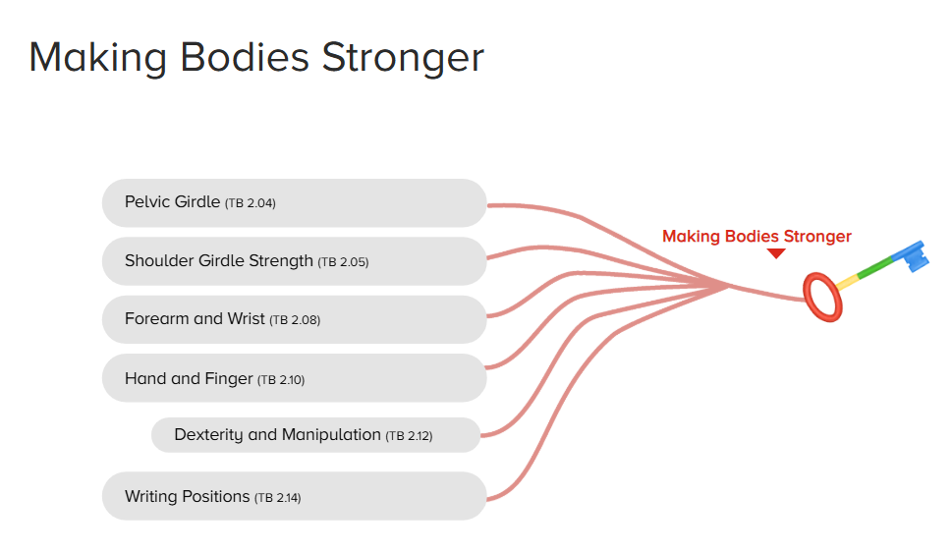
Module 2

Slide 8
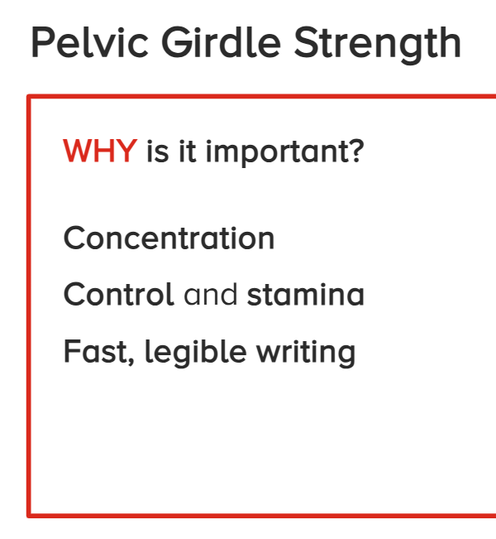
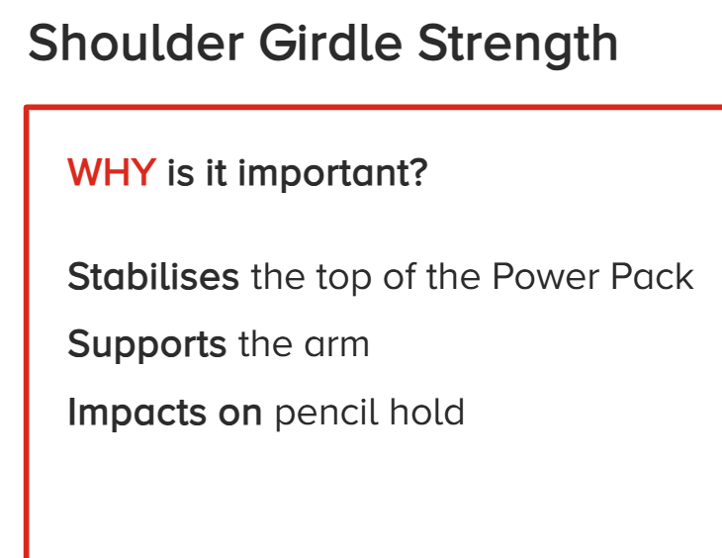
Module 2

Slide 9
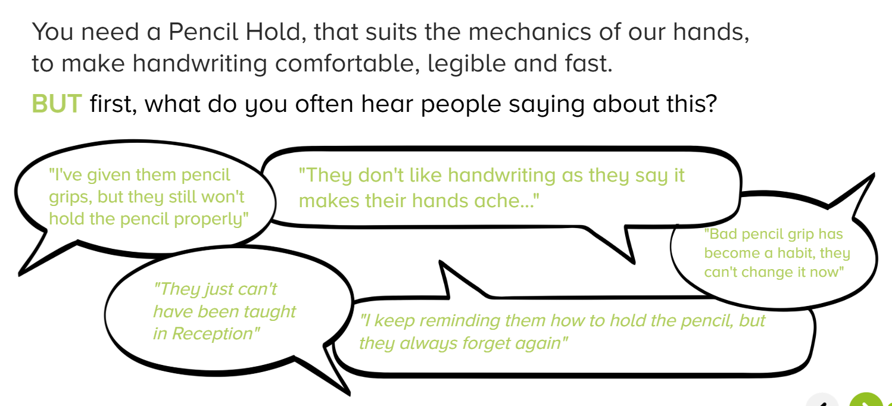
Module 3
Weds 1st Oct
Holding the Pencil

Slide 10
