Slide 1
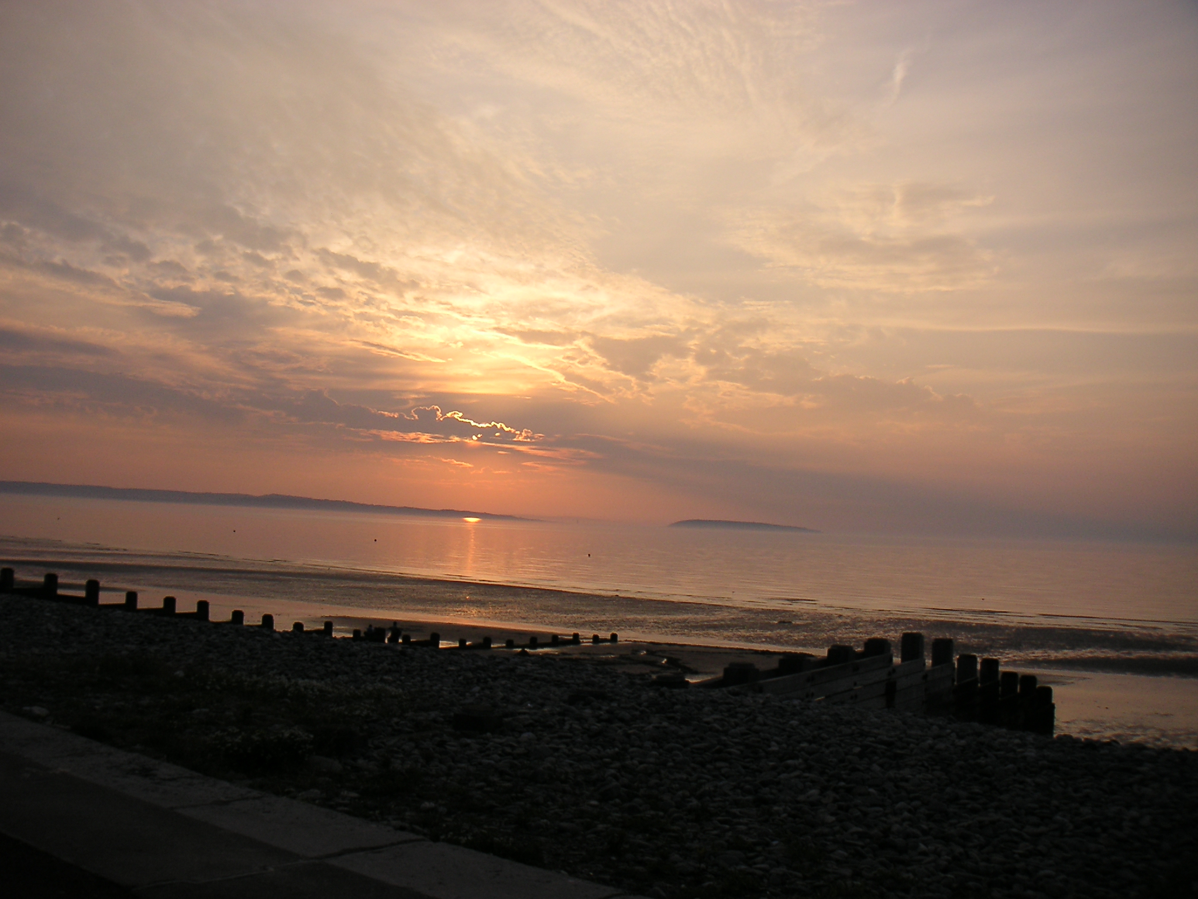
Intent: In Geography at Bledlow Ridge School, we aim to:
Inspire children’s curiosity and a lifelong interest in the world and its people
Equip them with knowledge & developing skills to find out more about the world
Build their understanding of geographical processes, interactions and changes over time
Overview of EYFS Provision
In the EYFS, children are encouraged to explore the world and environment around them through play-based, child-centred learning. The children are encouraged to discuss past and present events, usually those they have experienced first hand.
Geographical concepts taught are based upon what the children know already and how this can be developed and enhanced. This is facilitated through discussing their immediate environments. Children are encouraged to share their cultural and religious beliefs to create discussion and understanding of how families differ from each other.
Pupils are given many opportunities to explore the natural world around them. Our school field and woodland area to see first-hand the natural environment which surrounds them and compare this to other areas they might see such as the towns and villages they live in. They explore the changes in weather and seasons and how this affects their immediate location by spending time discovering outside and experiencing the physical changes around them using their scientific knowledge.

Slide 2
Intent: In Geography at Bledlow Ridge School, we aim to:
Inspire children’s curiosity and a lifelong interest in the world and its people
Equip them with knowledge & developing skills to find out more about the world
Build their understanding of geographical processes, interactions and changes over time
KS1: Starting with the children’s own geographical experiences
Exploring their world of home/school/holidays – introducing other places and describing them
Building up to comparison between places and introducing scale, local-national-international
Bledlow Ridge and surrounding area of The Chilterns, UK countries, other countries and continents
Places in other people’s stories (Florence Nightingale and characters in stories)
KS2: Introducing global processes & patterns
helping children see themselves and others as active global citizens who rely on the Earth’s resources
mountains & volcanoes, climate zones & biomes, rivers
Discovering that what places are like matters to people in history & today – interactions and changes
Ancient Egypt; The Caribbean (links with our local Caribbean population)
The Alps; Islamic Golden Age
Angles, Saxon and Viking invaders - part of the story of Britain
UK as a diverse landscape, countries & population

Slide 3

Barnaby Bear’s World Tour!
Like us, Barnaby likes going on holiday! He visits some amazing places and sometimes sends us postcards. ….? The pictures help us learn how to talk about places and what they are like.
Near ……
A geography-led project exploring our local world – from our village to our country! Thinking about a bird’s eye view we begin to draw our own maps, talk about geographical features and see famous landmarks around the UK.
….. and Far: continuing our journey we find out where we are in the world! We visit different locations to find out where it is hot and cold and use atlases and globes to find our way. We find out Uganda, travelling from the capital city to rural villages and comparing life there with life in Bledlow Ridge.
Observing our World
Geography and Science-led project that runs through the year. We identify how the seasons and our daily weather change.
Year One
Year Two
Geography in other projects: We use maps to build the context for Florence Nightingale and Mary Seacole’s journey to Crimea.
Contrasting Environments
A geography-led project looking at global scale climate zones and biomes – polar, temperate, desert and tropical rainforest & grassland. We can see our Science in context and think about what it is like in these different areas.
What is Sustainability? Geography-led Project to help children understand about the Earth’s resources, who uses them, where and how. Asking can we as Global Citizens use them better and share them more fairly?
Geography in French: using photos to describe 4 contrasting locations where French is spoken – DR Congo, Quebec Senegal, Vanuatu, & Madagascar.
Mountains and volcanoes – Geography and Science-led Project looking how they were made, where they are and what is it like to live there. Science unit brings in different types of rocks and their properties, which helps us understand why places look like they do..
Year Three
Ancient Egypt
Geography links: context for the Ancient Egyptians – locating Egypt and finding out why the River Nile was so important.
Year Four
Geography in French: looking at maps of France, naming some key features & places, considering ways to get there from UK.
The Caribbean
Geography-led project
Our local town High Wycombe, has a significant Caribbean community, mainly from St Vincent. Getting to know this region, we can review what we already know about volcanoes and rainforests and see how people live and work there.
Arabian Nights Geography links: to identify Arabia on a map and to find out key facts about the area, context for writing.
What does it mean to be British?
PSHE and Geography-led project: Identifying contrasts and similarities in values, culture, landscape and lifestyle across the country.
Wye Go There?
A geography-led project learning about rivers and the geography of North Norfolk, including fieldwork on our local River Wye and residential visit.
Year Five
Geography in French: Mali – language in a different context. Location and features, life and languages.
English language roots, Latin and Germanic
Year Six
The Alps: Geography-led project, with lots of opportunities to use different types of maps and compare living in the mountains with our local area The Chilterns.
Geography in other projects: where WW2 took place on the ground; context of stories e.g. Goodnight Mr Tom – contrast features of city and countryside during WW2,– Harry Potter – physical features of landscape, map reading to locate Hogwarts - and Journey to the River Sea –Amazonia, climate & biome, river systems, atlas work to trace journey.
Invaders from across the Sea
Geography links: where did the Vikings, Angles, Saxons and Jutes come from? What was it like there? What routes did they travel? Why?
Bledlow Ridge Curriculum Road Map- Geography

Slide 4
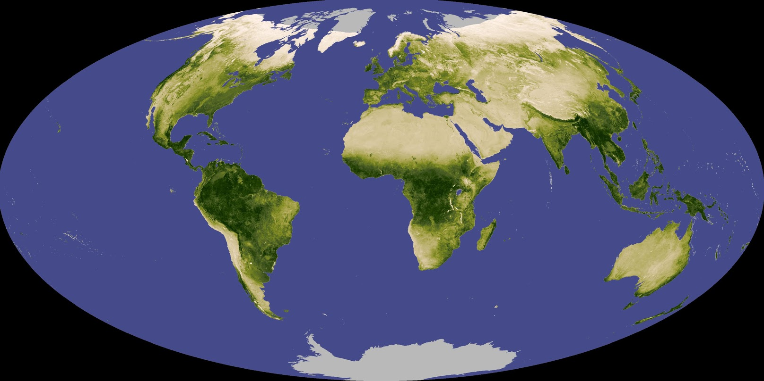
KS1 Geography National Curriculum : These areas are returned to a number of times and applied in different contexts. Some projects are geography-led, others might include one or more themes whiles others might provide a context – the setting for a story for example. Within each project the key themes and others that are touched on are given on the following slides.
1. Locate 7 continents and 5 oceans.
2. Name, locate and identify characteristics of the 4 UK countries and capital cities.
3. Understand similarities & differences between a small area of the UK (Bledlow Ridge and surrounding local area) and contrasting non-European country.
4. Identify seasonal and daily weather patterns in UK.
5. Locate hot and cold areas of the world (relate to equator and poles).
6. Use basic geographical vocabulary – physical features eg. river, hills, valley, beach.
7. Use basic geographical vocabulary – human features eg. village, town, city, harbour
8. Use world maps, atlases and globes to identify UK and countries looked at.
9. Use four points of a compass and basic directional language to describe location of features/routes on a map
10. Use aerial photos and plan perspectives to recognise landmarks/features
11. Devise a simple map, use and construct a basic key with symbols
12. Use simple fieldwork & observational skills to study geography of school grounds and local area

Slide 5
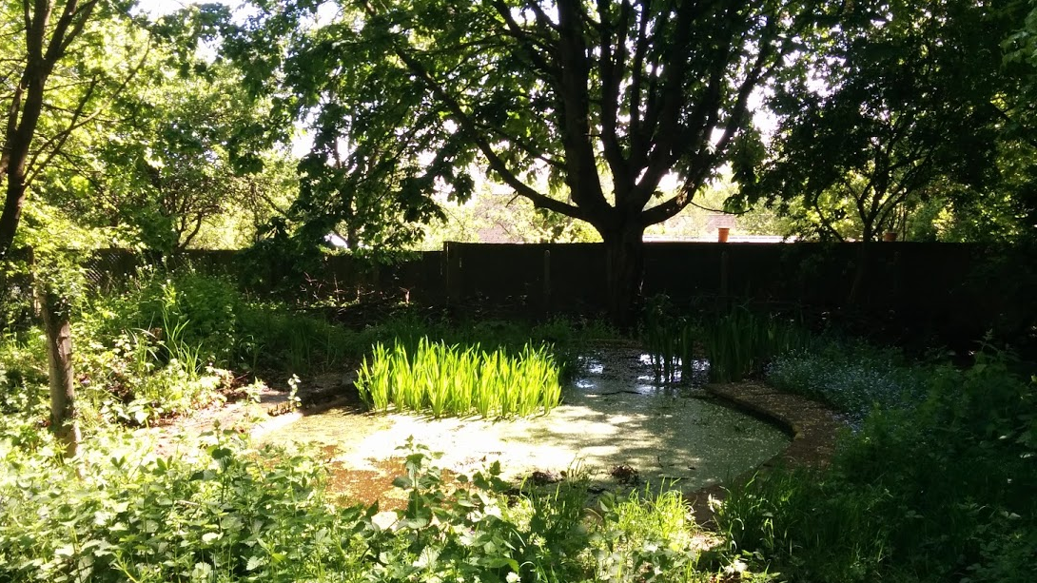
Year 1
Observing Our World through the year Geography & Science
1. Locate 7 continents and 5 oceans.
2. Name, locate and identify characteristics of the 4 UK countries and capital cities.
3. Understand similarities & differences between a small area of the UK and contrasting non-European country.
4. Identify seasonal and daily weather patterns in UK.
5. Locate hot and cold areas of the world (comparing UK weather with other places).
6. Use basic geographical vocabulary – physical features eg. river, hills, valley, beach.
7. Use basic geographical vocabulary – human features eg. village, town, city, harbour
8. Use world maps, atlases and globes to identify UK and countries looked at.
9. Use four points of a compass and basic directional language to describe location of features/routes on a map
10. Use aerial photos and plan perspectives to recognise landmarks/features
11. Devise a simple map, use and construct a basic key with symbols
12. Use simple fieldwork & observational skills to study geography of school grounds and local area

Slide 6
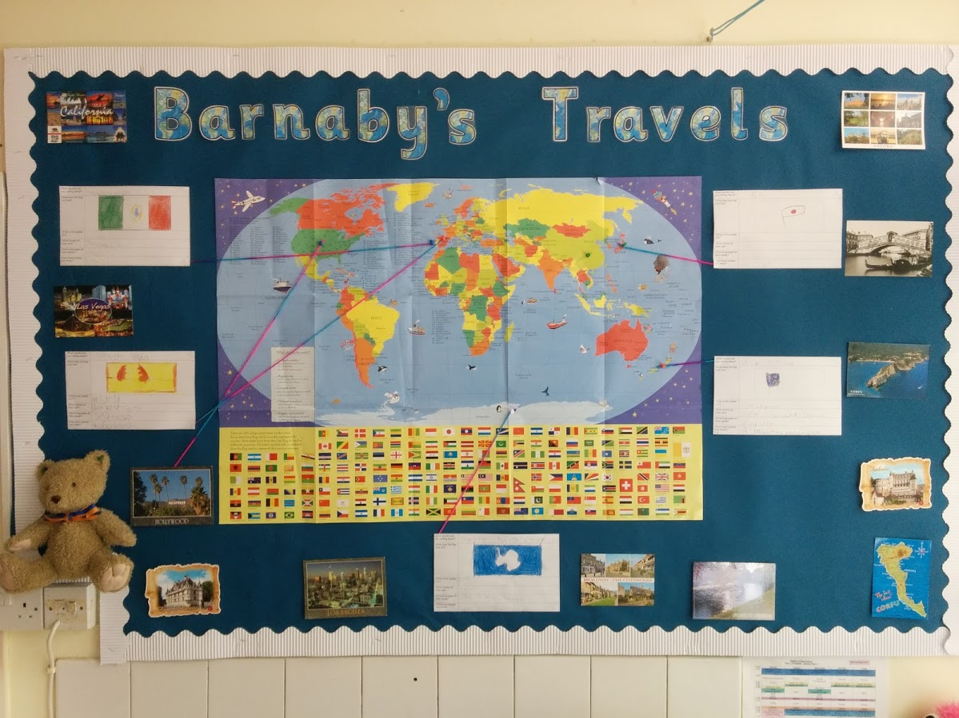
Year 1 Project 3 Barnaby Bear’s World Tour!
1. Locate 7 continents and 5 oceans.
2. Name, locate and identify characteristics of the 4 UK countries and capital cities.
3. Understand similarities & differences between a small area of the UK and contrasting non-European country.
4. Identify seasonal and daily weather patterns in UK.
5. Locate hot and cold areas of the world (relate to equator and poles).
6. Use basic geographical vocabulary – physical features eg. river, hills, valley, beach.
7. Use basic geographical vocabulary – human features eg. village, town, city, harbour
8. Use world maps, atlases and globes to identify UK and countries looked at.
9. Use four points of a compass and basic directional language to describe location of features/routes on a map
10. Use aerial photos and plan perspectives to recognise landmarks/features
11. Devise a simple map, use and construct a basic key with symbols
12. Use simple fieldwork & observational skills to study geography of school, grounds and local area

Slide 7
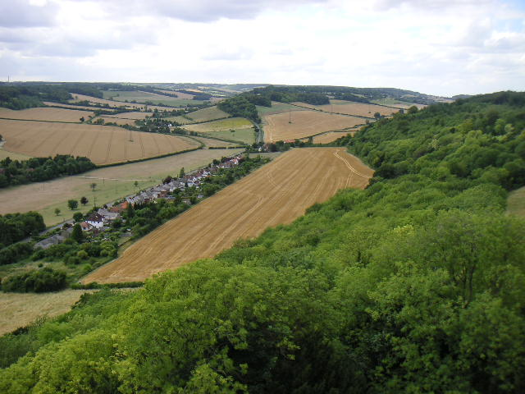
Year 2: Near… geography-led
1. Locate 7 continents and 5 oceans.
2. Name, locate and identify characteristics of the 4 UK countries and capital cities.
3. Understand similarities & differences between a small area of the UK (Bledlow Ridge and surrounding local area of The Chilterns) and contrasting non-European country.
4. Identify seasonal and daily weather patterns in UK.
5. Locate hot and cold areas of the world (relate to equator and poles).
6. Use basic geographical vocabulary – physical features eg. river, hills, valley, woodland, beach.
7. Use basic geographical vocabulary – human features eg. village, town, city, farm, harbour
8. Use world maps, atlases and globes to identify UK and countries looked at.
9. Use four points of a compass and basic directional language to describe location of features/routes on a map
10. Use aerial photos and plan perspectives to recognise landmarks/features
11. Devise a simple map, use and construct a basic key with symbols
12. Use simple fieldwork & observational skills to study geography of school, grounds and local environment

Slide 8
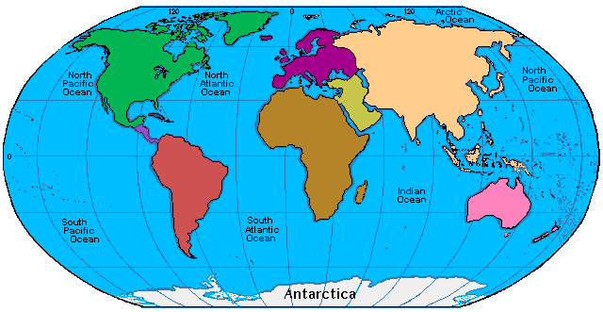
Year 2: … and Far geography-led
1. Locate 7 continents and 5 oceans.
2. Name, locate and identify characteristics of the 4 UK countries and capital cities.
3. Understand similarities & differences between a small area of the UK (Bledlow Ridge and surrounding local area of The Chilterns) and contrasting non-European country (sub-urban Nairobi, Kenya).
4. Identify seasonal and daily weather patterns in UK.
5. Locate hot and cold areas of the world (relate to equator and poles).
6. Use basic geographical vocabulary – physical features eg. river, hills, valley, beach.
7. Use basic geographical vocabulary – human features eg. village, town, city, harbour
8. Use world maps, atlases and globes to identify UK and countries looked at.
9. Use four points of a compass and basic directional language to describe location of features/routes on a map
10. Use aerial photos and plan perspectives to recognise landmarks/features
11. Devise a simple map, use and construct a basic key with symbols
12. Use simple fieldwork & observational skills to study geography of school grounds and local area

Slide 9
KS2 Geography National Curriculum : These areas are returned to a number of times and applied in different contexts to support retrieval practice.
1. Locate countries (focus on Europe & N. and S. America), environmental regions, physical and human features, countries and cities.
2. Name & locate countries of the UK, regions, features & how some aspects have changed over time
3. Identify position & significance of latitude & longitude, Prime meridian and time zones
4. Understand similarities and differences of region of UK and region of Europe or N. or S. America
5. Describe and understand physical geography incl. climate zones, biomes, rivers, mountains, volcanoes, earthquakes and the water cycle.
6. Describe and understand human geography incl. types of settlement and land use, economic activity including trade links, and the distribution of natural resources including energy, food, minerals and water.
7. Use maps, atlases, globes, computer-mapping to locate countries & features studied.
8. Use the eight points of a compass, four and six-figure grid references, symbols and key (including the use of Ordnance Survey maps) to build their knowledge of the United Kingdom and the wider world
9. Use fieldwork to observe, measure and record the human and physical features in the local area using a range of methods, including sketch maps, plans and graphs, and digital technologies.

Slide 10

Year
Extreme Earth:
Making Mountains & Volcanoes geography and science-led project
1. Locate countries where mountain building has taken place and volcano /earthquake zones, environmental regions, physical and human features, countries and cities.
2. Name & locate countries of the UK, regions, features & how some aspects have changed over time
3. Identify position & significance of latitude & longitude, Prime meridian and time zones
4. Understand similarities and differences of region of UK and region of Europe or N. or S. America
5. Describe and understand physical geography incl., climate zones, biomes, rivers mountains, volcanoes, earthquakes and the water cycle.
6. Describe and understand human geography incl. types of settlement and land use, economic activity including trade links, and the distribution of natural resources including energy, food, minerals and water.
7. Use maps, atlases, globes, computer-mapping to locate countries & features studied.
8. Use the eight points of a compass, four and six-figure grid references, symbols and key (including the use of Ordnance Survey maps) to build their knowledge of the United Kingdom and the wider world
9. Use fieldwork to observe, measure and record the human and physical features in the local area using a range of methods, including sketch maps, plans and graphs and digital technologies.

Slide 11
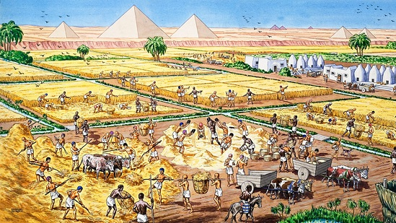
Year 3
The Ancient Egyptians
1. Locate country (Egypt), environmental regions, physical and human features, countries and cities.
2. Name & locate countries of the UK, regions, features & how some aspects have changed over time
3. Identify position & significance of latitude & longitude, Prime meridian and time zones
4. Understand similarities and differences of region of UK and region of Europe or N. or S. America
5. Describe and understand physical geography incl. climate zones, biomes, rivers, mountains, volcanoes, earthquakes and the water cycle.
6. Describe and understand human geography incl. types of settlement and land use, economic activity including trade links, and the distribution of natural resources including energy, food, minerals and water.
7. Use maps, atlases, globes, computer-mapping to locate countries & features studied.
8. Use the eight points of a compass, four and six-figure grid references, symbols and key (including the use of Ordnance Survey maps) to build their knowledge of the United Kingdom and the wider world
9. Use fieldwork to observe, measure and record the human and physical features in the local area using a range of methods, including sketch maps, plans and graphs, and digital technologies.

Slide 12
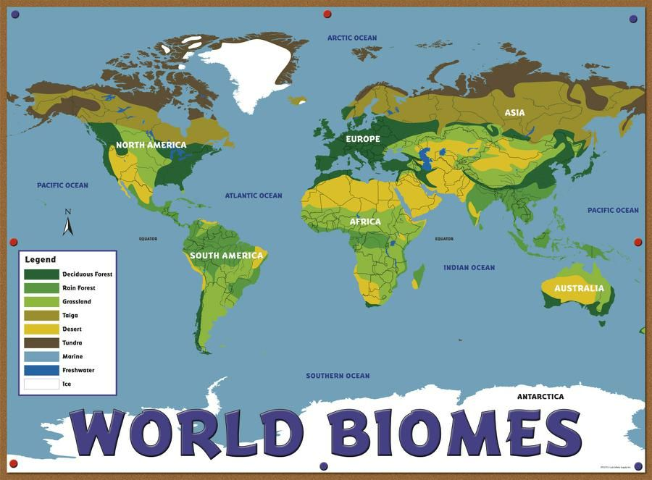
Year 3
Contrasting Environments
– World Biomes
Geography and science-led
1. Locate countries, environmental regions, physical and human features, countries and cities.
2. Name & locate countries of the UK, regions, features & how some aspects have changed over time
3. Identify position & significance of latitude & longitude, equator, Tropics of Cancer & Capricorn, Arctic and Antarctic Circles, North & South Poles, Prime meridian and time zones
4. Understand similarities and differences of region of UK and region of Europe or N. or S. America
5. Describe and understand physical geography incl. climate zones, biomes, rivers, mountains, volcanoes, earthquakes and the water cycle.
6. Describe and understand human geography incl. types of settlement and land use, economic activity including trade links, and the distribution of natural resources including energy, food, minerals and water.
7. Use maps, atlases, globes, computer-mapping to locate countries & features studied.
8. Use the eight points of a compass, four and six-figure grid references, symbols and key (including the use of Ordnance Survey maps) to build their knowledge of the United Kingdom and the wider world
9. Use fieldwork to observe, measure and record the human and physical features in the local area using a range of methods, including sketch maps, plans and graphs, and digital technologies.

Slide 13
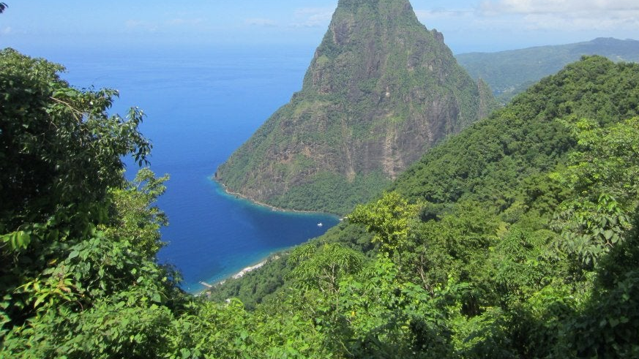
Year 4
The Caribbean – Where is it? What’s it like? What’s it like to live there?
1. Locate countries (focus on N. and S. America), environmental regions, physical and human features, countries and cities.
2. Name & locate countries of the UK, regions, features & how some aspects have changed over time
3. Identify position & significance of latitude & longitude, Prime meridian and time zones
4. Understand similarities and differences of region of UK and region of N. or S. America
5. Describe and understand physical geography incl. climate zones, biomes, rivers, mountains, volcanoes, earthquakes and the water cycle.
6. Describe and understand human geography incl. types of settlement and land use, economic activity including trade links, and the distribution of natural resources including energy, food, minerals and water.
7. Use maps, atlases, globes, computer-mapping to locate countries & features studied.
8. Use the eight points of a compass, four and six-figure grid references, symbols and key to build their knowledge of the United Kingdom and the wider world
9. Use fieldwork to observe, measure and record the human and physical features in the local area using a range of methods, including sketch maps, plans and graphs, and digital technologies.

Slide 14
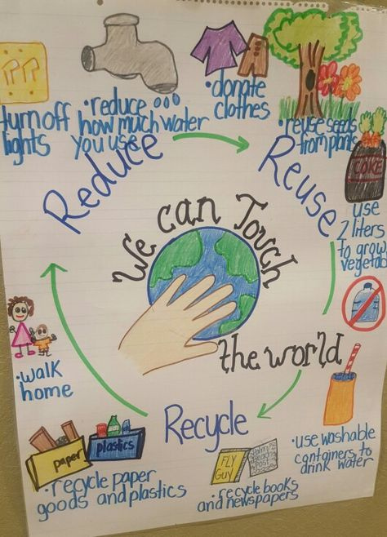
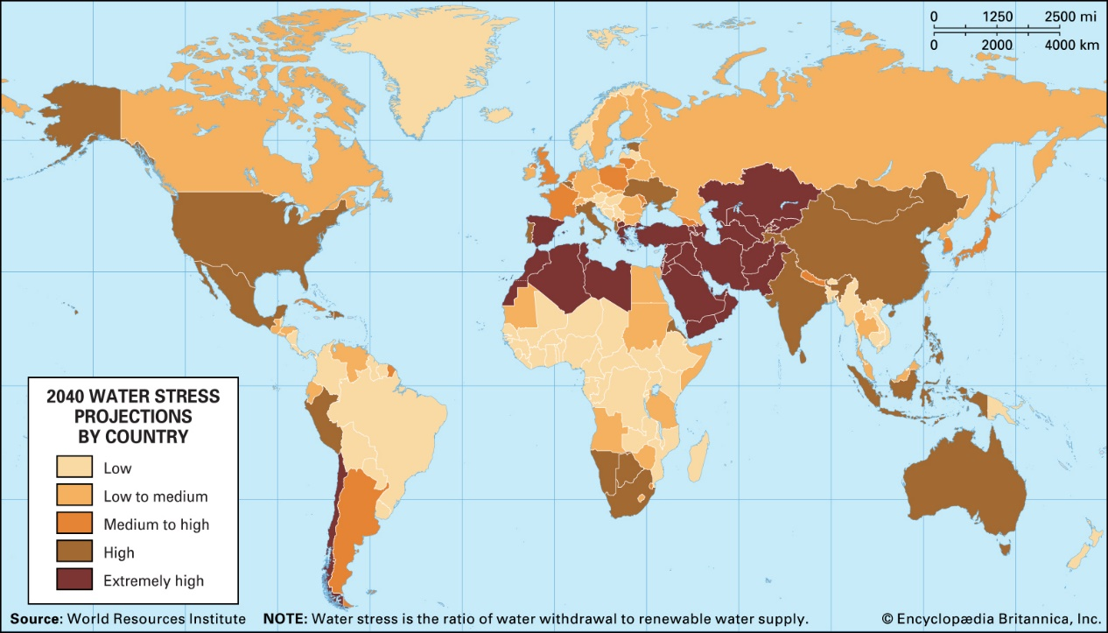
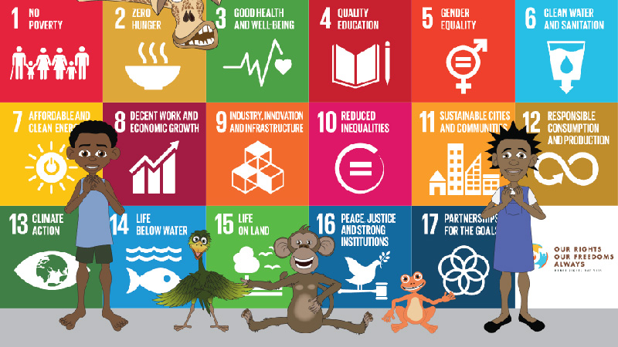
Y4: What is Sustainability?
As Global citizens, children need to understand what it means to use resources so they will last into the future and investigate how fairly resources are shared by the people of the world. Looking at how we can save water, reduce waste & be environmentally-friendly and see how we can make the world better by sharing those resources through fair-trade and the Sustainable Development Goals
1. Locate countries (focus on Europe & N. and S. America), environmental regions, physical and human features, countries and cities.
2. Name & locate countries of the UK, regions, features & how some aspects have changed over time
3. Identify position & significance of latitude & longitude, Prime meridian and time zones
4. Understand similarities and differences of region of UK and region of Europe or N. or S. America
5. Describe and understand physical geography incl. climate zones, biomes, rivers, mountains, volcanoes, earthquakes and the water cycle.
6. Describe and understand human geography incl. types of settlement and land use, economic activity including trade links, and the distribution of natural resources including energy, food, minerals and water.
7. Use maps, atlases, globes, computer-mapping to locate countries & features studied.
8. Use the eight points of a compass, four and six-figure grid references, symbols and key (including the use of Ordnance Survey maps) to build their knowledge of the United Kingdom and the wider world
9. Use fieldwork to observe, measure and record the human and physical features in the local area using a range of methods, including sketch maps, plans and graphs, and digital technologies.

Slide 15
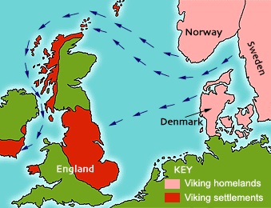
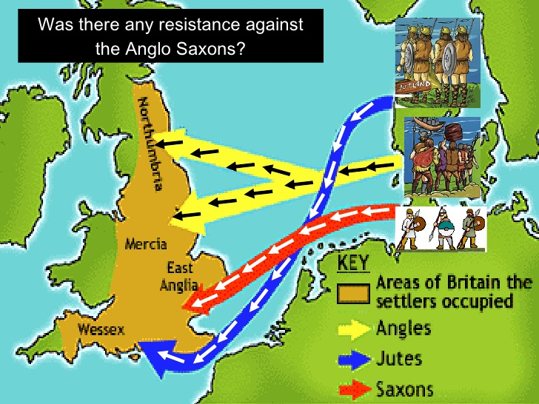
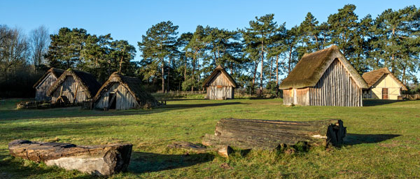
Year 5
Invaders from Across the Sea geography links
1. Locate countries (UK, Germany, Denmark, Norway, Netherlands), environmental regions, physical and human features, countries and cities.
2. Name & locate countries of the UK, regions, features & how some aspects have changed over time
3. Identify position & significance of latitude & longitude, Prime meridian and time zones
4. Understand similarities and differences of region of UK and region of Europe or N. or S. America
5. Describe and understand physical geography incl. climate zones, biomes, rivers, mountains, volcanoes, earthquakes and the water cycle.
6. Describe and understand human geography incl. types of settlement and land use, economic activity including trade links, and the distribution of natural resources including energy, food, minerals and water.
7. Use maps, atlases, globes, computer-mapping to locate countries & features studied.
8. Use the eight points of a compass, four and six-figure grid references, symbols and key (including the use of Ordnance Survey maps) to build their knowledge of the United Kingdom and the wider world
9. Use fieldwork to observe, measure and record the human and physical features in the local area using a range of methods, including sketch maps, plans and graphs, and digital technologies.

Slide 16
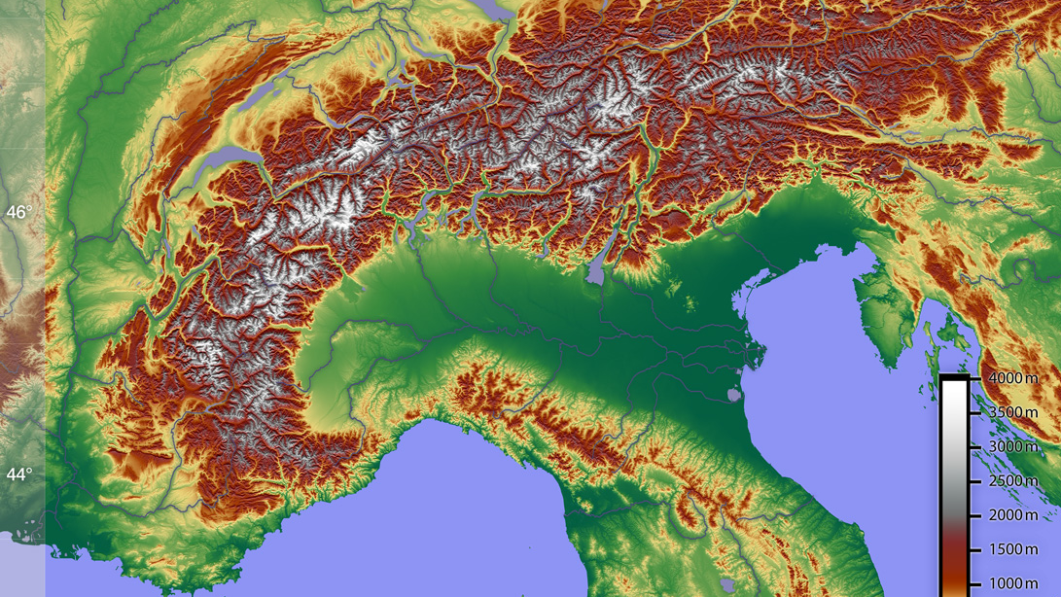
Year 5: The Alps
1. Locate countries (focus on The Alps, Europe), environmental regions, physical and human features, countries and cities.
2. Name & locate countries of the UK, regions, features & how some aspects have changed over time
3. Identify position & significance of latitude & longitude, Prime meridian and time zones
4. Understand similarities and differences of region of UK and region of Europe (The Chilterns & The Alps)
5. Describe and understand physical geography incl. climate zones, biomes, rivers, mountains, volcanoes, earthquakes and the water cycle.
6. Describe and understand human geography incl. types of settlement and land use, economic activity including trade links, and the distribution of natural resources including energy, food, minerals and water.
7. Use maps, atlases, globes, computer-mapping to locate countries & features studied.
8. Use the eight points of a compass, four and six-figure grid references, symbols and key (including the use of Ordnance Survey maps) to build their knowledge of the United Kingdom and the wider world
9. Use fieldwork to observe, measure and record the human and physical features in the local area using a range of methods, including sketch maps, plans and graphs, and digital technologies.

Slide 17
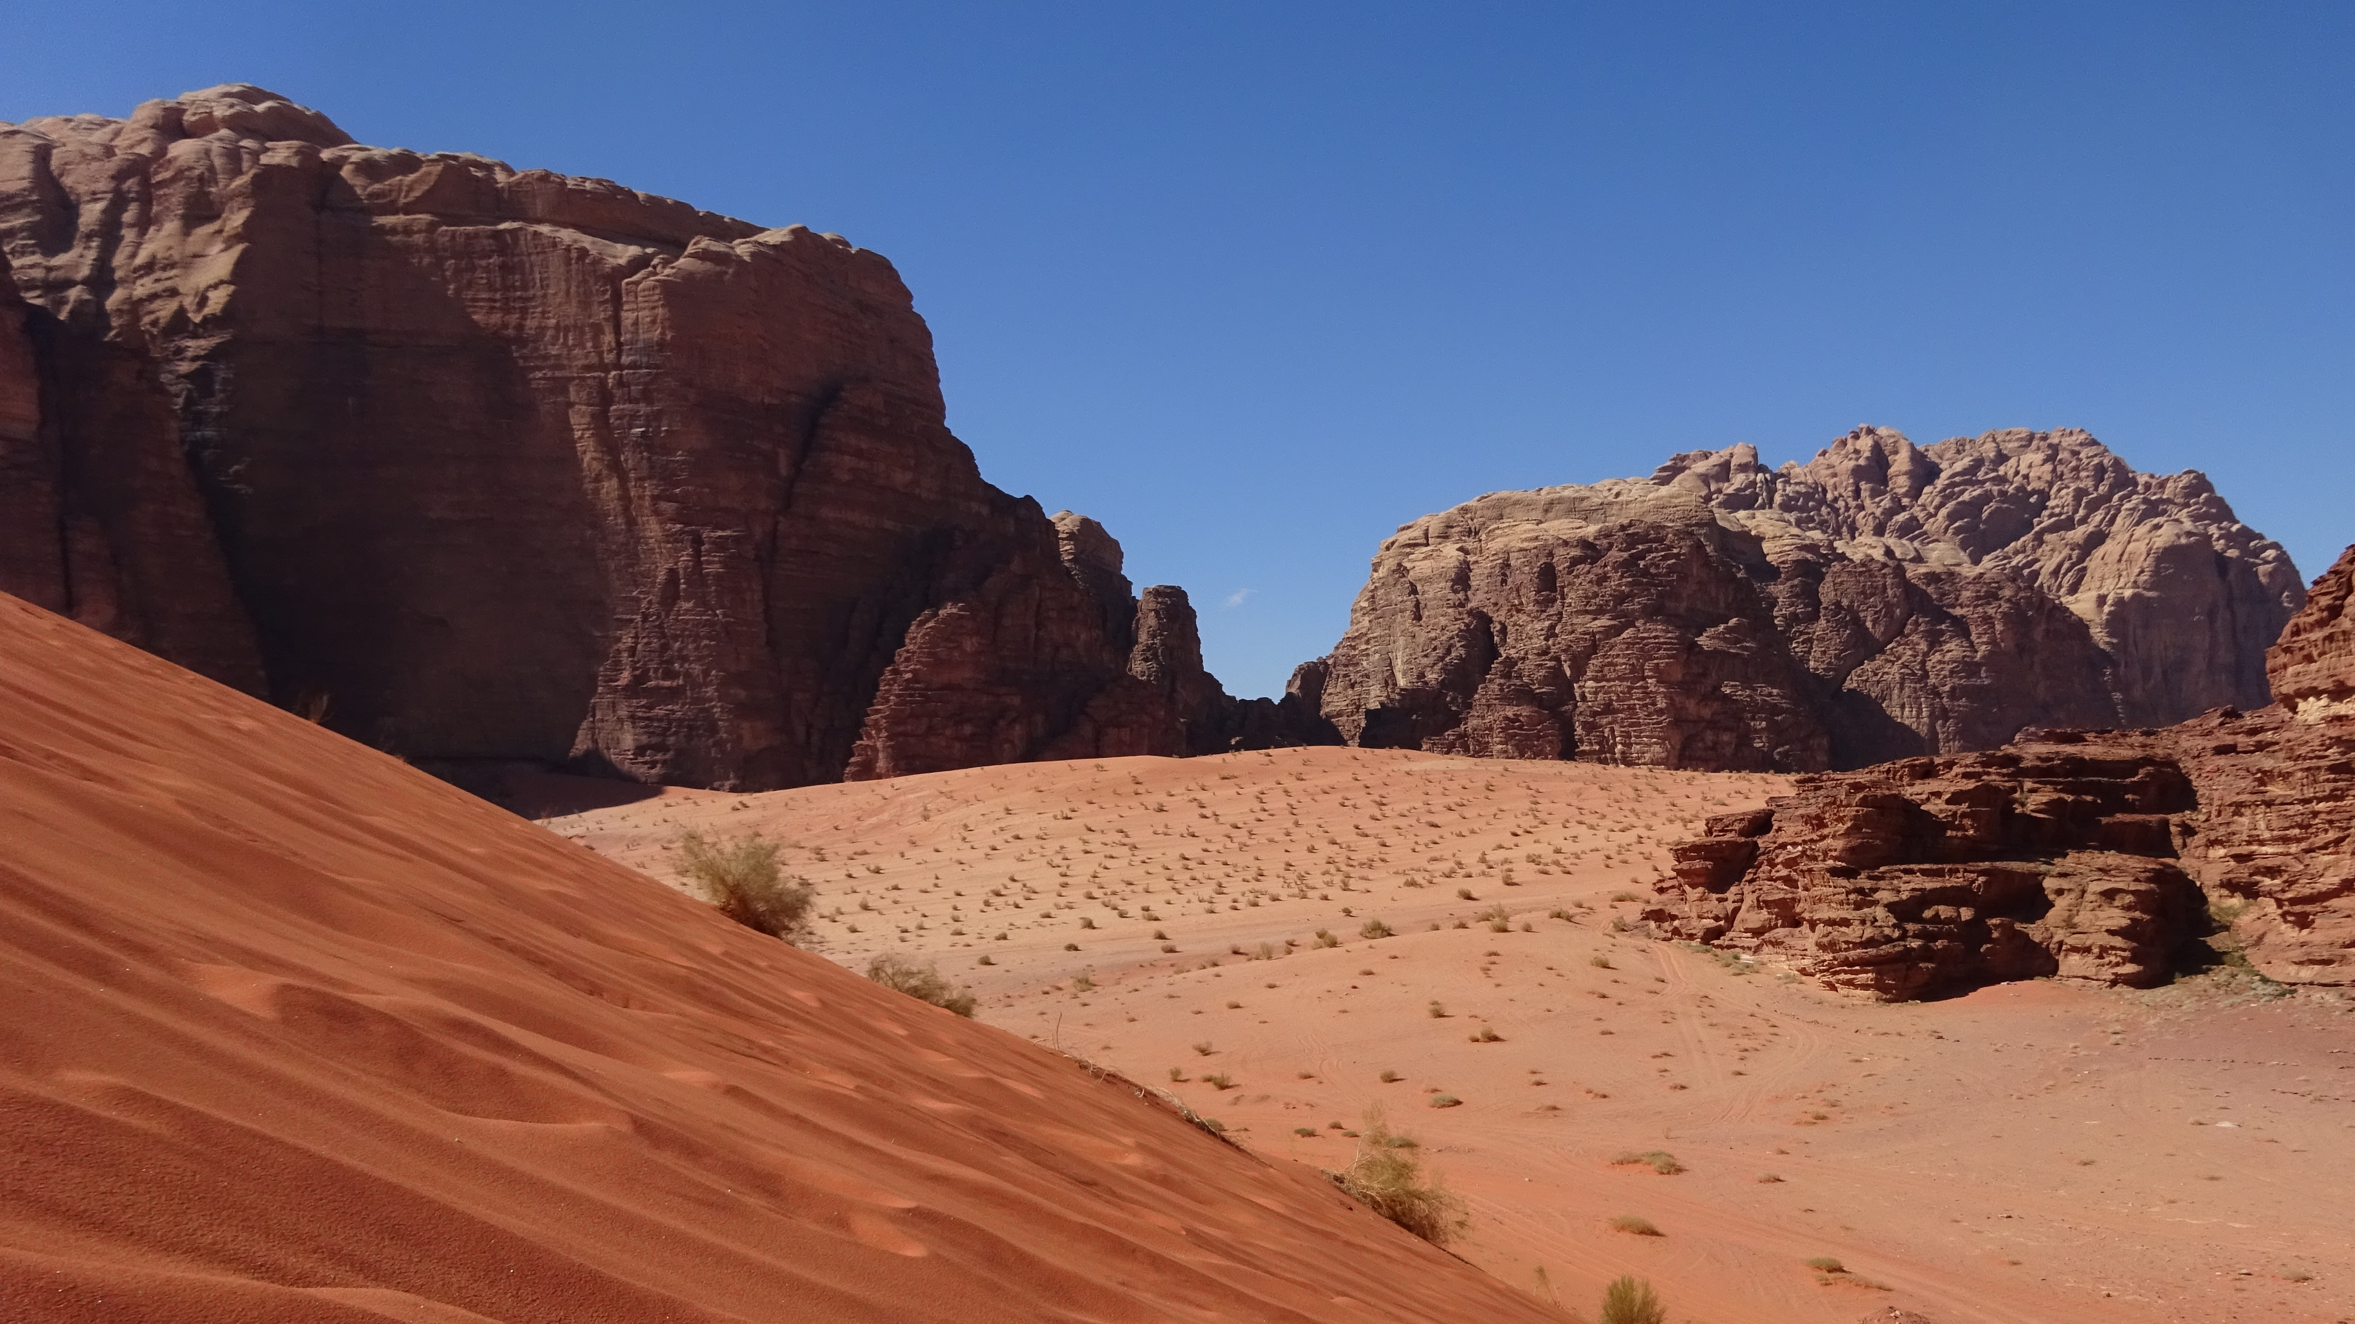
Year 6: Arabian Nights
1. Locate countries (Arabian Peninsula), environmental regions, physical and human features, countries and cities (ancient trade routes converging on Baghdad).
2. Name & locate countries of the UK, regions, features & how some aspects have changed over time
3. Identify position & significance of latitude & longitude, Prime meridian and time zones
4. Understand similarities and differences of region of UK and region of Europe or N. or S. America
5. Describe and understand physical geography incl. climate zones, biomes, rivers, mountains, volcanoes, earthquakes and the water cycle.
6. Describe and understand human geography incl. types of settlement and land use, economic activity including trade links, and the distribution of natural resources including energy, food, minerals and water.
7. Use maps, atlases, globes, computer-mapping to locate countries & features studied.
8. Use the eight points of a compass, four and six-figure grid references, symbols and key (including the use of Ordnance Survey maps) to build their knowledge of the United Kingdom and the wider world
9. Use fieldwork to observe, measure and record the human and physical features in the local area using a range of methods, including sketch maps, plans and graphs, and digital technologies.

Slide 18
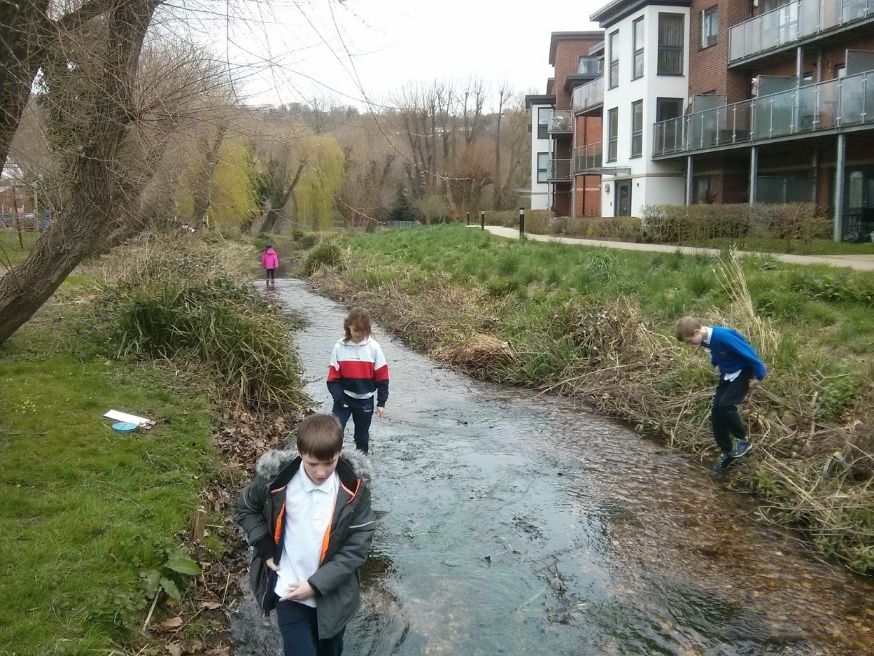
Year 6
Wye Go There?
- geography-led project
1. Locate countries (focus on important rivers in UK and around the world), environmental regions, physical and human features, countries and cities.
2. Name & locate countries of the UK, regions, features & how some aspects have changed over time
3. Identify position & significance of latitude & longitude, Prime meridian and time zones
4. Understand similarities and differences between a region of UK (North Norfolk and the Chilterns) and a region of Europe or N. or S. America
5. Describe and understand physical geography incl. climate zones, biomes, rivers, mountains, volcanoes, earthquakes and the water cycle.
6. Describe and understand human geography incl. types of settlement and land use, economic activity including trade links, and the distribution of natural resources including energy, food, minerals and water.
7. Use maps, atlases, globes, computer-mapping to locate countries & features studied.
8. Use the eight points of a compass, four and six-figure grid references, symbols and key (including the use of Ordnance Survey maps) to build their knowledge of the United Kingdom and the wider world
9. Use fieldwork to observe, measure and record the human and physical features in the local area using a range of methods, including sketch maps, plans and graphs, and digital technologies.

Slide 19
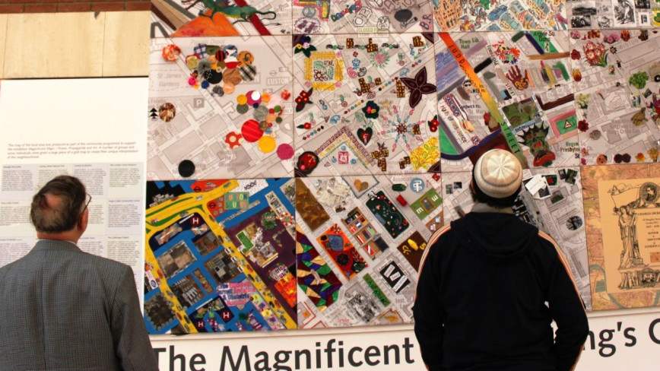
Year 6
What does it mean to be British? PSHE & geography led
1. Locate countries (focus on Europe& N. and S. America), environmental regions, physical and human features, countries and cities
2. Name & locate countries of the UK, regions, features & how some aspects have changed over time
3. Identify position & significance of latitude & longitude, Prime meridian and time zones
4. Understand similarities and differences of region of UK and region of Europe or N. or S. America
5. Describe and understand physical geography incl. climate zones, biomes, rivers, mountains, volcanoes, earthquakes and the water cycle
6. Describe and understand human geography incl. types of settlement and land use, economic activity including trade links, and the distribution of natural resources including energy, food, minerals and water.
7. Use maps, atlases, globes, computer-mapping to locate countries & features studied.
8. use the eight points of a compass, four and six-figure grid references, symbols and key (including the use of Ordnance Survey maps) to build their knowledge of the United Kingdom and the wider world
9. use fieldwork to observe, measure and record the human and physical features in the local area using a range of methods, including sketch maps, plans and graphs, and digital technologies.

