Slide 1
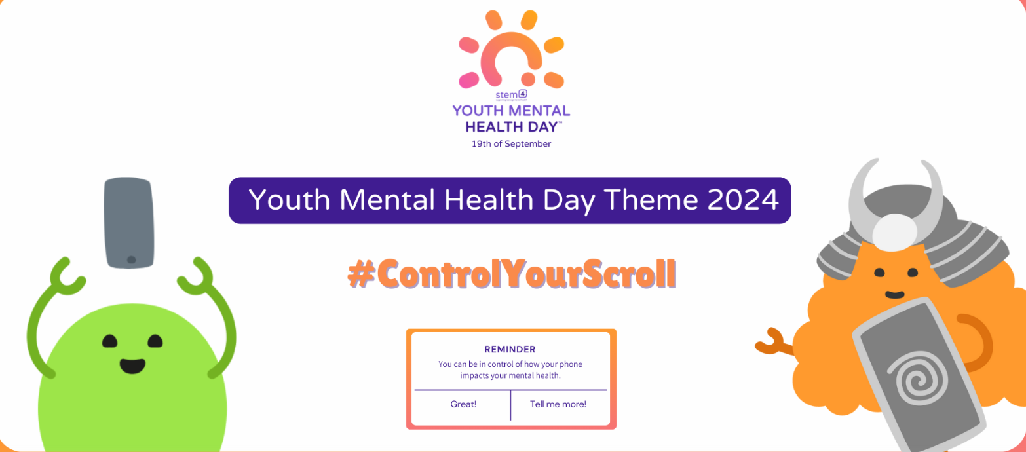

Slide 2


Slide 3


Slide 4
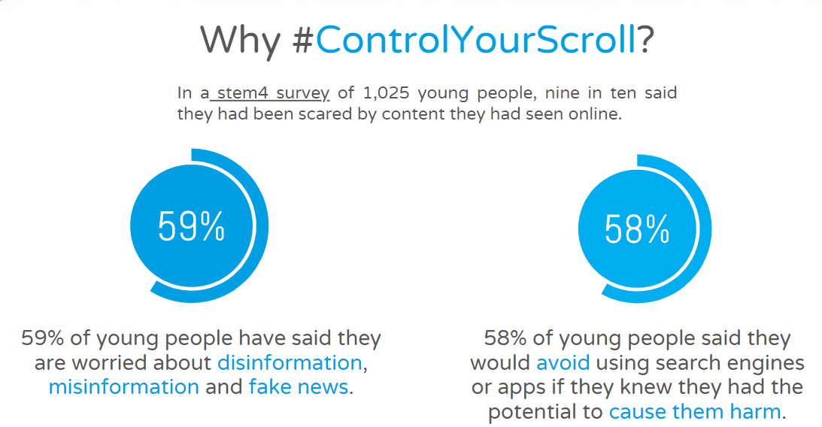

Slide 5
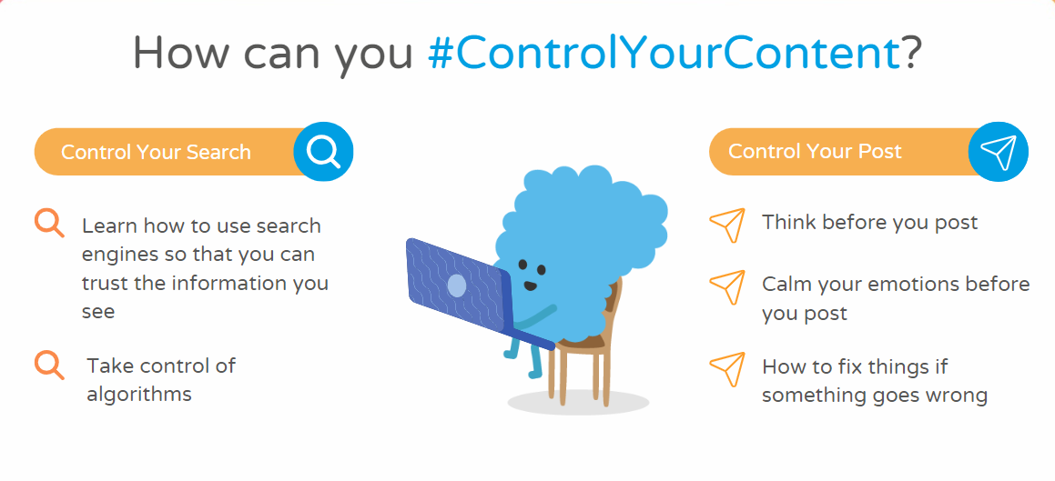

Slide 6
Think of three things you are thankful for…

Slide 7
Practice positive affirmations
“I am brave, I am hard working, I am special.”
We need to be kind to ourselves and tell ourselves how great we are.

Slide 8
Reflection
Hold in your mind a positive intention for the day, for example:
today I will be a good friend,
I will persevere with my times tables,
I will have fun at break and lunch and be kind

Slide 9
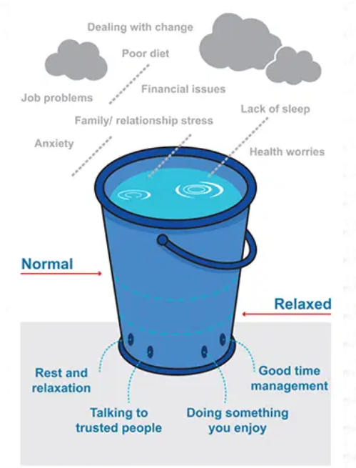
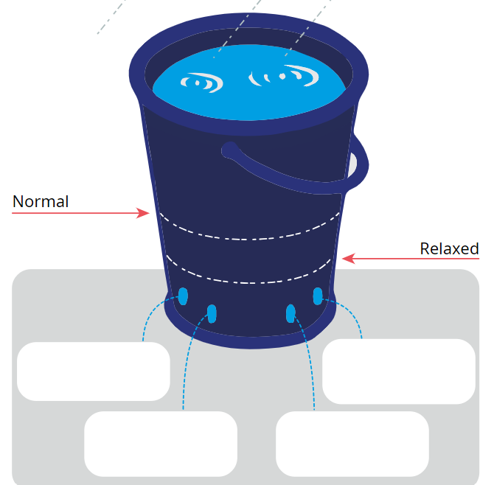
What do you do if your bucket fills up?

