Slide 1

Meet The Teacher
Welcome to Year 4
Mr Nicholl and Mrs Talyarkahn
Notes:
Record

Slide 2
Arrival and Dismissal
Morning Drop Off: 8.30am to 8.40am (to allow a natural stagger)
Pupils enter the school via front gate; make their way to their designated doors through the school playground, to their class
Registration is at 8.40am, pupils arriving after 8.40am will be marked as late
Afternoon Collection: 3.00pm to 3.10pm
Pupils will be released to attend after school clubs, or be collected from the classroom. Pupils can also be collected from the school gates with parental permission.
Notes:
Record

Slide 3
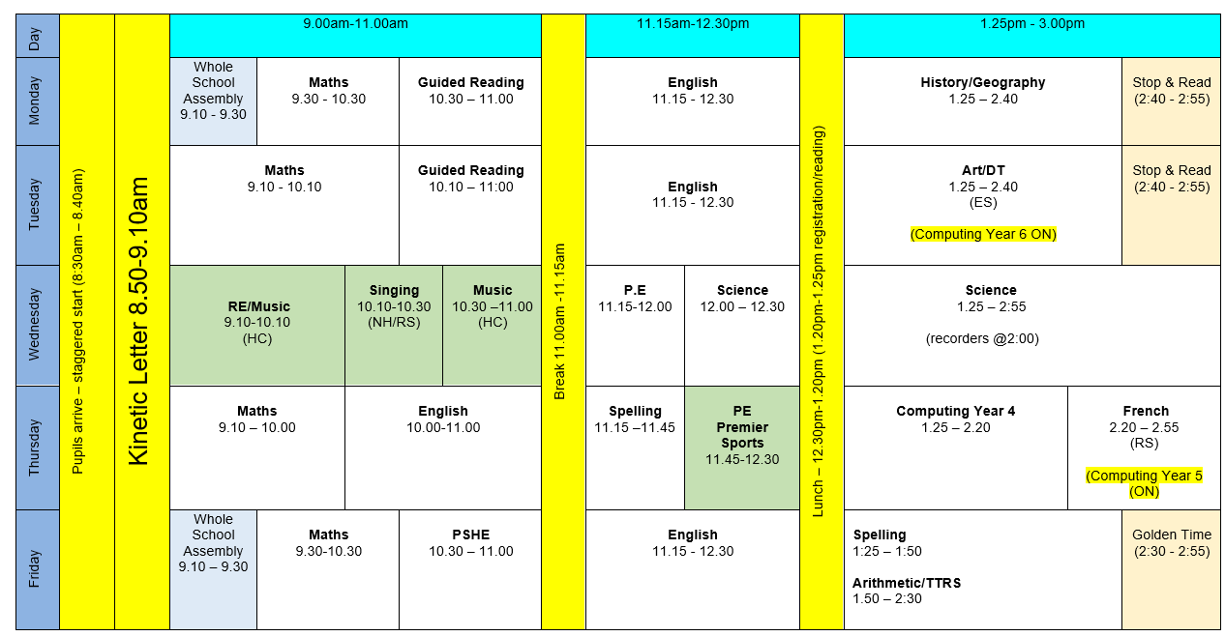
Timetable
Notes:
Record

Slide 4
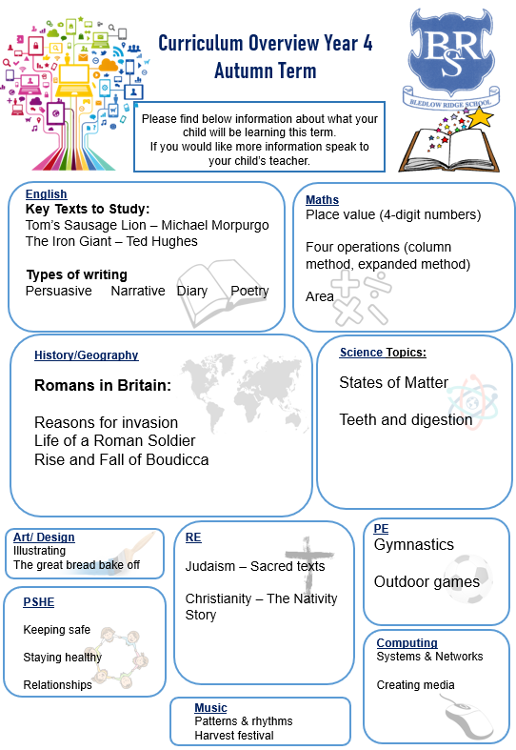
Termly Curriculum Overview
Notes:
Record

Slide 5
Equipment/what to bring to school
In Key Stage 2 (Years 3-6) every child will need to bring in a small clear pencil case with the following items. Please name items where possible.
    HB pencil
    rubber
    glue-stick
    ruler
    sharpener
    scissors
    colour pencils, felt tips, highlighters etc are optional
    School can supply a whiteboard and pen & purple pen
Notes:
Record

Slide 6
Homework
Maths:
Mathletics will be set on each Monday and will be accessible for the remainder of the term. The tasks will be linked to recent learning.
TTRS will be available for children to practise their tables – MTC in June 2026
Reading:
Children should read at least 3 times a week (or as often as possible) with a parent or carer.
Reading records should be signed by a parent/carer on these occasions.
Children can add if they have read independently.
Spellings:
Children will no longer receive a weekly spelling test.
Notes:
Record

Slide 7
Spelling at Bledlow Ridge School
New approach to spelling
Priority on School Development Plan
We are working with external literacy specialists
Focus: teach strategies, knowledge and skills pupils need to help them spell correctly, or to confidently ‘give it a go’.
There is little evidence that the traditional practice of learning spellings at home and being tested on them is effective.

Slide 8
Spelling
We use the No Nonsense Spelling scheme to support children in becoming confident, accurate spellers.
What is No Nonsense Spelling?
A structured programme that teaches spelling patterns, rules, and strategies
Focuses on understanding spelling, not just memorising words
Lessons include investigation, discussion, and practical activities
Our Aim:
To help pupils apply their spelling knowledge in their writing — not just learn words for a test.

Slide 9
What does spelling look like at BRS?
Two 20 minute lessons per week dedicated to teaching spelling skills
What will be sent home?
No weekly spelling list or weekly test
In Year 4 we will be focusing on a variety of concepts throughout the year including:
The alphabetic concept (upper and lower case), hearing and identifying syllables in words, understanding long and short vowels and reading syllables with open and closed vowels, prefixing and suffixing words.

Slide 10
PE
PE lessons are on Wednesday and Thursday (Premier Sports).
Children can wear their PE kit to school and remain in their PE kit for the duration of the day.
PE Uniform:
  White polo shirt
  Navy blue shorts
  Trainers (not plimsoles)
  Plain navy-blue tracksuit top
  Plain navy blue tracksuit trousers
  Swimming is in the Summer term and replaces Wednesday’s
  PE lesson. Swimming typically on a Tuesday – exact dates and
  times communicated before Easter.
Notes:
Record

Slide 11
Teaching and Learning
Curricular targets for English (writing) and mathematics
Every child has targets for writing and mathematics.
Writing targets match the year group National Curriculum objectives
Children have a copy of targets in their Maths and English books.
The target sheet is used to help each child understand the progress they are making.
Notes:
Record

Slide 12
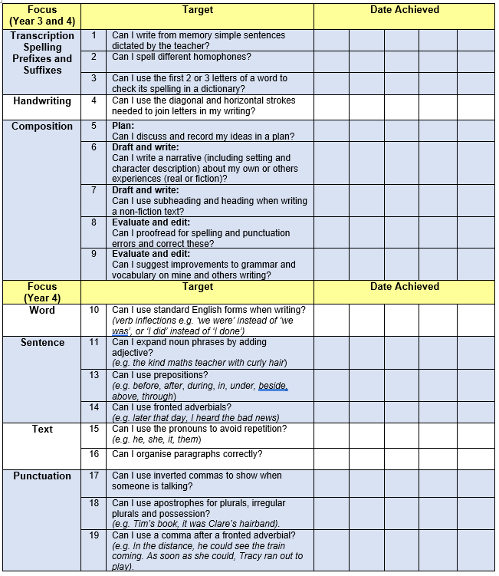
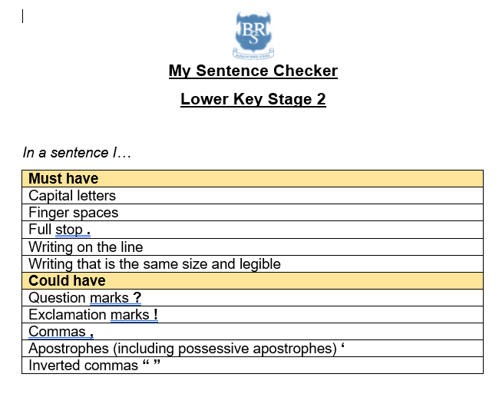

Slide 13
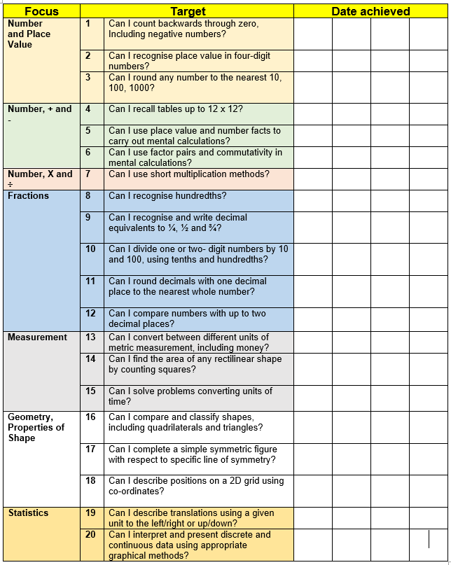

Slide 14
Teaching and Learning
Teacher Feedback
Research shows that the most effective feedback is given verbally, ‘in the moment’ – this will be evidenced as a ‘VF’ or ‘WS’ in pupils’ books
Adults may also sometimes provide written feedback and modelling in pupils’ books using a green pen
We expect pupils to respond to feedback given by adults. We ask the pupils to do this in purple pen to help them and the adults see the corrections/edits
Notes:
Record

Slide 15
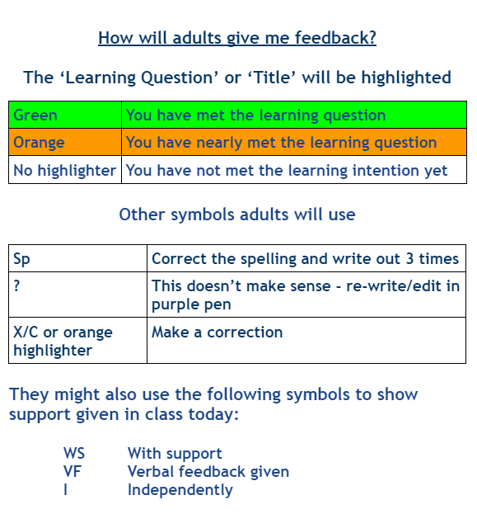

Slide 16
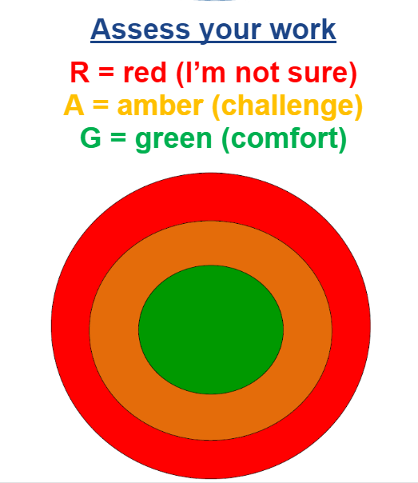

Slide 17
How We Assess Your Child’s Learning
Formative Assessment – Ongoing and Everyday
Formative assessment happens all the time in the classroom. It helps teachers understand what your child knows and what they need help with.
Examples include:
Marking and feedback
Observing how children work in class
Listening to responses in discussions
Guided reading and group work

Slide 18
How We Assess Your Child’s Learning
Summative Assessment – End of Term/Unit Summative assessments take place at set points in the year (Autumn, Spring and Summer) and give a more formal overview of learning.
At our school, we use:
PIRA (Progress in Reading Assessment)
PUMA (Progress in Understanding Mathematics Assessment)
These will be complete WB: 24th November

Slide 19
What Are PIRA and PUMA?
Nationally standardised tests
Provide a standardised score that shows how your child is performing compared to national expectations
Help us track progress across the year
Support teacher judgements when reporting to you
How Do These Assessments Help?
Identify gaps in learning
Inform planning and support
Contribute to teacher assessment, which includes classwork, effort, and wider knowledge

Slide 20
How We Monitor Your Child’s Learning
At the end of each term, we hold Pupil Progress Meetings with senior leaders (Mrs Harrison, Mrs Stanley, our Deputy Headteacher and Miss Grimaldi our SENDCo).
Every single child is discussed individually
We review:
  Their current attainment
  Whether they are on track with their learning
  What support they may need if they are not on track
  These meetings help us ensure that no child is overlooked and that we can quickly put the right support in place where needed.

Slide 21
Reporting to You
We use both formative and summative assessments to provide a full picture of your child’s learning.
You will hear about your child’s progress through:
Parents' evenings (October and March)
End-of-year reports
Informal conversations and updates
Support Plan reviews and termly meetings for pupils on the Special Educational Needs register

Slide 22

How can parents help?
Read, read and read some more!
Statistic: Parents who read 1 picture book with their children every day provide their children with exposure to an estimated 78,000 words each a year.
Cumulatively, over the 5 years, it is estimated that children from literacy-rich homes hear a cumulative 1.4 million more words during storybook reading than children who are never read to.​
https://schoolreadinglist.co.uk/
https://www.buckinghamshire.gov.uk/libraries/library-membership/join-library/
Notes:
Record

Slide 23


Slide 24
How can parents help?
In June, Year 4 pupils will complete a Multiplication Tables Check (MTC)
The MTC is an on-screen assessment designed to determine whether pupils are able to fluently recall their multiplication tables up to 12, through a set of timed questions
The official check consists of 25 questions. Pupils will have 6 seconds to answer each question, with 3-seconds pause between questions
Regular TTRS sessions (10-15 mins) will help pupils to consolidate their speed and accuracy of recall
There will be a specific presentation on the MTC in the Summer term
Notes:
Record

Slide 25
How can parents help?
Regular attendance is key – 95% is the minimum expectation Pupils whose attendance is of concern will be invited to discuss this in order that the school can support parents and pupils.
Number bonds and times tables – practise these everywhere
Practise telling the time (digital/analogue)
Communication! Please come and talk if you have any concerns/questions
Notes:
Record

Slide 26
Any questions?
Notes:
Record

