Slide 1

Year 6 SATs and Residential Meeting
January 2023
Helping you and your child prepare for the SATs

Slide 2
What are the Key Stage 2 SATs tests?
Statutory Assessment Tests
Designed to test children’s knowledge, skills and understanding in English and Mathematics
Provide a “snapshot” of a child’s attainment at the end of Key Stage 2

Slide 3
When are the tests administered?
All the tests will be taken in the classroom, some children will have adult readers for the reasoning and SPaG papers
The tests will take place on Tuesday 9 May – Friday 12th May
Tuesday 9th May | English Paper 1: SPaG English Paper 2: Spelling
Wednesday 10th May | English Reading Paper
Thursday 11th May | Maths Paper 1: Arithmetic Paper Maths Paper 2: Reasoning Paper
Friday 12th May | Maths Paper 3: Reasoning Paper

Slide 4
How will writing be assessed?
Writing will be assessed through teacher assessment:
  Throughout the year we assess the children’s writing on a regular basis
  Writing is assessed through all genre types
  Writing targets and steps to success help children to know what they need to include in their writing

Slide 5
How are the tests administered?
Test papers are not seen by school staff prior to the test
Pupils take the tests in classrooms
Access arrangements
Children have to work independently and unaided
Questions in numeracy and the grammar test may be read out to an individual pupil
Pupils who have an EHCP or statement will receive 10% extra time.

Slide 6
How can parents help?
From Friday, children will receive some arithmetic homework and comprehension homework in addition to spellings.
Encourage your children to read at home and to bring their reading record in every Friday.
At the end of this meeting, please take home a sample pack of questions to look through with your child.

Slide 7
Receiving and interpreting results
Tests are marked externally
Results will be shared with parents
Child will achieve a level of:
    Working below expected standards
    Working at expected standards

Slide 8
How are we preparing the children in school?
Practising tests – November, February and April
Working through past paper questions in class including looking at model answers
Extra intervention sessions to help children to make progress
Breakfast club in the hall before school during SATs week

Slide 9
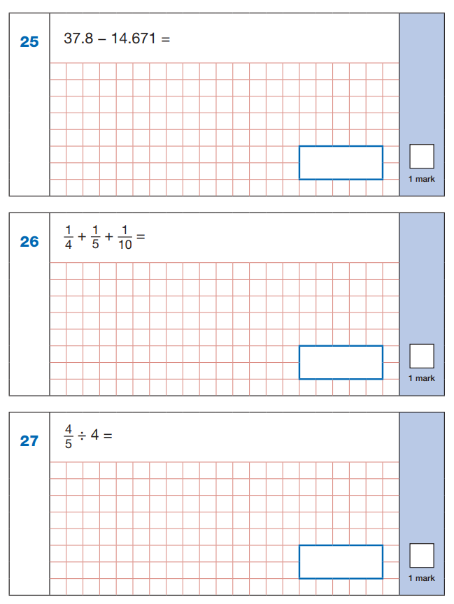
What children are required to do: Arithmetic test
Under time pressure (30 minutes)
Recall of all of 4 operations
Using and applying known facts (e.g. x tables, metric conversions, calculating fractions and percentages)
Use a range of strategies
36 questions a maximum of 40 marks

Slide 10
What children are required to do: Maths Test (40minutes)

Slide 11
What children are required to do:
Reading Paper (60 minutes including reading time)

Slide 12
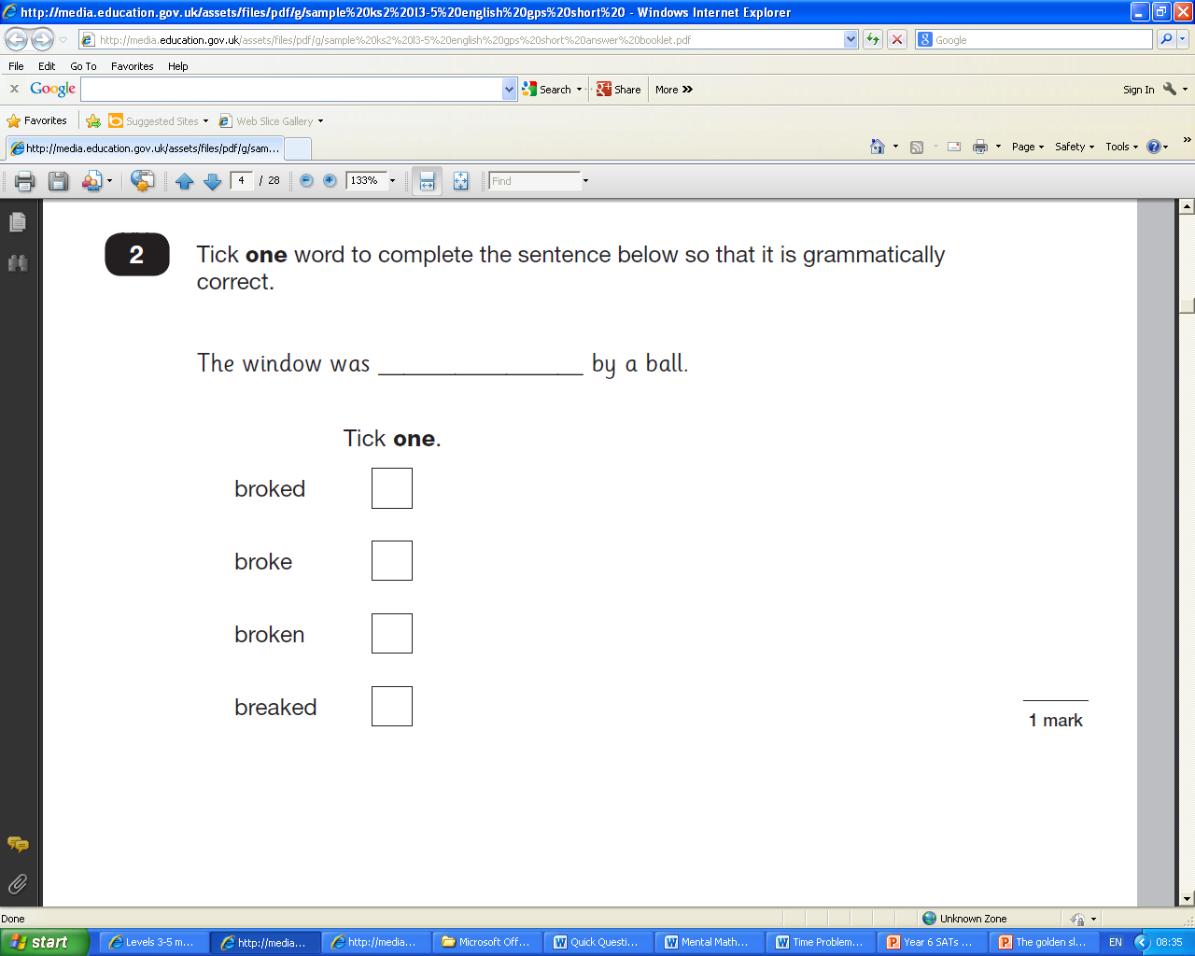
What children are required to do:
Grammar, Punctuation and Spelling (45 mins)

Slide 13
During the week of the tests
Holidays should not be taken during the “run-up” to SATs or during the SATs week
Unless absolutely unavoidable, children should be in school- levels will not be awarded if a test has been missed
Be positive! Children shouldn’t feel worried or anxious, but they need to understand that the tests are important
Make sure children have enough sleep, a good breakfast and plenty of water to drink
Life should carry on as normal

Slide 14

Hilltop Residential

Slide 15
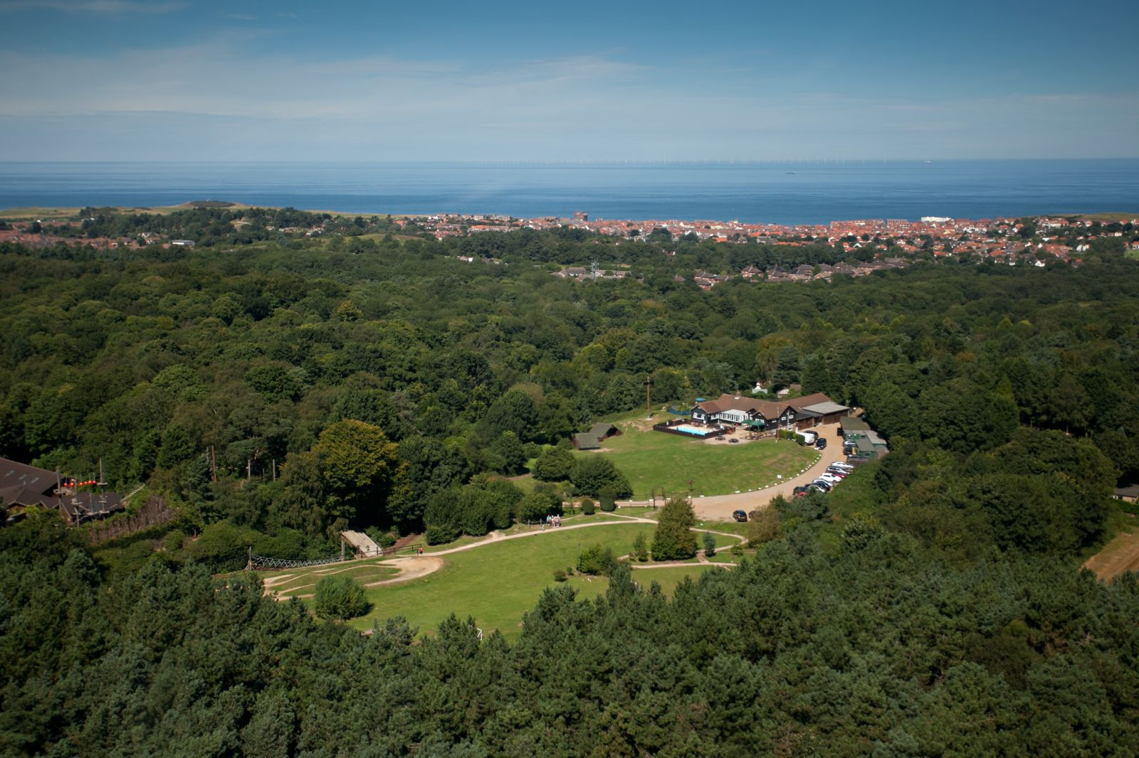
Where are we going?
Sherringham in Norfolk
Set in 26 acres of picturesque woodland.
Close to the coast.
Lots of fantastic facilities.

Slide 16
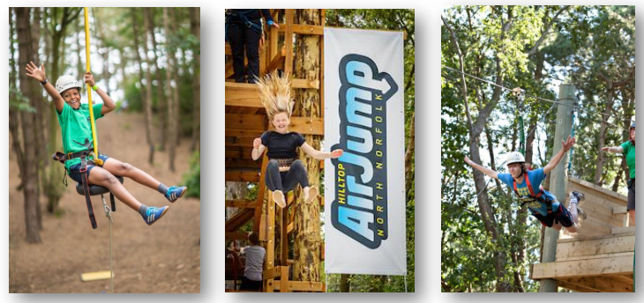
Activities
Hilltop will design an activity schedule for us which contains activities to support our Geography work as well as outdoor and adventurous activities.
Examples of the activities we will be taking part in include:
  Coastal erosion activities on the beach
  Bush craft
  Assault Course
  Tree top trail
  Climbing wall
  Abseiling
  Air jump

Slide 17
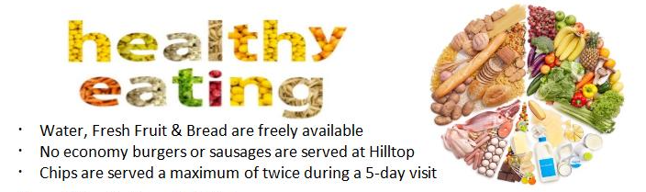
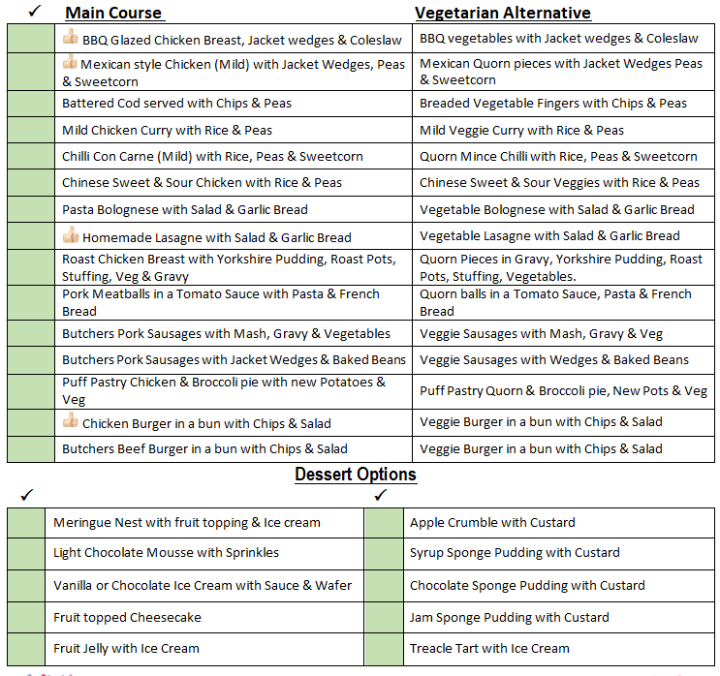
Meals

Slide 18
Accommodation
Children’s bedrooms have between 2-10 beds with the majority accommodating 4-6 children. Rooms are either en-suite or have facilities close by. Each bed is fitted with a waterproof mattress protector and a pillow and pillowcase are provided. Night lights are built in to children’s rooms via a ceiling light.
Children’s bedding is NOT provided – please ensure each child brings a sleeping bag or duvet and duvet cover with a fitted sheet and their own towels.
Pupils will be given opportunity to choose name of a friend they would like to share with.

Slide 19
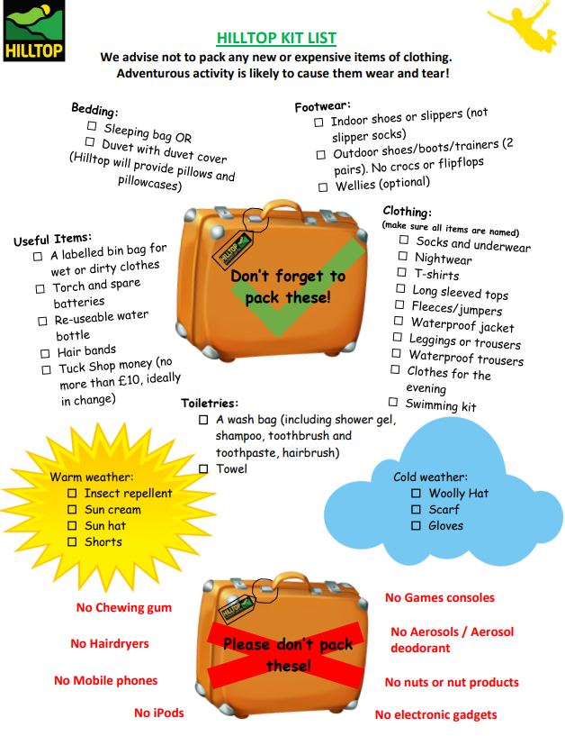
Kit List - clothes
No need to buy new clothes

Slide 20
Bledlow Ridge School Staff
Bledlow Ridge School Staff: Pupil ratio = 1:8
Mrs Stanley- Y6 teacher, Deputy Head
Mrs Lyons– Y6 teacher
Ms Picasso- Year 6 TA
All activities are led by trained instructors, school staff remain with groups at all times.

Slide 21
Medical Issues
A form will be given out at then end of this meeting where you can add any medical/dietary needs
All medication to be brought to school in labelled plastic bag with relevant paperwork completed.
Staff available to discuss any personal issues in private

Slide 22

Letters to the children
Hilltop welcomes letters from parents, please ensure that envelopes are clearly addressed and include the child’s name and the name of their school to assist with distribution of mail.
Hilltop E-telegram Visit: www.hilltopoutdoorcentre.co.uk/e-telegram Passcode: ht95432b

Slide 23
Questions

