Slide 1


Slide 2

Curiosity
Everyone is open to learning new things about themselves, all that surrounds them and how the two fit together.

Slide 3

Health
Everyone has the skills and tools to maintain a healthy balance of their mental, physical and emotional wellbeing.

Slide 4

Confidence
Everyone believes in themselves, stands up for what is right and has the confidence to reflect and learn from their actions.

Slide 5

Resilience
Everyone keeps trying to better themselves, even when things are difficult or when we make mistakes.

Slide 6

Empathy
Everyone is kind, caring and considerate of the feelings of one another.

Slide 7

Respect
Everyone treats our environment with respect and appreciates the cultures, beliefs and views of one another.

Slide 8
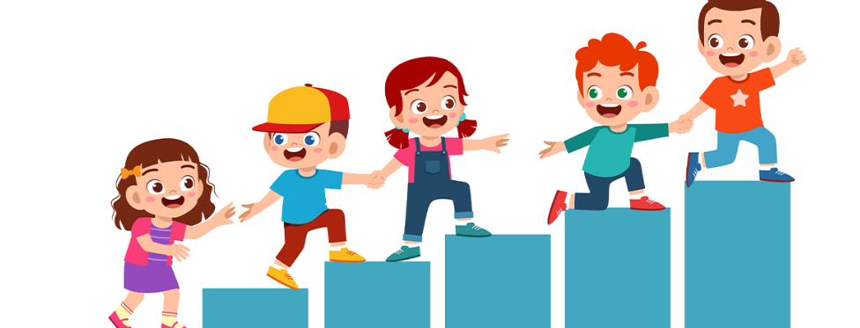
Pupil Leadership Teams
Why do we have Pupil Leaders at Bledlow Ridge School?

Slide 9
Black History Month Assembly
Primary School Presentation

Slide 10
What is Black History Month?
- A time to celebrate the achievements of Black people
- Remember their contributions to history, culture, and society
- Learn from the past to build a better future

Slide 11
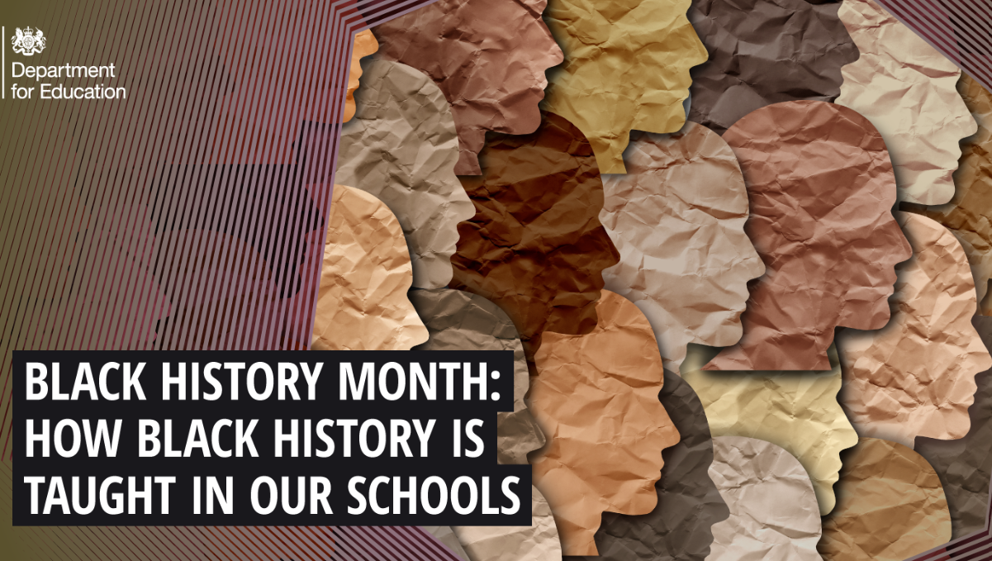
Why Do We Celebrate?

Slide 12
Why Do We Celebrate?
- To recognise important leaders and role models
- To learn about equality and fairness
- To be inspired by stories of courage and strength

Slide 13
What does this mean?
‘equality’

Slide 14
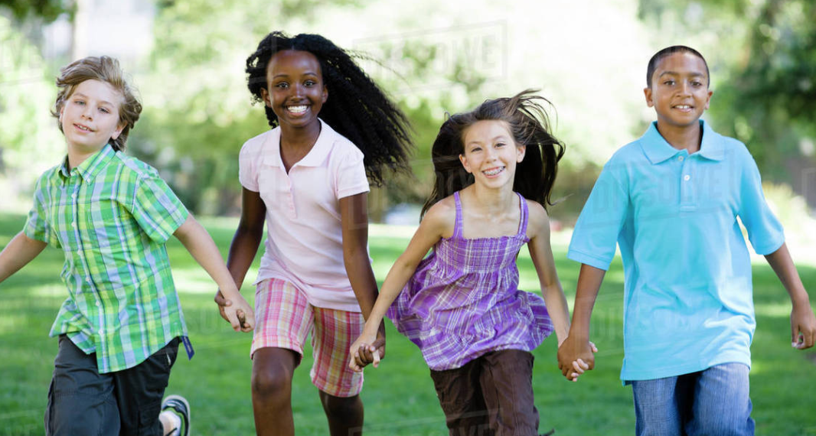
What does this mean?
‘equality’
Treating everyone fairly.
Making sure everyone has the same chances.
Respecting people no matter their skin colour, religion, gender, or background.
Equality means everyone matters
9 protected characteristics

Slide 15
Famous Black Figures
- Martin Luther King Jr. – fought for civil rights
- Rosa Parks – stood up for equality on a bus
- Mary Seacole – nurse who cared for soldiers
- Barack Obama – first Black President of the USA

Slide 16
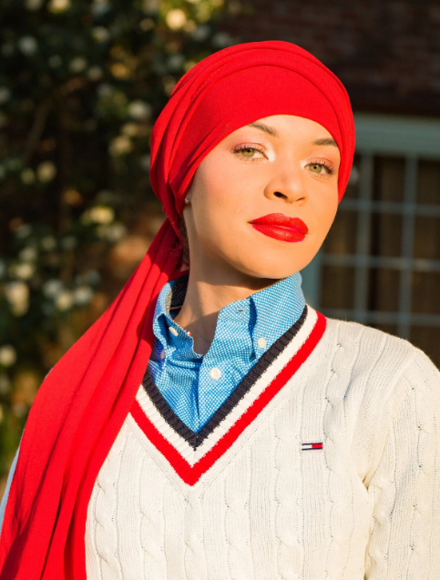
Blair Imani
Blair Imani is an American author, historian, educator, and activist.
Known for speaking out about racism and injustice; she was arrested while protesting
Has written and taught about history
Her work encourages young people to learn history, stand up for fairness, and believe their voice matters.

Slide 17
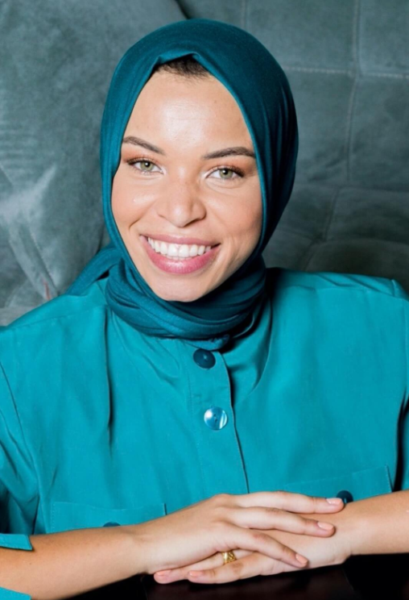
Blair Imani
- Born in the USA in 1993
- Historian, author, and teacher
- Helps people learn about history in a fun and easy way

Slide 18
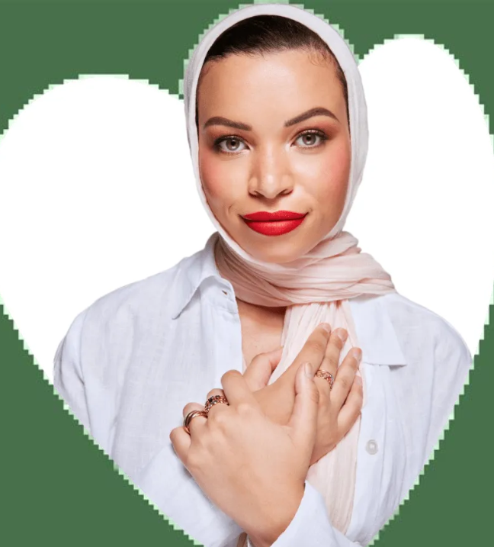
What Did She Do?
- Speaks up for fairness and equality
- Teaches about race, gender, and identity
- Creates short videos called 'Smarter in Seconds'

Slide 19
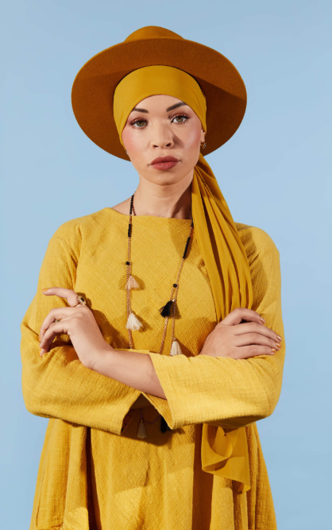
Why She Inspires Us
- Teaches us to be brave
- Reminds us to be kind and fair
- Shows us we can use our voices to help others

Slide 20
Reflection
How can we use our voices to make school and the world a fairer place?
- Show kindness
- Be fair
- Speak up if something is wrong

Slide 21
Closing Thought
Black History Month reminds us to celebrate diversity, learn from the past, and create a fair and equal future.

Slide 22
Pupil Leaders
School Council
House Captains
Head Boys and Head Girls
Eco Team
Sports Leaders
JRSOs
World Friendship Ambassadors

Slide 23
Celebrating Differences
- Diwali is known as the Festival of Lights
- Celebrated by Hindus, Sikhs, Jains, and some Buddhists
- A time of joy, family, and traditions

Slide 24
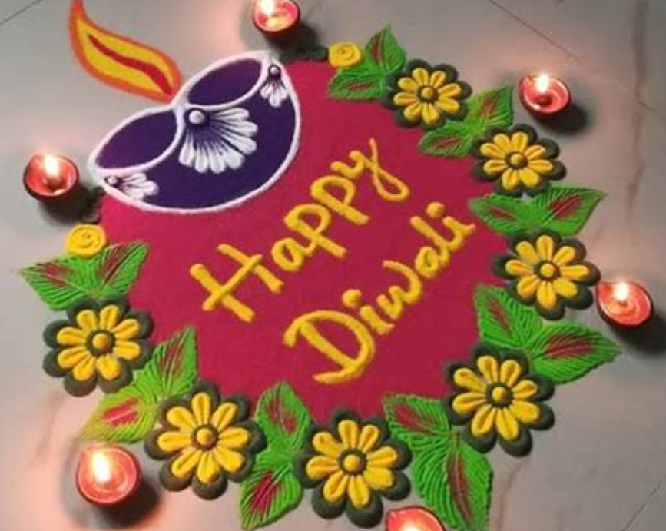
How is Diwali Celebrated?
- Families decorate homes with lights and rangoli
- People exchange sweets and gifts
- Fireworks and celebrations take place
- Many visit temples to pray

Slide 25
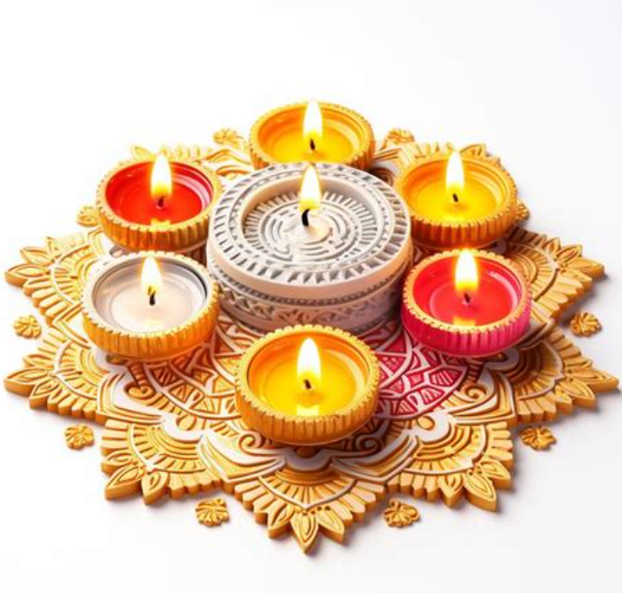
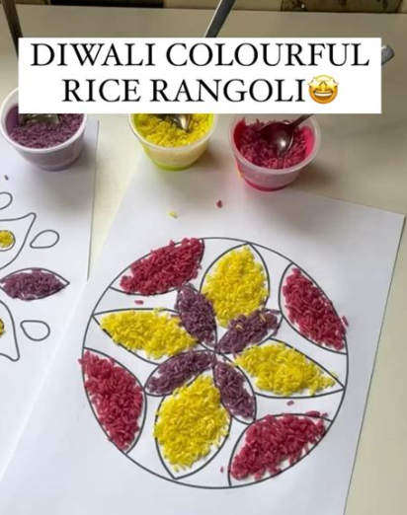
Symbols of Diwali
- Diyas (oil lamps) and candles
- Rangoli patterns
- Fireworks
- Sharing food and sweets

Slide 26
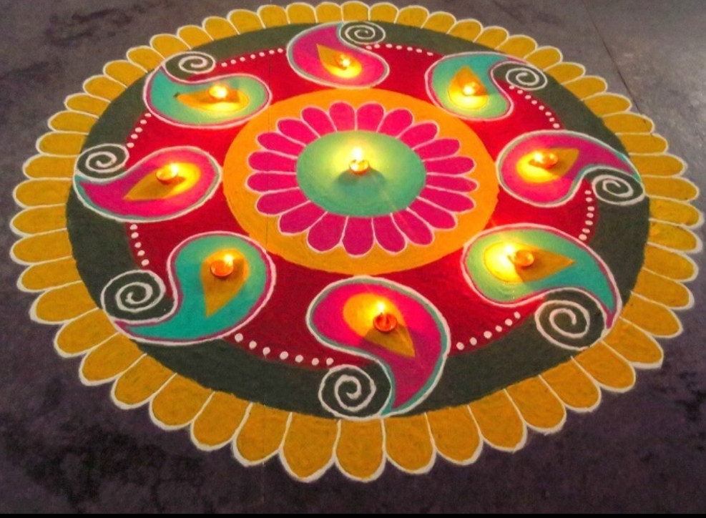
Values of Diwali
- Light over darkness
- Goodness over evil
- Knowledge over ignorance
- Hope for a brighter future

Slide 27
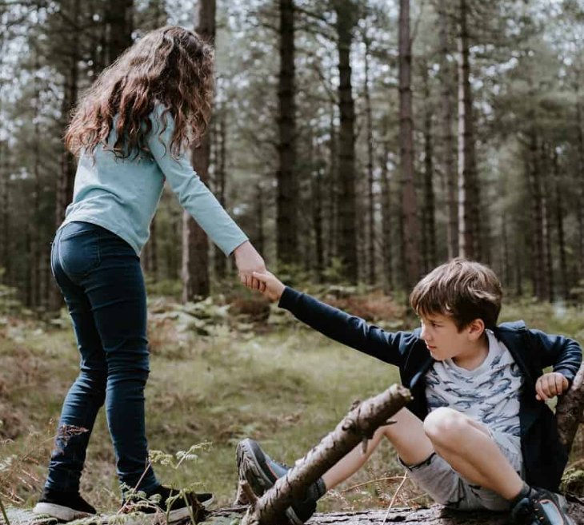
Reflection
- How can we bring light into other people’s lives?
- Can we be kind, helpful, and caring each day?
Diwali reminds us to celebrate goodness, share joy, and bring light to the world around us.

