Slide 1
By Year 2

Slide 2
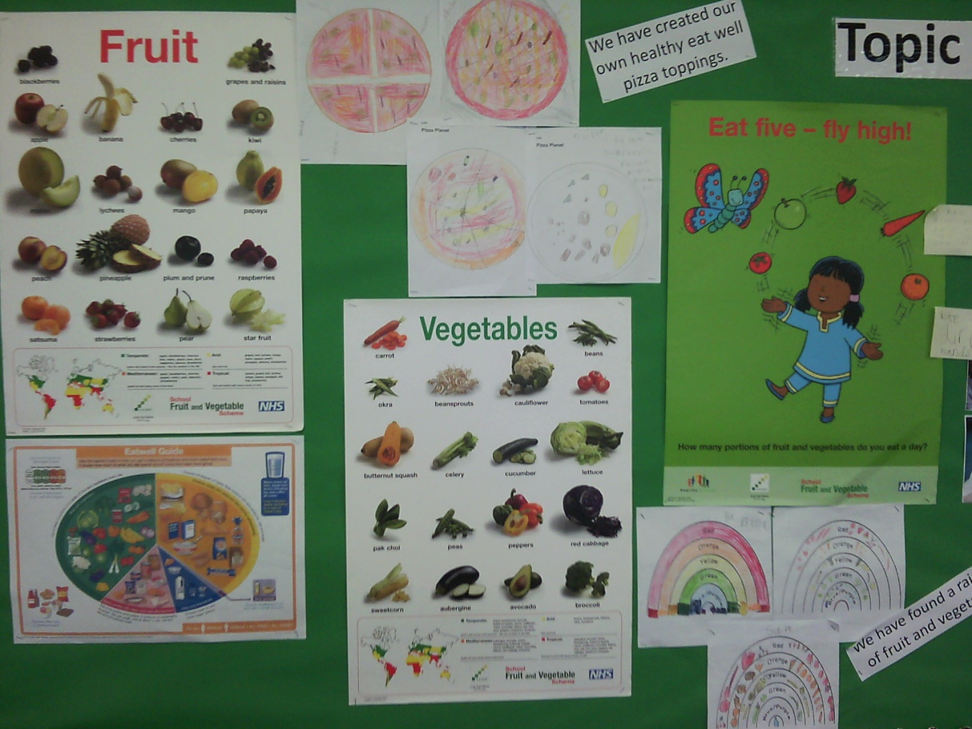
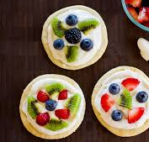
We learnt about how to keep our bodies healthy by thinking about how much we eat, where we eat and what we eat. Using the Eatwell Plate we designed pizzas that had something from every portion.
We also designed and made a fruit and vegetable rainbow, which we turned into recipe cards (instruction writing).
To finish our food section, the children had a selection of colourful fruit (including some tropical fruits that they might not normal tasted) to eat on top of a biscuit base.
These were our fruit pizzas.

Slide 3
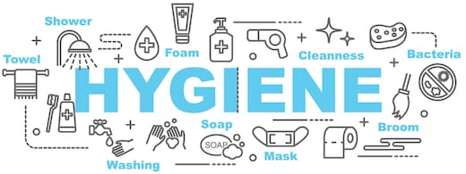
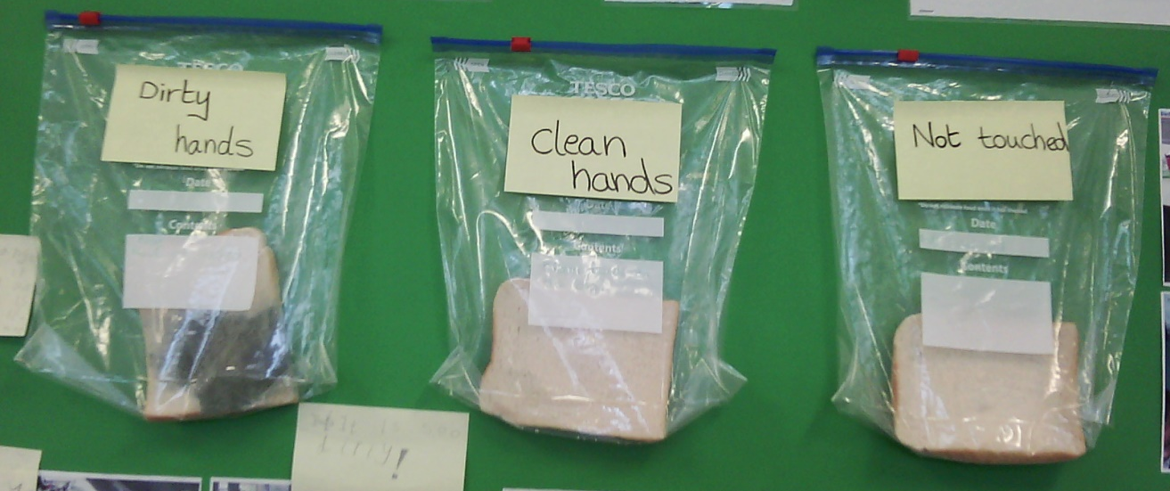
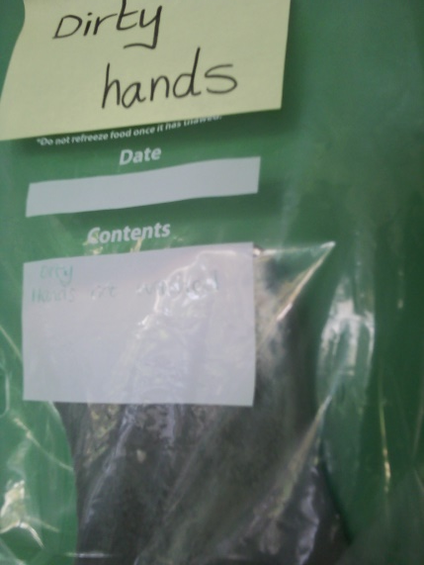
In our books we were able to show how we could stay hygienic and we created a science experiment using some bread. We also learnt about how to make predictions and later to conclude our results and observations.
Mrs Laight (a retired nurse) came to into school to tell us about her time as a nurse and to show us how easily germs can be spread by using two colours of chalk on their hands.
We created a question together – How far can germs fly? – and investigated with some spray bottles and watery paint. We discovered that the spray (like from our noses) travelled a lot further than we predicted!
A scientist told us that a sneeze can travel up to 200 feet. Longer than every though before. Yuck!

Slide 4
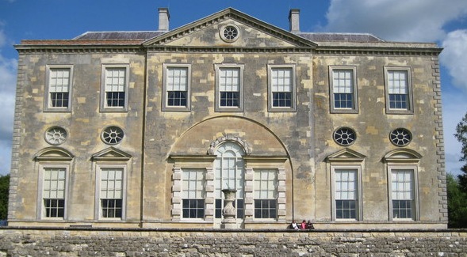
We decided to learn about a famous person in history that helped people become aware of hygiene and cleanliness. We decide on Florence Nightingale and Mrs West also taught us about Mary Seacole (Mother Seacole) too.
To start our topic about Florence Nightingale, Mrs West got us to go on a fact finding hunt. We had to find time capsules with key facts about Florence hidden outside. “Florence Nightingale was born in 1820, it Italy, in Florence. She helped to heal the soldiers but some did die” (Isla Palmer).
To find out more about Florence and experience what it would have been like during her time in history, we all went to Claydon House (Florence’s sisters house) to be soldiers and nurses. We really enjoyed it!
When we got back we used all our new knowledge to write up facts about our trip.

Slide 5
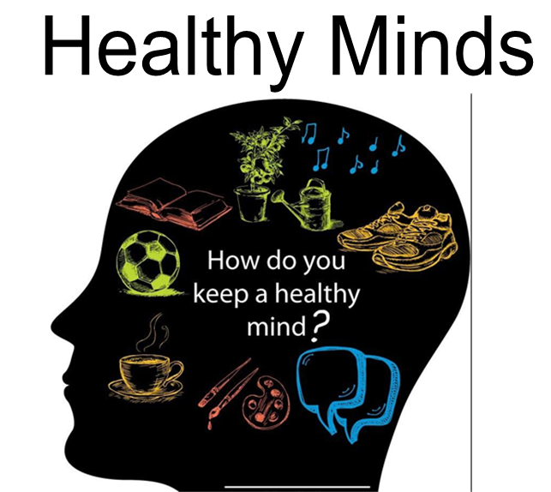
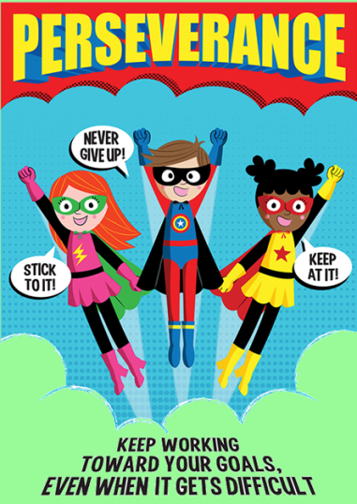
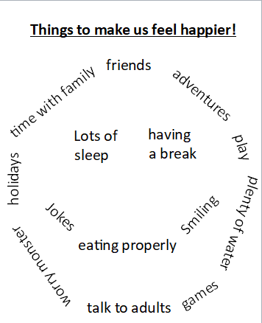
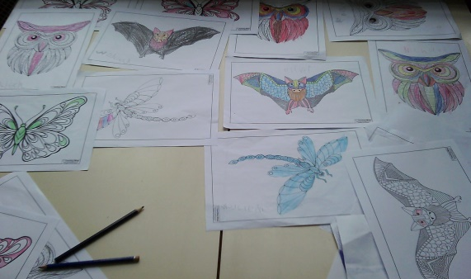
We linked healthy minds to being an active learner who acts like a super hero.
We learnt about how to keep our minds healthy and that it is very hard to tell how people are feeling unless they show it on their faces. We agreed that we want to feel happy but sometimes we don’t and that’s okay too. We know that it is good to cry and show our emotions as otherwise they can fill up and over flow.
We made a list of all the things that were important to help us feel happy. Mrs West then wrote our list into a smiley face poem.
We took time to have a break and complete some mindful colouring.
We talked about worries and being happy with who we are as a person through monsters and videos.

Slide 6
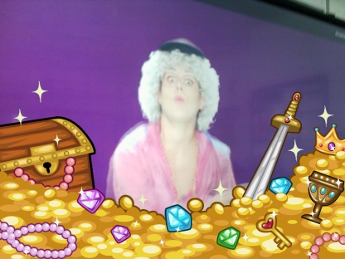
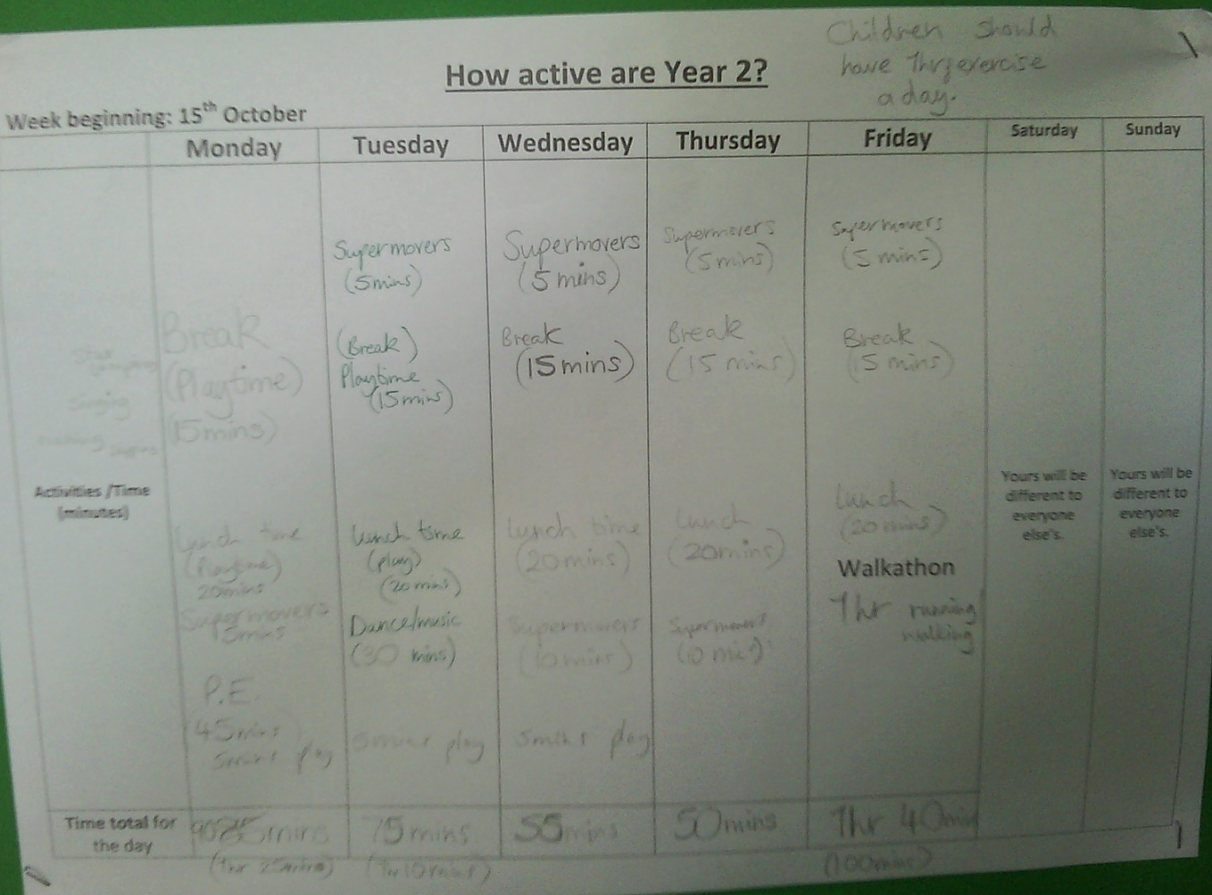
Being Active
We do a super movers very day.
We discovered that children need 1hr of exercise everyday, so we filled in a table of exercise for each day of our last week at school.
In P.E. we have been looking at why we warm-up and cool-down our bodies.
In our last week, we tried several different forms of exercise in a circuit. We exercised for 45mins and discussed whether we wanted to exercise at once or build it up throughout the day.
We finished the week with an 1hr walkathon, were some of us ran or walked round the school field.

Slide 7
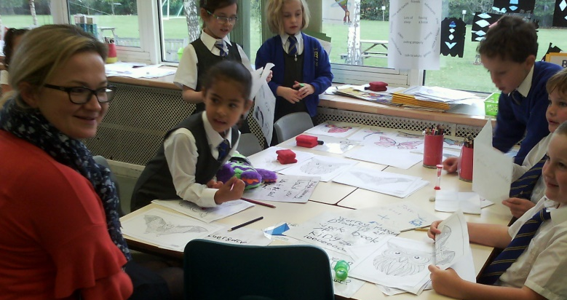
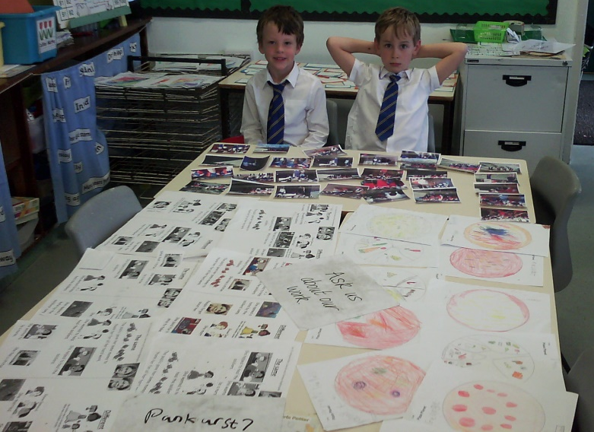
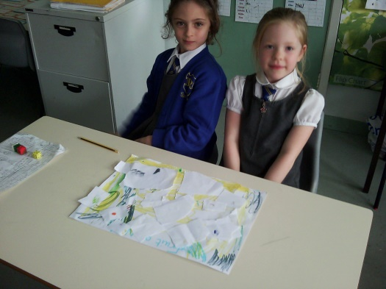
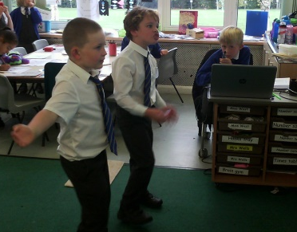
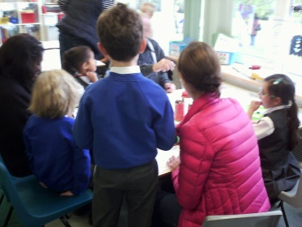
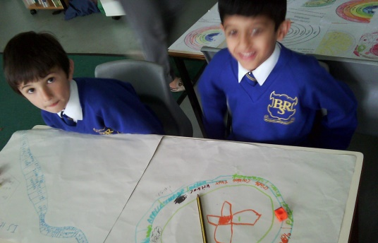
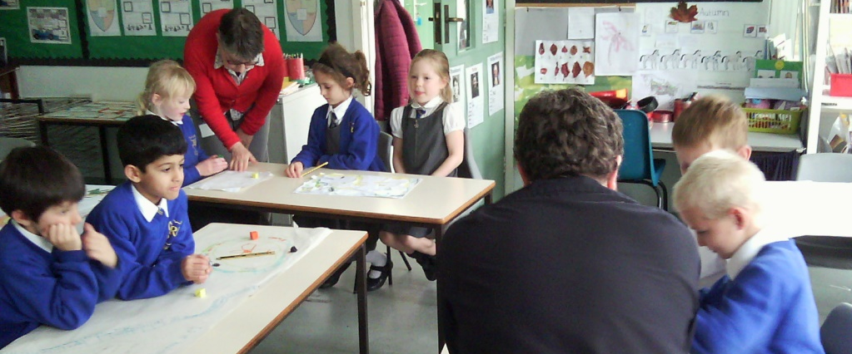
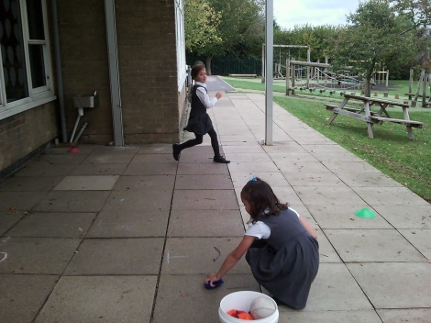
Our class showcase
In our last week, we held a showcase of all our work to parents. In addition to our work, we wanted to add some games into our showcase. The food group made some food related games, whilst healthy minds made joke books and used timers to see how long it took them to make someone laugh.
The fitness group created fitness games outside and had a ICT technician playing super movers on the whiteboard inside for parents and children to move to. The hygiene group made some new facts for parents to hunt for and took them to see our Trip Fact file.

