Slide 1
Games
Can drop and catch a ball with consistency. Can bounce a ball on the spot with consistency. In pairs, play a ‘roll-receive’ rallying game. In pairs, play a ‘throw-catch’ rallying game.
Gymnastics
Answer a given task, eg. Perform a roll, then a jump, then a balance, with appropriate, controlled actions.
Gymnastics
Create and perform a short sequence linking basic actions, with a clear beginning, middle and end. Plan and perform a movement sequence showing contrasts in speed, level and direction.
Games
Can travel whilst bouncing a ball, showing control. In pairs, make up and play a simple rallying game.
Dance
Responds imaginatively, and with control and co-ordination. Uses different body parts. Can vary dynamics, speed, direction and level of their movements.
Year One
Year Two
Dance
Can copy, explore and perform basic actions in response to teacher led stimuli. Choose and link actions to create an expressive dance phrase which shows some sensitivity to accompaniment.
Games
Can travel whilst bouncing a ball, showing control. Using either hand can dribble showing changes of speed and direction. Effectively play a competitive net/wall game.
Games
Can dribble effectively in and out of obstacle courses. Can consistently dribble past all active opponents. Play recognised version of net game showing tactical awareness and knowledge of rules and scoring. Attack and defend successfully showing appropriate positional play and awareness of opponent.
Year Three
Gymnastics
Perform a range of rolls showing varying entrances and exists with increasing control. Plan and perform with precision, control and fluency a movement sequence showing a wide range of actions including variations in levels, speed and directions.
Dance
Improvises freely, individually and with a partner. Can translate ideas from a stimulus into movement.
Year Four
Gymnastics
Plan and perform a movement sequence showing contrasts in speed, level and direction. Develop a longer and more varied movement sequence demonstrating smooth transitions between actions.
Games
Uses selected skills effectively under pressure. Use a range of techniques/tactics in adapting game plans. Performs with a high degree of difficulty using skills, techniques and ideas with precision.
Gymnastics
Perform a combination of skills showing consistent fluency and control. Create an original movement sequence, demonstrating an extensive range of gymnastic actions. Perform this sequence with control, fluency and clarity showing contrasts in speed, level and direction.
Dance
Perform with a growing sense of style showing more complex movement patterns and an awareness of musical accompaniment i.e. rhythm and mood. Perform a good range of technical movements with expression and accuracy.
Dance
Can perform and create movement motifs in a variety of dance styles with accuracy and consistency. Perform with a growing sense of style showing more complex movement patterns and an awareness of musical accompaniment i.e. rhythm and mood.
Dance
Compose group dances demonstrating the principles of choreographic form. Analyse professional, dance works and use to inform their practical choreography and performance
Gymnastics
Perform more complex sequences demonstrating clarity and a consistent high level performance. Select and use a range of skills and agilities that suit their level of performance.
Year Five
Year Six
Games
Can consistently dribble past all active opponents. Has established skills with consistent accuracy and control. Attack and defend successfully showing appropriate positional play and awareness of opponent. Contribute to team strategies.
Bledlow Ridge Curriculum Road Map-Physical Education (PE)

Slide 2
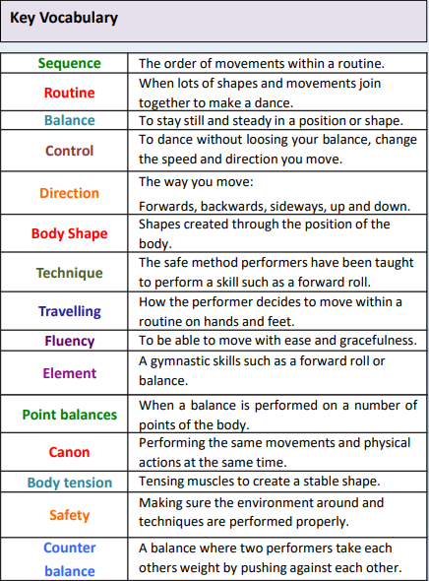
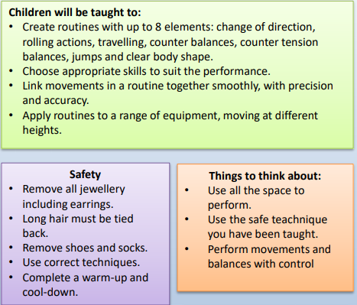
KS2

Slide 3
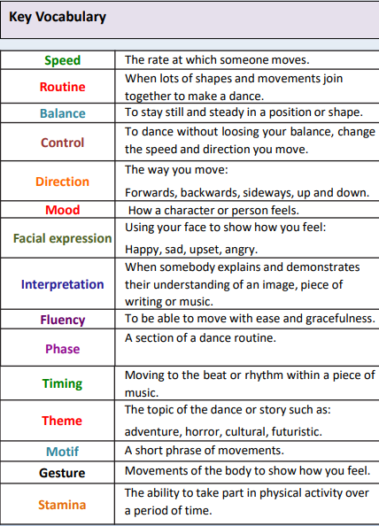
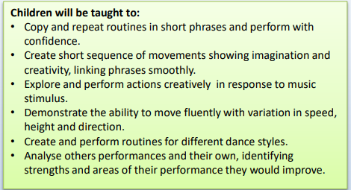
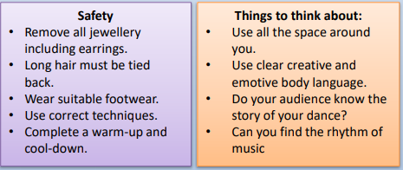
KS2

Slide 4
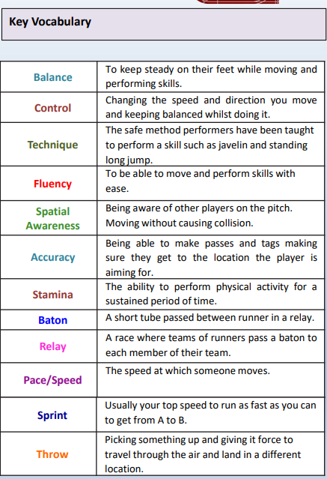
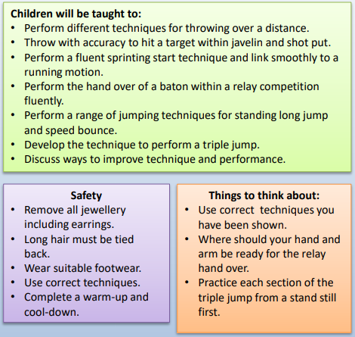
KS2

Slide 5
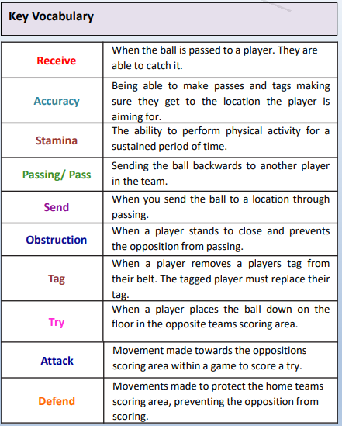
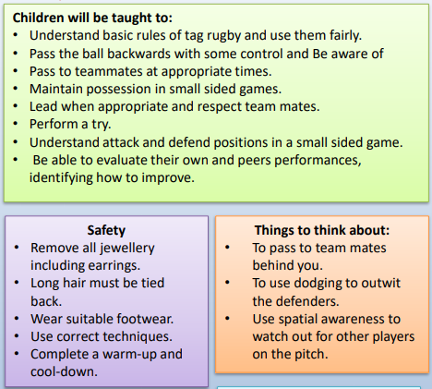
KS2

Slide 6
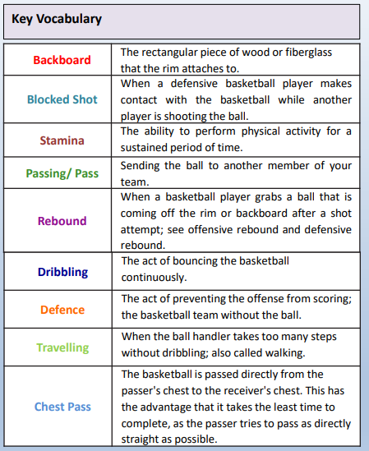
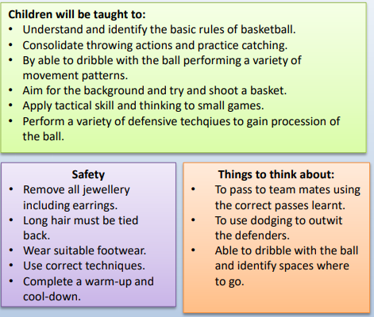

Slide 7
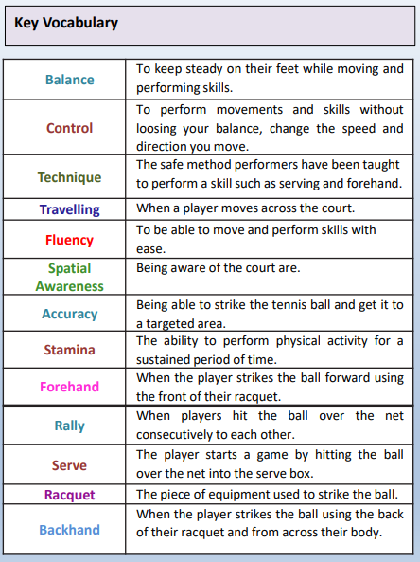
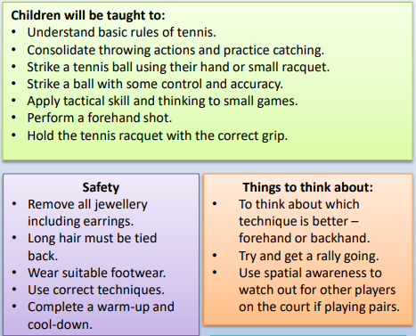

Slide 8
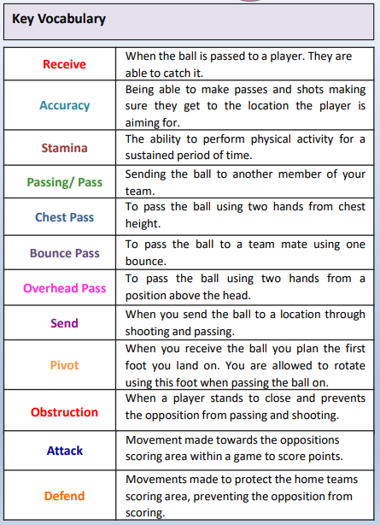
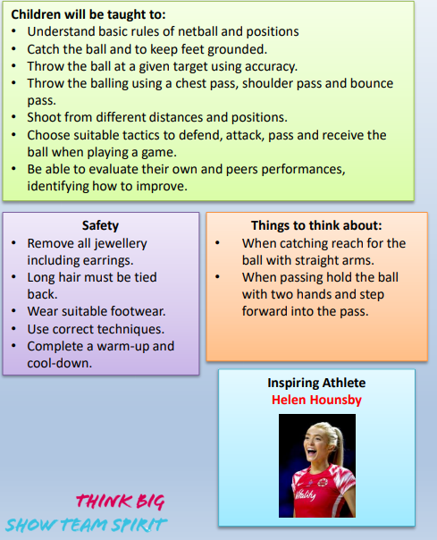

Slide 9
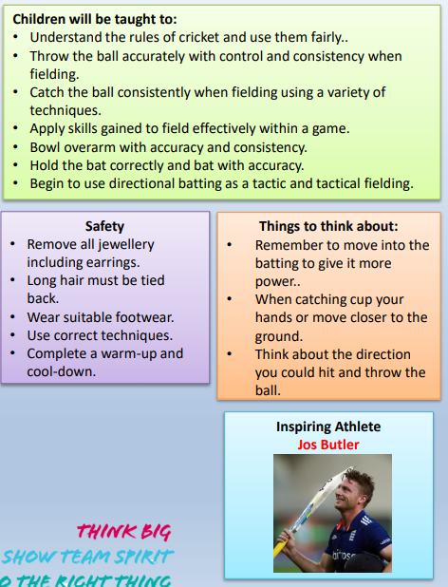
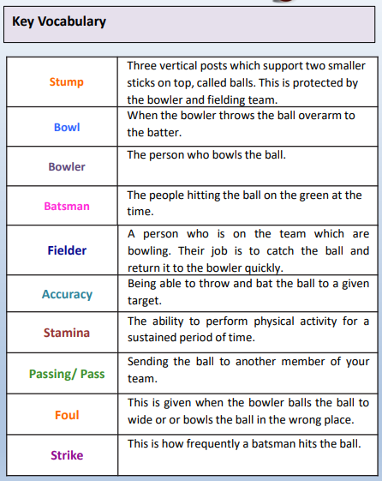

Slide 10
