Slide 1
Easter

Slide 2
Respect
Everyone treats our environment with respect and appreciates the cultures, beliefs and views of one another.

Slide 3
The most important Christian festival
Remember last week of Jesus’ life
The celebration of Easter starts on shrove Tuesday
Day before Lent – this is where Christians reflect on how they can be better Christians

Slide 4
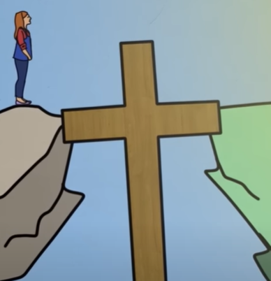
What is Lent?
Preparation for the celebration of Easter
Reminds Christians how sin separates us from God

Slide 5
Lent lasts for 40 days
From Ash Wednesday to the Saturday before Easter
Lent is a time of prayer and fasting to draw us closer to God

Slide 6
Reflection
Rather than give something up. Is there something you can begin?

Slide 7
Respect
Everyone treats our environment with respect and appreciates the cultures, beliefs and views of one another.

Slide 8
