Slide 1
'Meet The Teacher'
September 2022
Welcome to Year 2
Mrs Rankin and Mrs Parke
Notes:
Record

Slide 2
Arrival and Dismissal
Morning Drop Off: 8.30am to 8.40am (to allow a natural stagger)
Pupils enter the school via front gate; make their way to their designated doors through the school playground, to their class
Registration is at 8.40am, pupils arriving after 8.40am will be marked as late
Afternoon Collection: 3.00pm
All pupils will be collected from the outside door of their classroom.
Notes:
Record

Slide 3
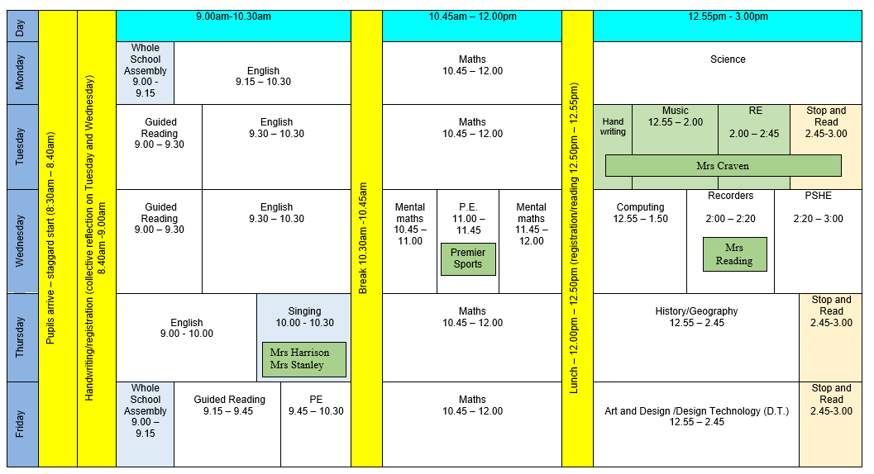
Timetable
Notes:
Record

Slide 4
Termly Curriculum Overview
Notes:
Record

Slide 5
Trips
Autumn Term trip:
Claydon House – September 22nd
Exploring the connection between Florence Nightingale and Claydon House. Finding out about nursing in the Crimea.
A visit from a Nightingale nurse – October 6th
Two nature walks in locality – visiting ‘Fiona’s garden’ to find out how her plants are doing and identify habitats
Spring Term trip:
A trip to Science Oxford – to further our studies about materials.
Two nature walks in locality – visiting ‘Fiona’s garden’ and observing changes in flora and fauna as we go
Summer Term trip: tbc
Notes:
Record

Slide 6
Homework
Maths homework will be set on Mathletics each Friday.
If you can, please read every day with your child and encourage them to complete a ‘grid activity’ in their Big Green Book each week.
Class 2 will begin each week with a new spelling focus (see list) and a short spelling and dictation test will follow each Friday.
Learning Logs will be set every three weeks. The idea behind the logs is to give your child freedom in how they approach a task, and the opportunity to be creative in their thinking. The children will be given challenge, but how they present the work, is up to them - with the freedom the children have, no two Learning Logs are ever the same.
Notes:
Record

Slide 7
Equipment/what to bring to school
In EYFS and Key Stage 1, we will provide the stationery your child needs – bring in reading book and diary everyday, water bottle
Notes:
Record

Slide 8
PE
PE lessons are taught on Wednesday and Friday.
Children can wear their PE kit to school and remain in their PE kit for the duration of the day, only on the days that they have PE
PE Uniform
White polo shirt
Navy blue shorts
Trainers (not plimsoles)
Plain navy-blue tracksuit top
Plain navy blue tracksuit trousers
Notes:
Record

Slide 9
Teaching and Learning
Curricular targets for English (writing) and mathematics
Every child has targets for writing and mathematics.
Writing targets match the year group National Curriculum objectives
Children have a copy of their targets in the back of their Maths and English books.
When a target is met, the target sheet is ticked and dated to help each child understand the progress they are making.
Copies of your child’s targets will be shared and discussed at parent consultations in October.
Notes:
Record

Slide 10
Teaching and Learning
Teacher Feedback
Research shows that the most effective feedback is given verbally, ‘in the moment’ – this will be evidenced as a ‘VF’ in pupils’ books
Adults may also sometimes provide written feedback and modelling in pupils’ books using a green pen
We expect pupils to respond to feedback given by adults. We ask the pupils to do this in purple pen to help them and the adults see the corrections/edits they are
Notes:
Record

Slide 11
How can parents help?
Read, read and read some more!
Statistic: Parents who read 1 picture book with their children every day provide their children with exposure to an estimated 78,000 words each a year. Cumulatively, over the 5 years, estimated that children from literacy-rich homes hear a cumulative 1.4 million more words during storybook reading than children who are never read to.​
Notes:
Record

Slide 12
How can parents help?
Number bonds and times tables – practise these everywhere
Practise telling the time on a clock with hands
Regular attendance is key – 95% is the minimum expectation. Pupils whose attendance is of concern will be invited to discuss this in order that the school can support parents and pupils as best possible.
Communication! Please come and talk to us if you have any concerns/questions
Notes:
Record

Slide 13
Any questions
Notes:
Record

