Slide 1

'Meet The Teacher'
September 2025
Welcome to Year 6
Mrs Stanley
Mrs Lyon
Mrs Craven
Mrs Blakeman
Notes:
Record

Slide 2
Arrival and Dismissal
Morning Drop Off: 8.30am to 8.40am (to allow a natural stagger)
Pupils enter the school via front gate; make their way to their designated doors through the school playground, to their class
Registration is at 8.40am, pupils arriving after 8.40am will be marked as late
Afternoon Collection: 3.00-3.10pm
All pupils will be collected from the gate (School side) where either Mrs Stanley or Mrs Lyon will be waiting with them.
If you are happy for your child to walk all or part of the way home on their own, please send an email to the office.
Notes:
Record

Slide 3
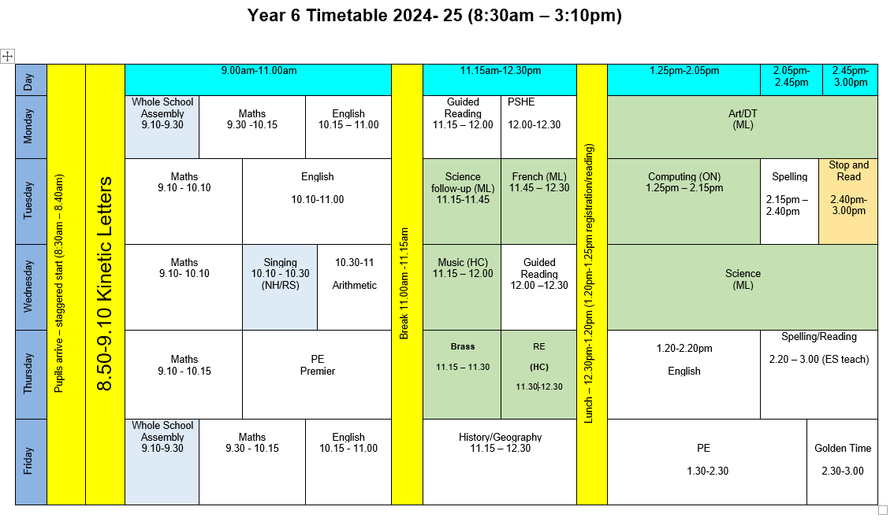
Timetable
Notes:
Record

Slide 4
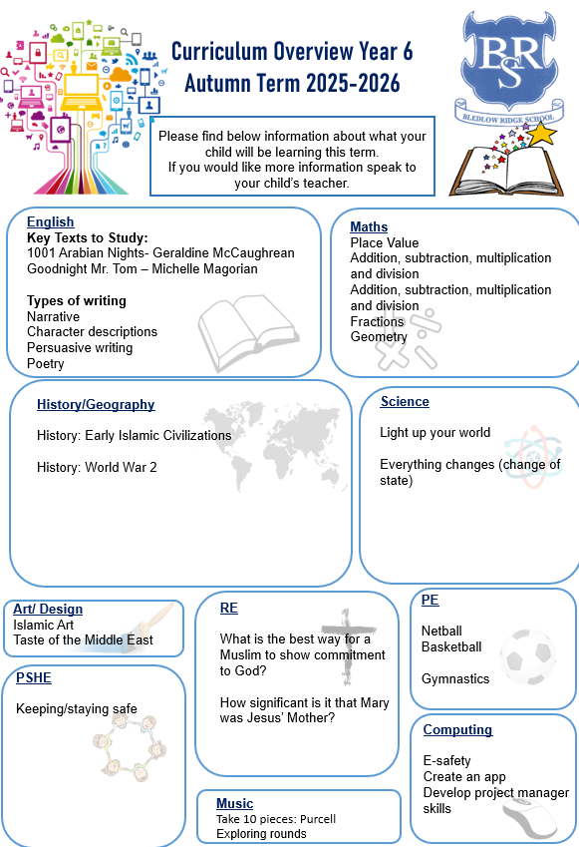
Termly Curriculum Overview
Notes:
Record

Slide 5
PE
PE lessons are taught on Thursday and Friday.
Children can wear their PE kit to school and remain in their PE kit for the duration of the day, only on the days that they have PE.
PE Uniform
  White polo shirt
  Navy blue shorts
  Trainers (not plimsoles)
  Plain navy-blue tracksuit top
  Plain navy blue tracksuit trousers
Notes:
Record

Slide 6
Spelling
We use the No Nonsense Spelling scheme to support children in becoming confident, accurate spellers.
What is No Nonsense Spelling?
A structured programme that teaches spelling patterns, rules, and strategies
Focuses on understanding spelling, not just memorising words
Lessons include investigation, discussion, and practical activities
Our Aim:
To help pupils apply their spelling knowledge in their writing — not just learn words for a test.

Slide 7
Trips
Autumn Term trip:
Bletchley Park(date TBC)
Spring Term trips:
Harry Potter Studios (10.2.26)
Residential trip to Liddington (9.3.26-13.3.26)
Summer Term trip/visit:
TBC
Notes:
Record

Slide 8
Roles and Responsibilities
Pupil Leadership Team
House Captain
Sports Leader
Junior Road Safety Officer (JRSO)
Eco-Council
Monday’s assembly will be all about pupil Leadership and information will be given to the children about how to apply for different roles.

Slide 9
How We Assess Your Child’s Learning
Formative Assessment – Ongoing and Everyday
Formative assessment happens all the time in the classroom. It helps teachers understand what your child knows and what they need help with.
Examples include:
Marking and feedback
Observing how children work in class
Listening to responses in discussions
Guided reading and group work

Slide 10
How We Assess Your Child’s Learning
Summative Assessment – End of Term/Unit Summative assessments take place at set points in the year and give a more formal overview of learning.
In Year 6 we use past SATs papers.

Slide 11
Baseline Assessments
We will be completing baseline assessments in Reading and Maths during the week beginning 29th September.
This will be to allow us to identify how we can best support the children during their time in year 6.

Slide 12
How We Monitor Your Child’s Learning
At the end of each term, we hold Pupil Progress Meetings with senior leaders (Mrs Harrison, Mrs Stanley, our Deputy Headteacher and Miss Grimaldi our SENDCo).
Every single child is discussed individually
We review:
  Their current attainment
  Whether they are on track with their learning
  What support they may need if they are not on track
  These meetings help us ensure that no child is overlooked and that we can quickly put the right support in place where needed.

Slide 13
Reporting to You
We use both formative and summative assessments to provide a full picture of your child’s learning.
You will hear about your child’s progress through:
Parents' evenings (October and March)
End-of-year reports
Informal conversations and updates
Support Plan reviews and termly meetings for pupils on the Special Educational Needs register

Slide 14
Homework
Every Friday, the children will be set homework which will be due in the following Friday.
The homework they will be set will be all or some of the following:
  Reading (at least 3 x per week and recorded in reading record- children can do this themselves)
  Mathletics task
  Arithmetic task
  Spelling Task
  Reading comprehension task
  Homework will start next Friday (19.9.25)

Slide 15
Any questions?
Notes:
Record

