Slide 1


Slide 2

Curiosity
Everyone is open to learning new things about themselves, all that surrounds them and how the two fit together.

Slide 3

Health
Everyone has the skills and tools to maintain a healthy balance of their mental, physical and emotional wellbeing.

Slide 4

Confidence
Everyone believes in themselves, stands up for what is right and has the confidence to reflect and learn from their actions.

Slide 5

Resilience
Everyone keeps trying to better themselves, even when things are difficult or when we make mistakes.

Slide 6

Empathy
Everyone is kind, caring and considerate of the feelings of one another.

Slide 7

Respect
Everyone treats our environment with respect and appreciates the cultures, beliefs and views of one another.

Slide 8
Reminders
Playtime and break time – no ball games
Lunch hall – food
Year 5 and 6 Staying in the hall/class until 12.45pm
Sitting at a table
Litter
Pro-Social behaviour

Slide 9
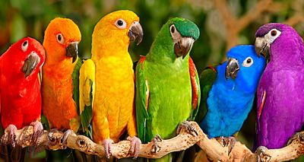

CELEBRATING
DIFFERENCES!

Slide 10
Protected Characteristics
Primary School Assembly
Understanding and respecting everyone

Slide 11
What Are Protected Characteristics?
Protected characteristics are parts of who we are that the law helps protect.
They help us make sure everyone is treated fairly.
They remind us to be kind and respectful to all.

Slide 12
The Protected Characteristics
Can you name them?

Slide 13
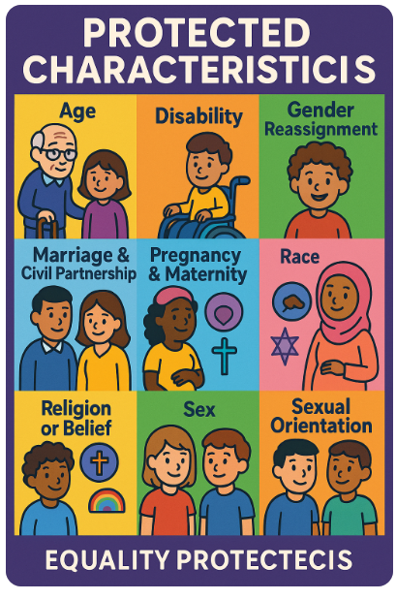
The Protected Characteristics
Age
Disability
Gender reassignment
Marriage and civil partnership
Pregnancy and maternity
Race
Religion or belief
Sex
Sexual orientation

Slide 14
Why They Matter
Protected characteristics help us create a welcoming school community.
Everyone feels safe and valued.
We learn to celebrate our differences.
We treat others how we want to be treated.
What school value does this link to?

Slide 15
Examples in Our School
Being kind to someone who learns differently.
Respecting different family types.
Celebrating different cultures and beliefs.
Including everyone in games and activities.

Slide 16
How We Can Help
Use kind words.
Stand up for others.
Include people in activities.
Listen and learn from each other.
Ask questions respectfully.

Slide 17
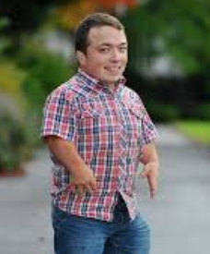
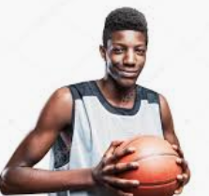
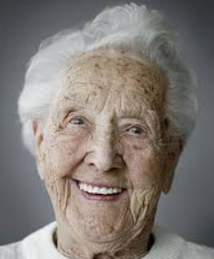
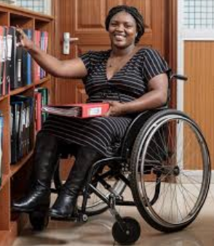
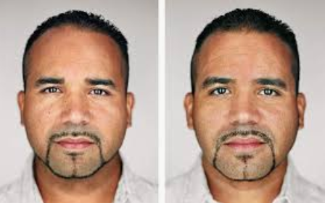
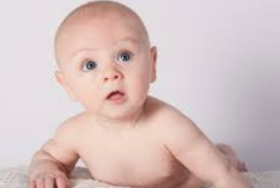
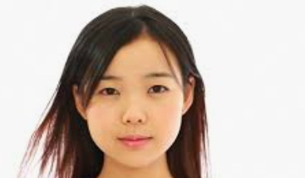
ARE ANY TWO PEOPLE IN THE WORLD THE SAME?

Slide 18
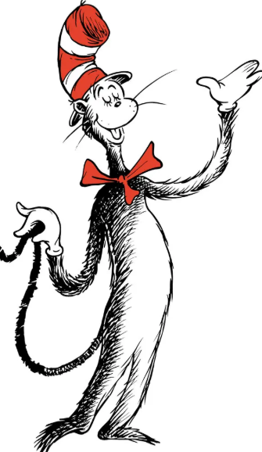
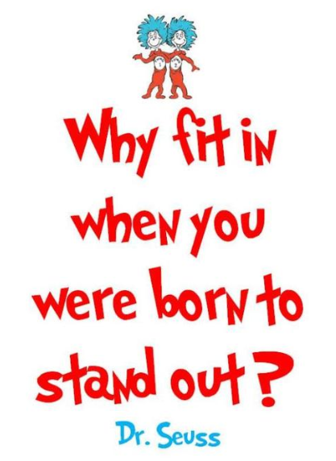

Slide 19
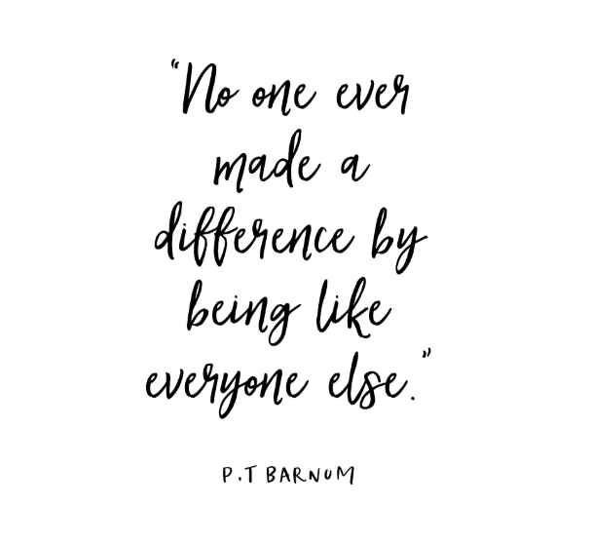

Slide 20
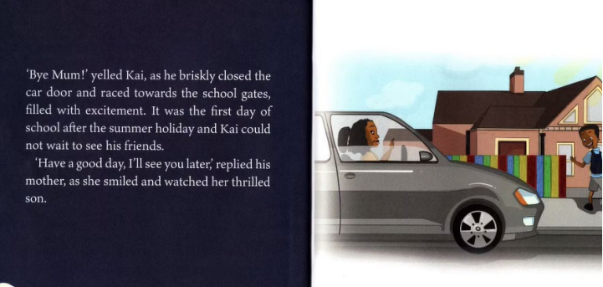

Slide 21
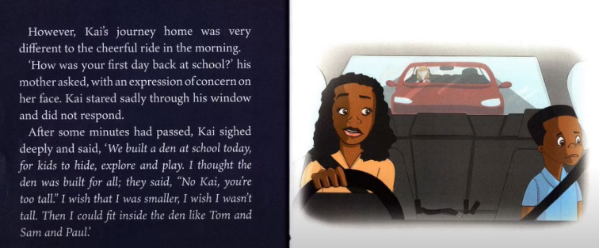

Slide 22
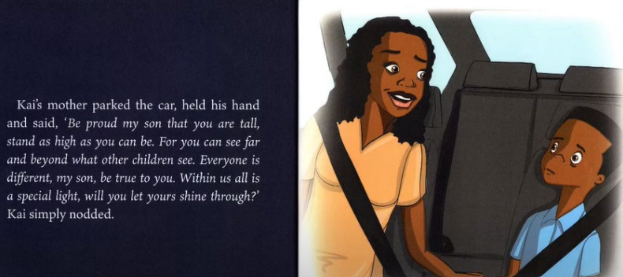

Slide 23
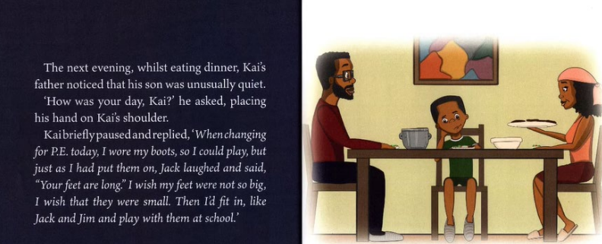

Slide 24
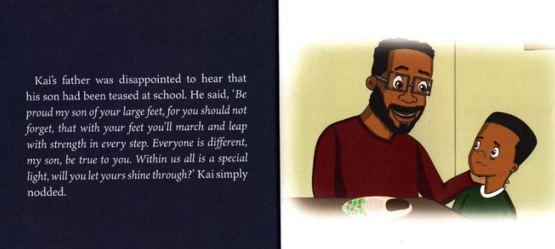

Slide 25
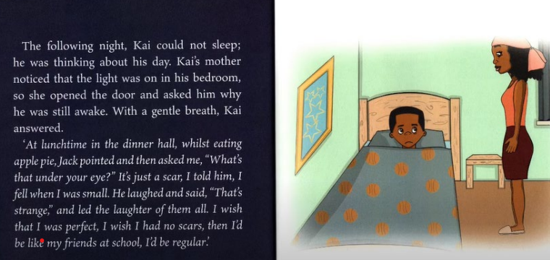

Slide 26
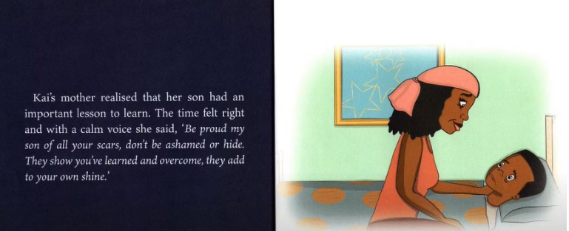

Slide 27
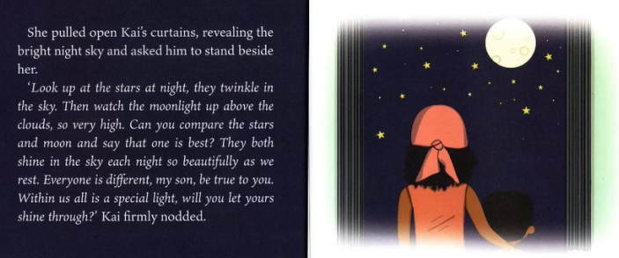

Slide 28
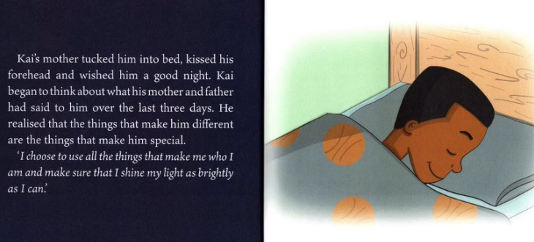

Slide 29
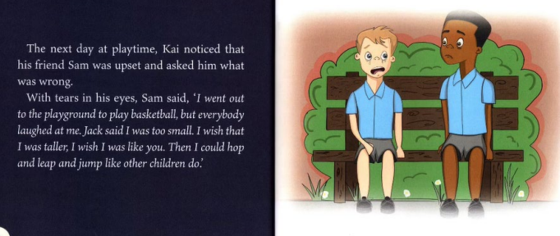

Slide 30
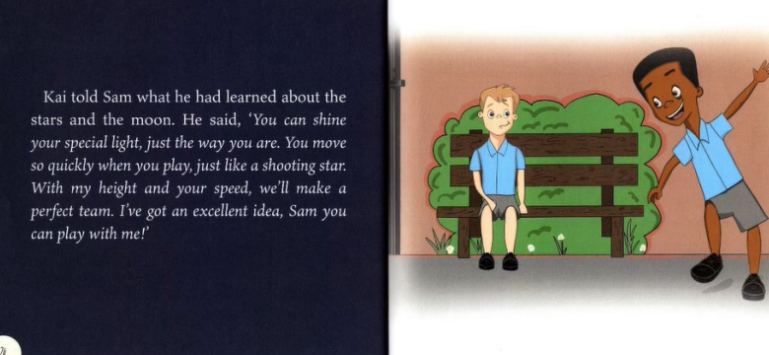

Slide 31
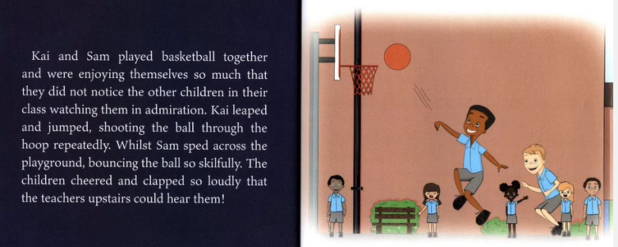

Slide 32
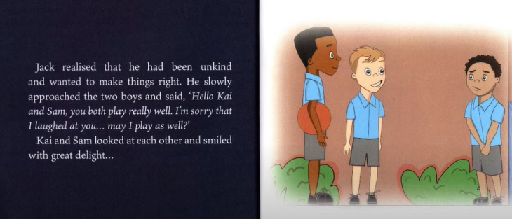

Slide 33
