Slide 1
Can we speak in different lanuages? Using greetings in different languages in class.
KS1 Geography & History projects: children journey around the world! We visit different locations to find out where it is hot and cold and use atlases and globes to find our way. The names of continents and features so we can talk about places. These help children relate to the wider world and being a global citizen.
Year One
Year Two
Year Three
greetings
introducing myself
Noticing cognates
Geography in French: using photos to describe 4 contrasting locations where French is spoken – DR Congo, Quebec, Senegal, Vanuatu, & Madagascar.
Adjective agreement (colours)
days & dates
The Caribbean
Geography-led project.
In French, we look at children living in Martinique using videos to listen and understand.
colours
Numbers 30-60
Weather & clothes
Year Four
Stories: Brown Bear & Hungry Caterpillar
Geography in French: looking at maps of France, naming some key features & places, considering ways to get there from UK.
Body parts
alphabet
un/une noun groups
Family members, friends & pets
Looking for words we know
Possessive pronouns mon/ma/mes
Other strategies to understand – context, sensible guesses
Year Five
Geography in French: Mali – language in a different context. Location and features, life and languages.
English language roots, Latin and Germanic
Introducing tenses
Role plays – café & buying tickets
Ice cream flavours
Year Six
In the future...
Combine strategies + grammar K&U
à la and au pattern
Numbers to 100+ and money
Hobbies
Famous French people
food
Transition to KS3 languages
Describing winter scenes
Telling the time
School subjects
faire and jouer de la/du/de l’
The Alps: Geography-led project. We look at maps of the French Alps and try to apply our phonics knowledge to pronouncing placenames.
Introducing verb endings
Adjective agreement (eux/euse)
Bledlow Ridge Curriculum Road Map - MFL French

Slide 2
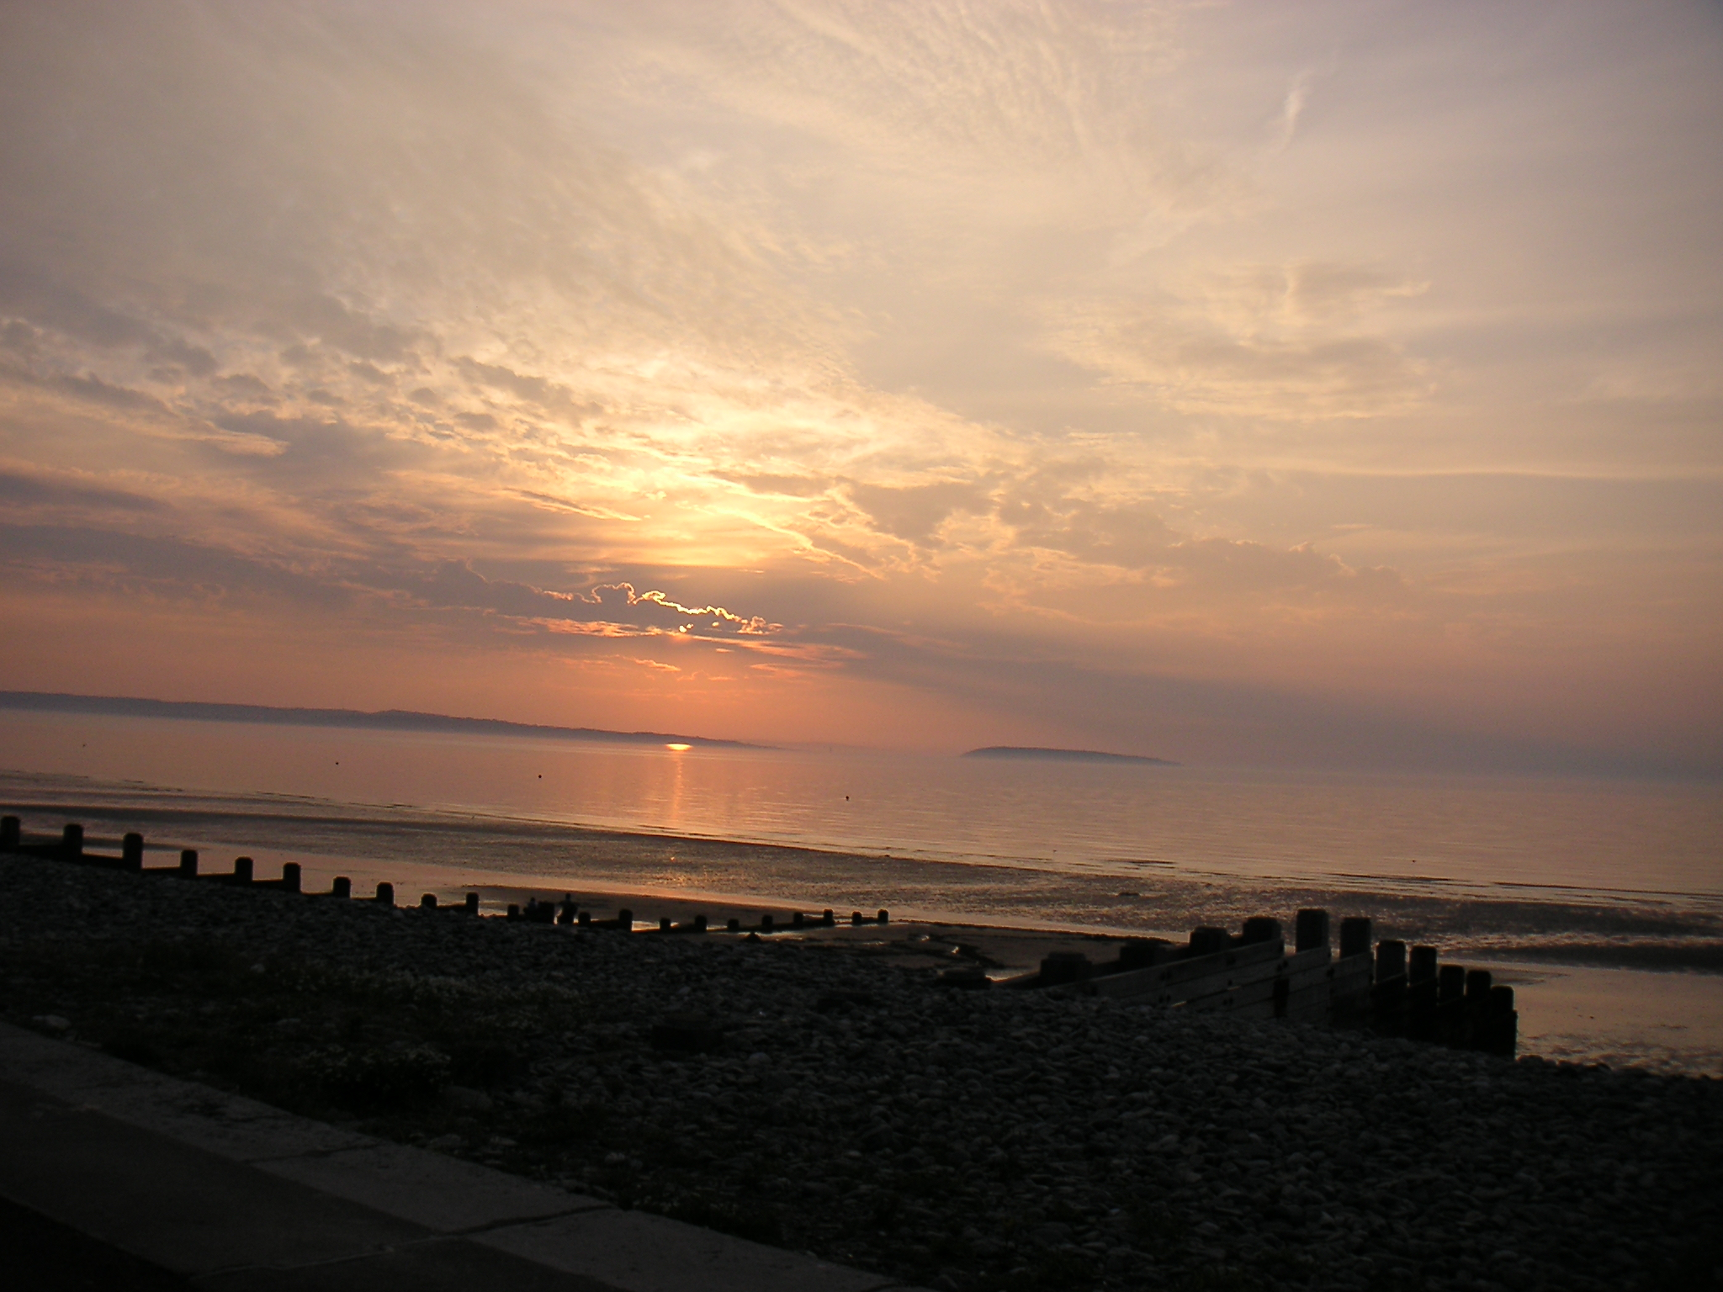
Intent: In French at Bledlow Ridge School, we aim to:
Inspire children’s curiosity about the world & its people and respect for diversity
Equip them with knowledge and skills to develop understanding and communication in French
Build their understanding of strategies that can be used in learning any language
KS1: In Geography and getting to know each other as a class, children are introduced to different places and languages
KS2: From Y3 – Y6 Children learn French, through a mix of speaking and listening, reading and writing activities.
Singing, pairs conversations and games give children opportunities to practise their speaking and listening,
as well as develop their vocabulary.
In upper KS2 children have more opportunities to see a range of written texts and write their own texts.

Slide 3
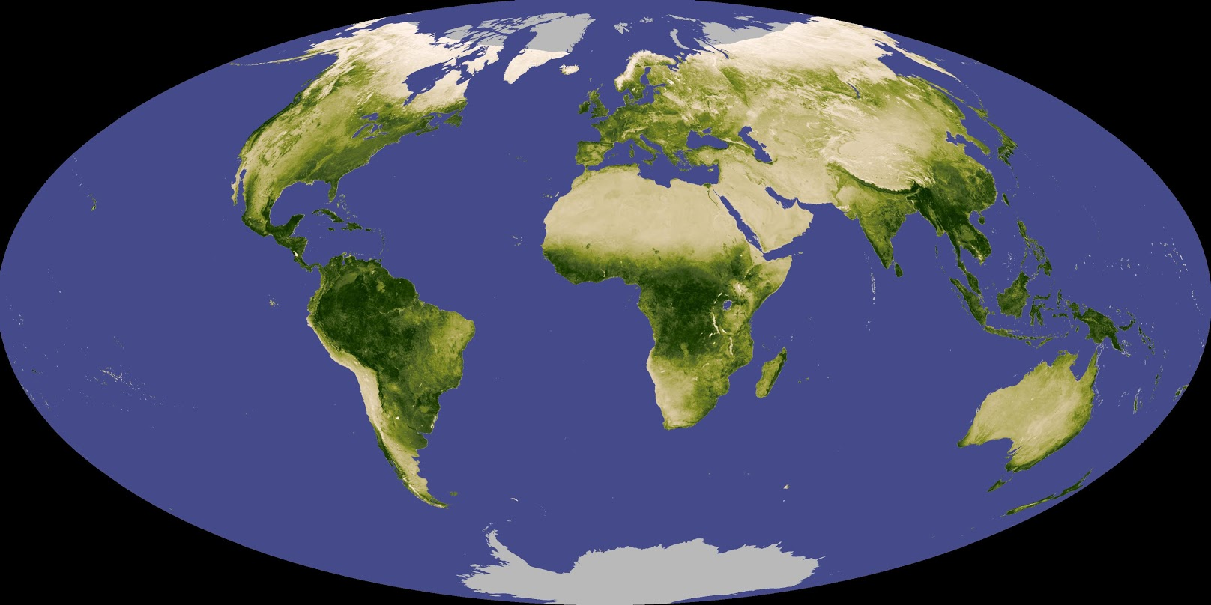
KS2 Programme of Study
listen attentively to spoken language and show understanding by joining in and responding
explore the patterns and sounds of language through songs and rhymes and link the spelling, sound and meaning of words.
engage in conversations; ask and answer questions; express opinions and respond to those of others; seek clarification and help
speak in sentences, using familiar vocabulary, phrases and basic language structures
develop accurate pronunciation and intonation so that others understand when they are reading aloud or using familiar words and phrases.
present ideas and information orally to a range of audiences.
read carefully and show understanding of words, phrases and simple writing.
appreciate stories, songs, poems and rhymes in the language
broaden their vocabulary and develop their ability to understand new words that are introduced into familiar written material, including through using a dictionary
write phrases from memory, and adapt these to create new sentences, to express ideas clearly.
describe people, places, things and actions orally and in writing.
understand basic grammar appropriate to the language being studied, such as : feminine, masculine forms and the conjugation of high-frequency verbs; key features and patterns of the language; how to apply these to build sentences; and how these differ from or are similar to English

