Slide 1






Our Values
Underpin our teaching and learning and provide an environment which prepare our pupils to be confident and happy citizens

Slide 2

'Meet The Teacher'
September 2025
Welcome to Reception
Miss Stanley, Miss Ingleby, and Miss Sarah
Notes:
Record

Slide 3
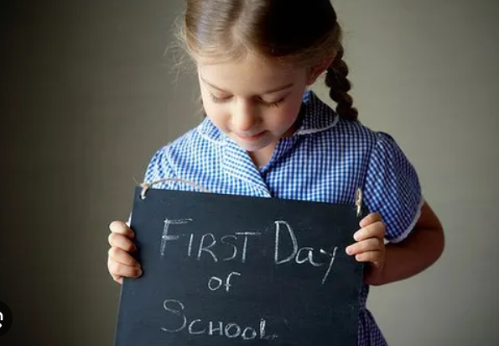
Starting School
The children are beginning an amazing learning journey – their first footsteps into independence.
Pre-school experience will help the settling in process, particularly leaving you at the beginning of the day.
Starting school can be difficult for children and parents, but we are here to support you.
The children will get worn out! You may notice a different in behaviour at home the first few weeks, including elevated emotions.
Encourage their ongoing independence as far as possible and praise them for their capabilities.

Slide 4

Structure of our day
Morning Drop Off: 8.30am to 8.40am (to allow a natural stagger)
As soon as you feel comfortable, the children will come into class independently (parents drop off outside.)
From January, you can drop off via the front gate; the children make their way to their designated doors through the school playground, to their class
Registration is at 8.40am, pupils arriving after 8.40am will be marked as late
Afternoon Collection: 3.00pm All pupils will be collected from the outside door of their classroom.

Slide 5
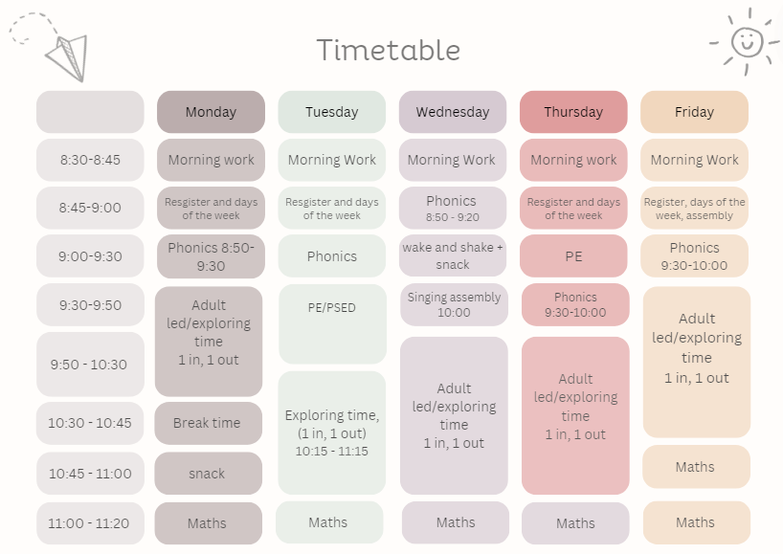
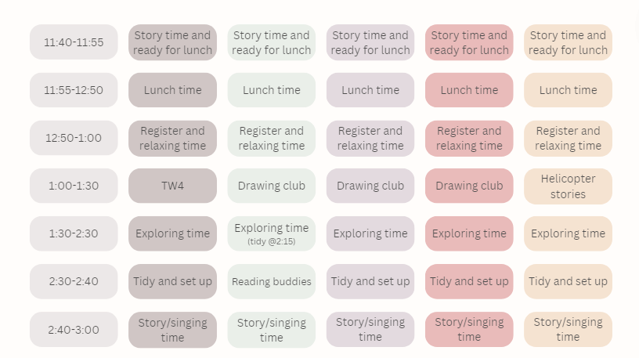
Autumn term Timetable

Slide 6
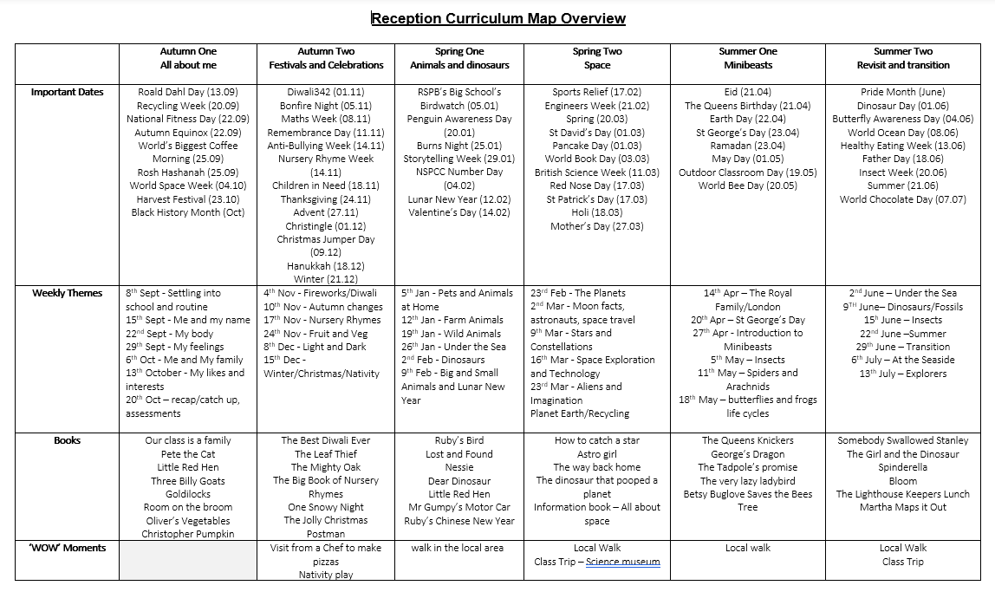

Slide 7
Trips
Autumn Term Trip:
Chef visit (TBC)
Spring Term Trip:
Zoo lab (with Year 1)
Summer Term Trip:
Science museum (with Year 1)
Notes:
Record

Slide 8
Homework
Please share a story with your child every night.
Reading Eggs will be set up after October half term – access codes will be sent home.
Individual reading books will be sent out as part of the phonics programme (Little Wandle) when your child is ready.
Reading books should be signed at least 2 x each week.
Notes:
Record

Slide 9
Equipment/what to bring to school
In EYFS, we will provide the stationery your child needs.
Each child has a coat peg to store his/her belongings. Please bring in:
Water bottle
Wellies
Coat with a hood
Bag with spare clothing (E.g. Underwear, socks, trousers/skirt, T-shirt.)
Please could all belongings be named, even water bottles.
Notes:
Record

Slide 10

Phonics
We use Little Wandle as our phonics scheme
They are delivered in 5-week intervals
An assessment is completed for each child at the end of each 5-week programme to ensure all children are supported in their progress
We learn 4 sounds a week (Mon-Thurs), Friday is our review day
I will post the sounds we learn each week onto Seesaw so you know which ones we are learning
We will give out reading books after half term.
The reading books will always be a phase below what we are learning. This facilitates a love for reading, while consolidating the sounds previously learnt
The first books will be wordless. This supports the children in building their vocabulary and comprehension on the pictures
You will also have access to Reading Eggs – a map-based reading programme that the children can do at home. While it is a great resource, this is not compulsory.

Slide 11
Reception Baseline Assessment
In the first six weeks of Reception, all children must complete the DfE Reception Baseline Assessment.
Further information can be found by following the link: https://assets.publishing.service.gov.uk/government/uploads/system/uploads/attachment_data/file/1074327/2022_Information_for_parents_reception_baseline_assessment.pdf
We will also complete Speech and Language assessments during the first term
Notes:
Record

Slide 12
PE & Physical Development
PE lessons are taught on Tuesdays and Thursdays at 9am.
Children are also encouraged to spend time learning outdoors through a range of fine and gross motor skills on offer.
Children can wear their PE uniform to school and remain in it for the duration of the day, only on the days that they have PE.
PE Uniform:
White polo shirt
Navy blue shorts
Trainers (not plimsoles)
Plain navy-blue tracksuit top
Plain navy-blue tracksuit trousers
Notes:
Record

Slide 13
Where do we get our assessments of children and how do we use them?
Getting to know the whole child through nursery visits, home visits, and spending time with them creating quality interactions.
Continually building a picture of your child’s learning and development as they make progress throughout the year – photos, observations, physical pieces of work
The observations of every adult who comes in contact with your child.
Working alongside your child during child initiated learning.
As much as possible, all assessments should be child initiated.
Where this is not possible, the children should carry it out as independently as possible.

Slide 14
How We Assess Your Child’s Learning
Formative Assessment – Ongoing and Everyday
Formative assessment happens all the time in the classroom. It helps teachers understand what your child knows and what they need help with.
Examples include:
Marking and feedback
Observing how children work in class
Listening to responses in discussions
Guided reading and group work

Slide 15
How We Monitor Your Child’s Learning
At the end of each term, we hold Pupil Progress Meetings with senior leaders (Mrs Harrison, Mrs Stanley, our Deputy Headteacher and Miss Grimaldi our SENDCo).
Every single child is discussed individually
We review:
  Their current attainment
  Whether they are on track with their learning
  What support they may need if they are not on track
  These meetings help us ensure that no child is overlooked and that we can quickly put the right support in place where needed.

Slide 16
Reporting to You
We use both formative and summative assessments to provide a full picture of your child’s learning.
You will hear about your child’s progress through:
Parents' evenings (October and March)
End-of-year reports
Informal conversations and updates
Support Plan reviews and termly meetings for pupils on the Special Educational Needs register

Slide 17
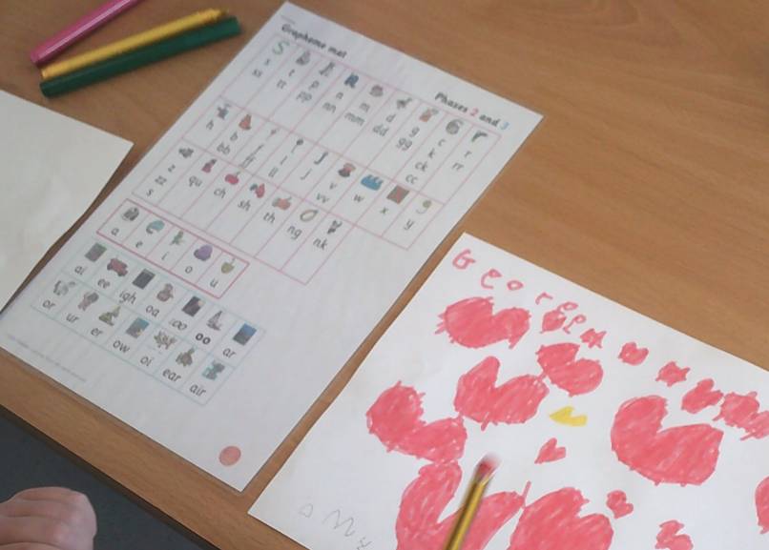
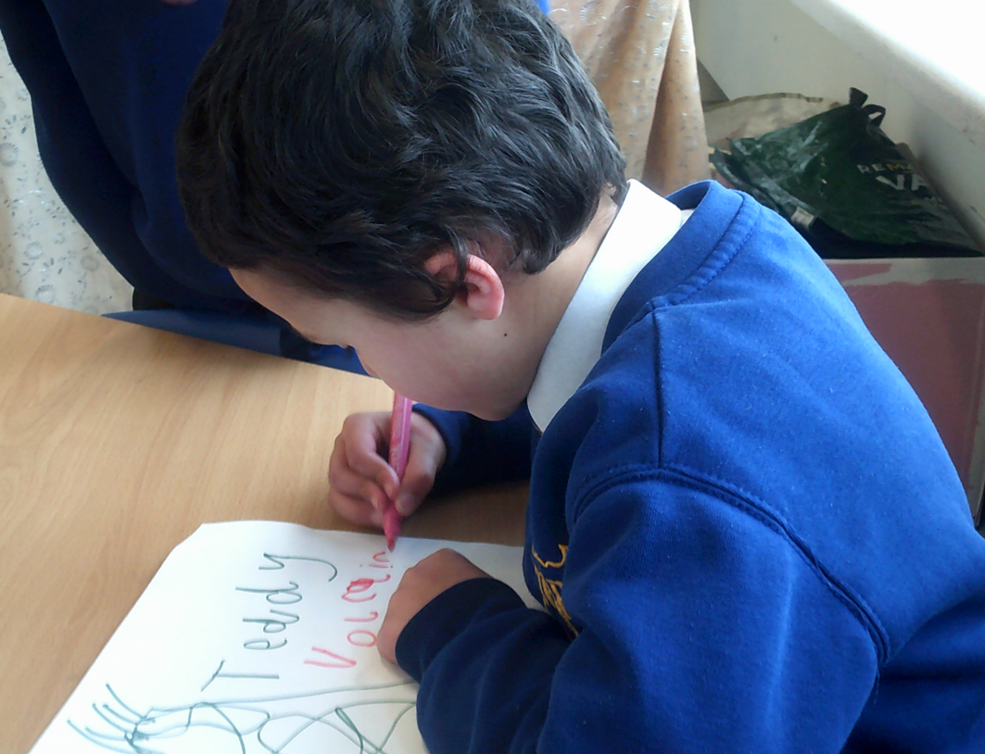
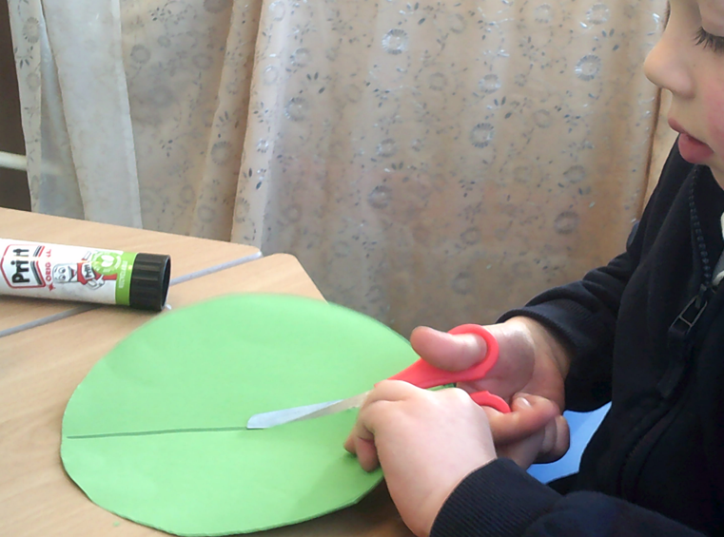
Expectations
We do not expect your children to be able to read and write before they come into school; that’s what we are here for ☺
What would be helpful is:
  Recognising their own name.
  Knowing basic self-care skills; using the toilet and washing hands
  Putting on their coat (not the zip), The superhero method is great!
  Following 1 step instructions.

Slide 18
The Early Years Foundation Stage’s seven areas of learning and development
The Prime areas:
  Communication and Language (CL)
  Personal, Social and Emotional Development (PSED)
  Physical Development (PD)
Early Learning Goals (ELGs)
The early learning goals gives an overview of the knowledge, skills and understanding that all young children should have gained by the end of the academic year, in which they turn 5, the Reception year.
They are included here so you can see a child’s expected level of development by the time they turn 5:
  https://assets.publishing.service.gov.uk/government/uploads/system/uploads/attachment_data/file/974907/EYFS_framework_-_March_2021.pdf
The early learning goals are not a curriculum but used as an assessment tool during the summer term of the Reception year.
The Specific areas:
  Mathematics (M)
  Understanding the World (UW)
  Expressive Arts and Design (EAD)
  Literacy (L)

Slide 19
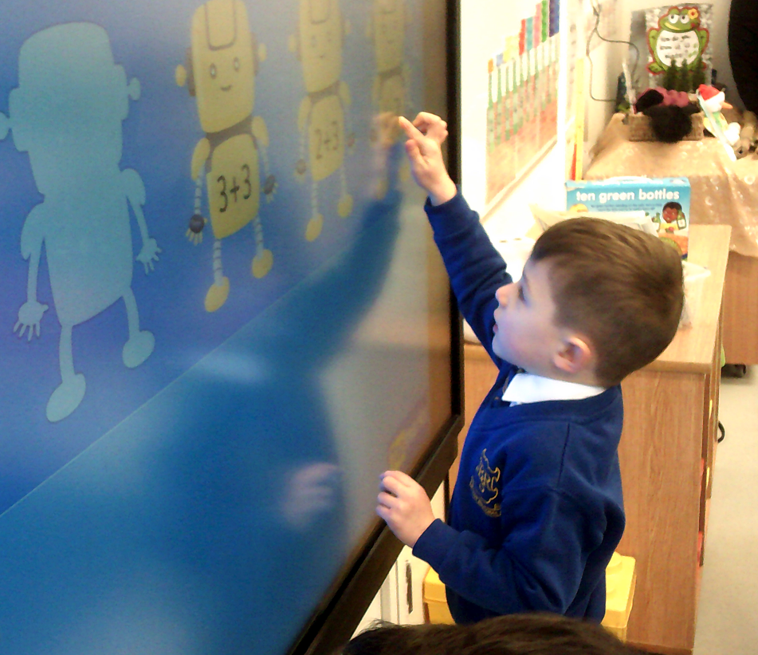
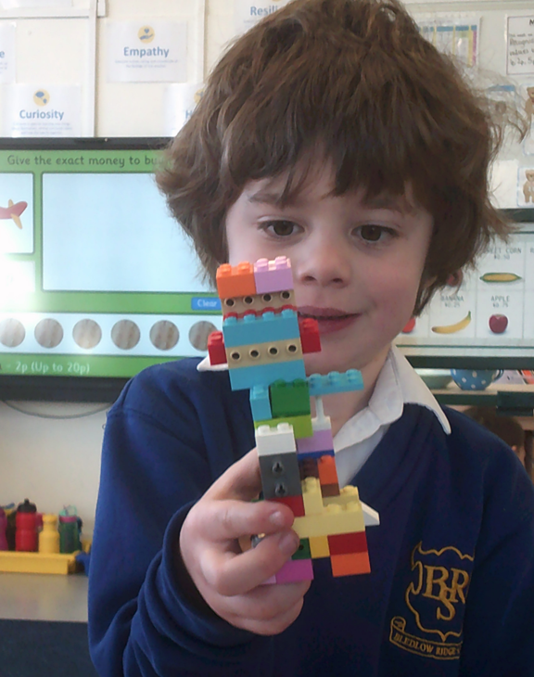
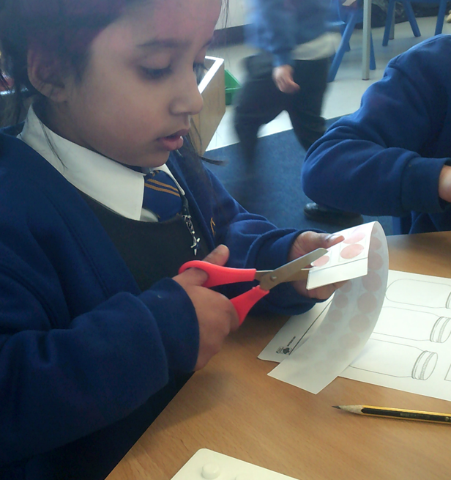
How can you help?
Communication skills are key – talk lots!
Share books with your child.
Foster curiosity in the world around them.
Play board games to develop turn taking.
Gross and fine motor skills – Lego and cooking opportunities are wonderful for this! Did you know that if a child does not have a strong core, their fine-motor skills will not develop.
Go outdoors and encourage your child to engage with all his/her senses.
Support your child to take risks in their learning
Develop independence by encouraging your child to have a go at dressing themselves and keeping their belongings tidy (!)
Have a regular bed time routine.
Please share your queries and questions and let us know of any change in your personal circumstances. Our door is always open and we are here to help.

Slide 20

How can parents help?
Read, read and read some more!
Statistic: Parents who read 1 picture book with their children every day provide their children with exposure to an estimated 78,000 words each year. Cumulatively, over the 5 years, it is estimated that children from literacy-rich homes hear a cumulative 1.4 million more words during storybook reading than children who are never read to.​
Notes:
Record

Slide 21
Seesaw and eSchools
All communication will be through seesaw, unless urgent or you need to report an illness.
Please do add on your own posts. The children love to share home experiences, and it is great for their self-esteem and confidence
There will be times that we send out activities on seesaw. This is to help us address any misconceptions they may have around a certain concept
If you need any help, please let us know
If you already have a child in school, you won’t get a new eschools login, everything will be on your eldest child’s login.

Slide 22
Other info
Speech and language link
All children will be assessed on Language link, and only those who we feel need support with speech, or pronunciation of particular sounds will be assessed in Speech link.
Reading books
Wordless books will be sent out in the next couple of weeks. Wordless books are an amazing tool to support children in developing the inference skills needed to critically think about the text, while developing their comprehension.
When we move to books with words, the children will be provided with a book that is a phase lower than what we are currently learning. This is to ensure that the children are able to decode the words and recognise the sounds, and essential skill needed when learning to read. We want the children to develop a love for reading, and when they are provided with a book that is too challenging, this can cause them to be disheartened and fall out of love with books.
Classroom temperature in winter
The classroom can become quite cold in the winter, so please could you ensure your child has additional layers available to them. On the other hand, when the radiators are on full, it can also get quite warm. We will always keep you up to date with this.
Snack
We do provide snack, fruit or veg each day, alongside milk. However, if you want to provide your child with a snack, please can this either be fruit or veg.
Behaviour policy
Our behaviour policy has been updated. We do not use sanctions or a visual behavioural system in reception. As the children are still learning about what is right and wrong, we talk about behaviour as it arises, but also support them through our personal, social, and emotional lessons and activities. We do use the red and yellow card system for serious incidents, but as mentioned about, this is not a visual aid in the classroom, but rather a tool for us to use when logging behaviour. We will always communicate with you about behaviour.

Slide 23
Useful Resources
Statutory Framework for the Early Years Foundation Stage:
https://assets.publishing.service.gov.uk/government/uploads/system/uploads/attachment_data/file/974907/EYFS_framework_-_March_2021.pdf
What to Expect When:
https://foundationyears.org.uk/wp-content/uploads/2021/09/What-to-expect-in-the-EYFS-complete-FINAL-16.09-compressed.pdf
Birth to Five Matters:
https://www.birthto5matters.org.uk/wp-content/uploads/2021/04/Birthto5Matters-download.pdf
Development Matters:
https://assets.publishing.service.gov.uk/government/uploads/system/uploads/attachment_data/file/1007446/6.7534_DfE_Development_Matters_Report_and_illustrations_web__2_.pdf

