Slide 1
'Meet The Teacher'
September 2023
Welcome to Year 3
Mrs Bourke, Mrs Craven, Mrs Lyon, Mrs Luyk and Mrs Wells.
Notes:
Record

Slide 2
Arrival and Dismissal
Morning Drop Off: 8.30am to 8.40am (to allow a natural stagger)
Pupils enter the school via front gate; make their way to their designated doors through the school playground, to their class
Registration is at 8.40am, pupils arriving after 8.40am will be marked as late
Afternoon Collection: 3.00pm to 3.15pm (to allow a natural stagger)
All pupils will be collected from the outside door of their classroom.
Notes:
Record

Slide 3
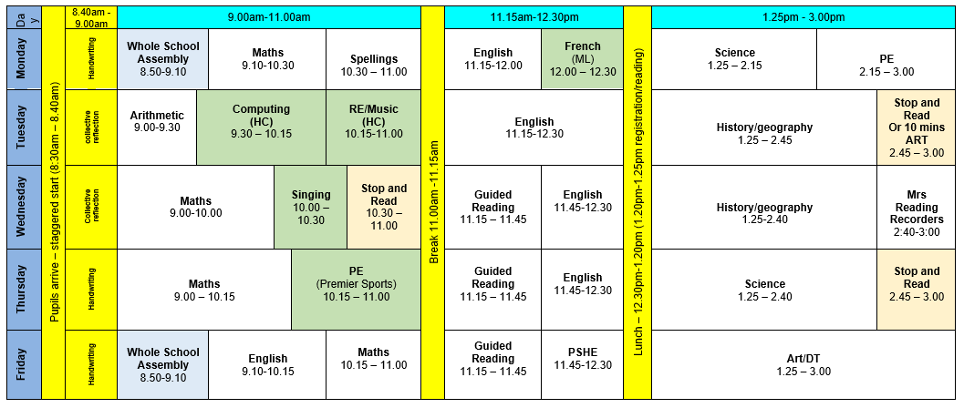
Timetable (8:30 am -3:00 pm)
Notes:
Record

Slide 4
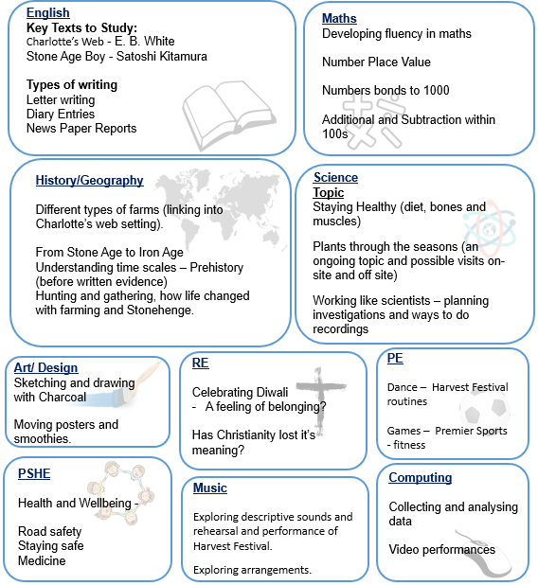
Termly Curriculum Overview
Notes:
Record

Slide 5
Trips
Autumn Term: Chiltern Open Air Museum
Friday 10th November
Spring Term: Amersham Museum
Friday 1st March
Summer Term: Geology Jill
still to be confirmed
Hazard Alley will be next year (every 2 years)
Notes:
Record

Slide 6
Homework
Homework is set each Friday (to be completed by the following Friday)
Maths homework will be set on Mathletics or through a practical task if Mathletics is not suitable for the week’s topic
If you can, please read every day with your child.
Reading books should be signed at least 5 x each week if not more
Spellings set Mondays and the spelling test is on following Monday morning (first thing, so please be prompt)
Notes:
Record

Slide 7
Equipment/what to bring to school
In Key Stage 2 (Years 3-6) every child will need to bring in a small pencil case with the following stationery. Please name items where possible.
HB pencils
colouring pencils
ruler
a glue-stick
a rubber
a sharpener
water bottles
reading books
Notes:
Record

Slide 8
PE
PE lessons are taught on Mondays and Thursday.
Children can wear their PE kit to school and remain in their PE kit for the duration of the day, only on the days that they have PE
PE Uniform
White polo shirt
Navy blue shorts
Trainers (not plimsoles)
Plain navy-blue tracksuit top
Plain navy blue tracksuit trousers
Notes:
Record

Slide 9
Teaching and Learning
Curricular targets for English (writing) and mathematics
Every child has targets for writing and mathematics.
Writing targets match the year group National Curriculum objectives
Children have a copy of their targets in the back of their maths and English books.
When a target is met, the target sheet is ticked and dated to help each child understand the progress they are making.
Copies of your child’s targets will be shared and discussed at parent consultations in October.
Notes:
Record

Slide 10
Teaching and Learning
Teacher Feedback
Research shows that the most effective feedback is given verbally, ‘in the moment’ – this will be evidenced as a ‘VF’ in pupils’ books
Adults may also sometimes provide written feedback and modelling in pupils’ books using a green pen
We expect pupils to respond to feedback given by adults. We ask the pupils to do this in purple pen to help them and the adults see the corrections/edits they are
Notes:
Record

Slide 11
How can parents help?
Read, read and read some more!
Statistic: Parents who read 1 picture book with their children every day provide their children with exposure to an estimated 78,000 words each a year. Cumulatively, over the 5 years, estimated that children from literacy-rich homes hear a cumulative 1.4 million more words during storybook reading than children who are never read to.​
Notes:
Record

Slide 12
How can parents help?
Number bonds and times tables – practise these everywhere
Practise telling the time on a clock with hands
Regular attendance is key – 95% is the minimum expectation. Pupils whose attendance is of concern will be invited to discuss this in order that the school can support parents and pupils as best possible.
Communication! Please come and talk to us if you have any concerns/questions
Notes:
Record

Slide 13
Any questions
Notes:
Record

