Slide 1
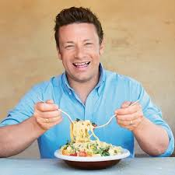
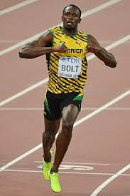
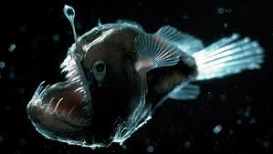
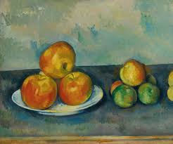
Transition Day – 3.7.18
“ What do
have in common….?

Slide 2
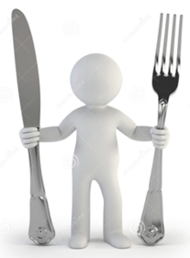
Food, Glorious Food
Year 3 project-based learning focus
Autumn 1

Slide 3
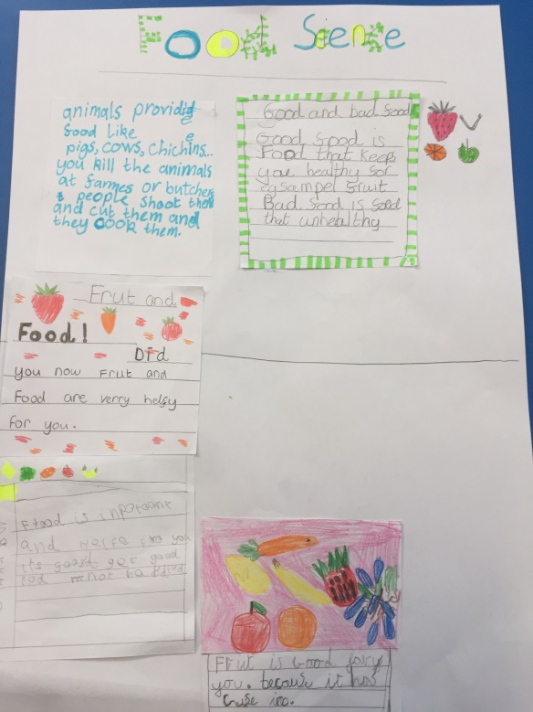
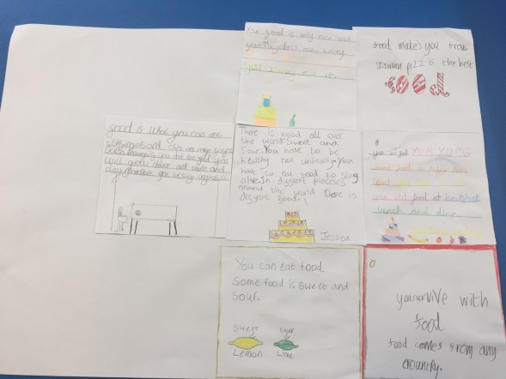
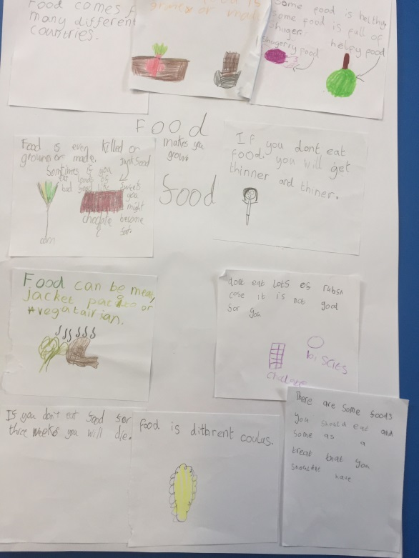
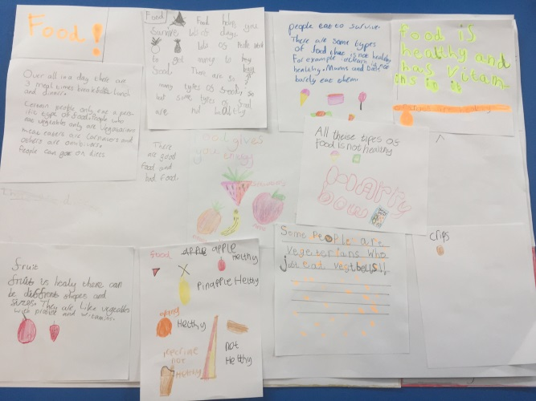
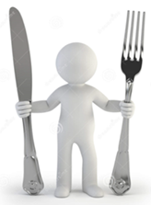
Science - Food, Glorious Food
We looked at what we knew already and then began asking questions… : What foods do our bodies need to stay healthy.? What makes a ‘balanced diet’? What’s the role of each food group? Do all animals need the same nutrients?

Slide 4
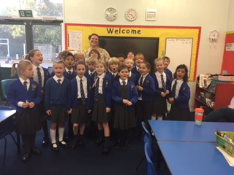
Science - Food, Glorious Food
We researched the major food groups and learnt about the different nutrients that these food types contain. Mrs Talyarkhan, a nutritionist and sports injury therapist, came into give us a talk.

Slide 5
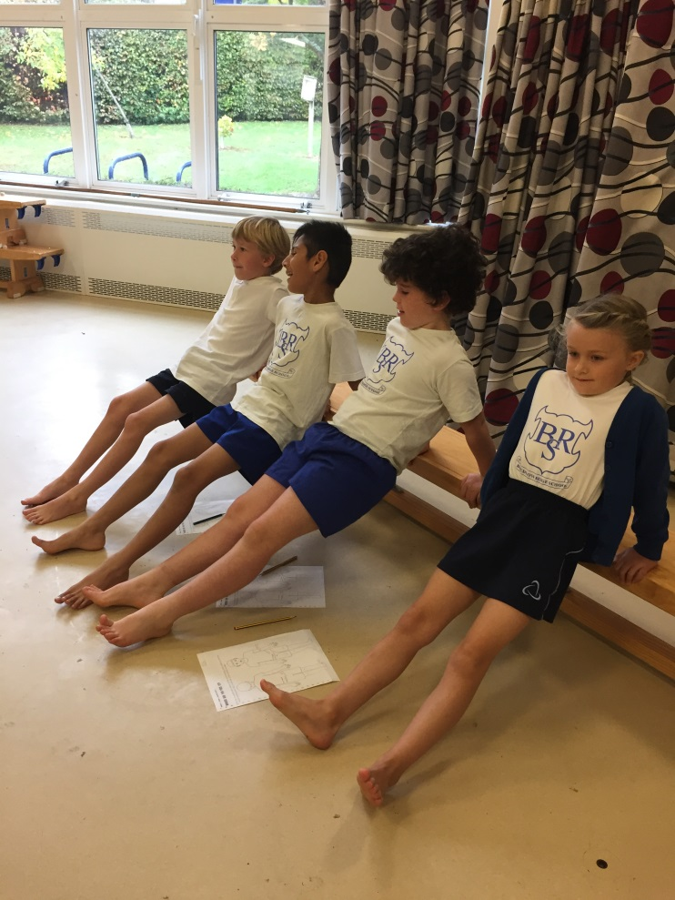
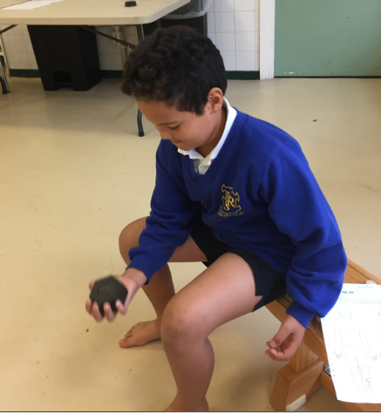
P.E - Food, Glorious Food
We learnt that muscles are made from protein.
and completed a circuit of activities to become more acquainted with them!

Slide 6
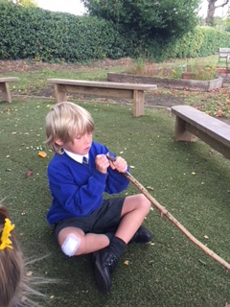
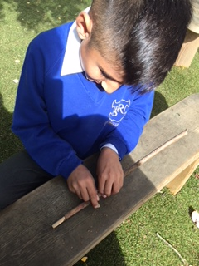
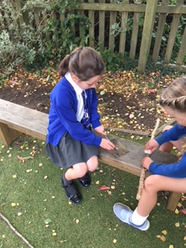
History - Food, Glorious Food
Like our Mesolithic forebears we went into woodland, armed
with sharpened sticks, flints and arrow heads in search
of food. We spotted evidence of rabbits, birds, badgers
and foxes but on this occasion failed to come home
with any meat.

Slide 7
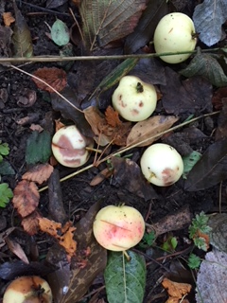
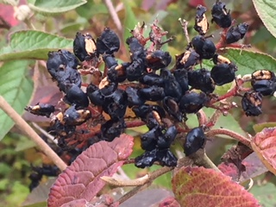
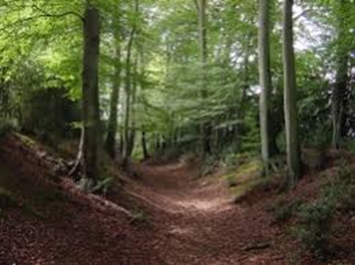
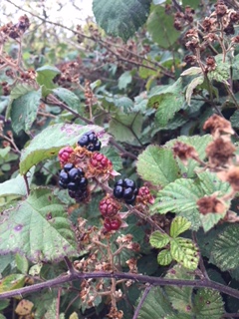
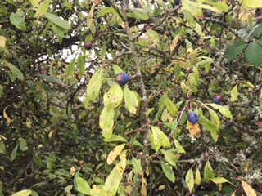
History - Food, Glorious Food
We found plenty of plant life that may have kept
hunger at bay though: blackberries, elder flowers, hazel
nuts, apples and nettles.

Slide 8
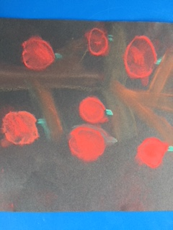
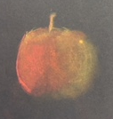
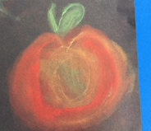
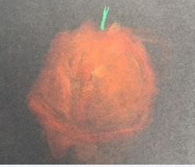
Art - Food, Glorious Food

Slide 9
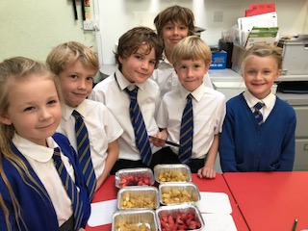
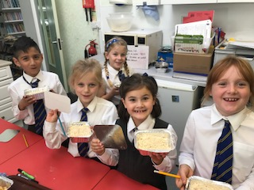
D/T - Food, Glorious Food
Blackberry and Apple Crumble
Flapjack
(Locally foraged ingredients!)

Slide 10
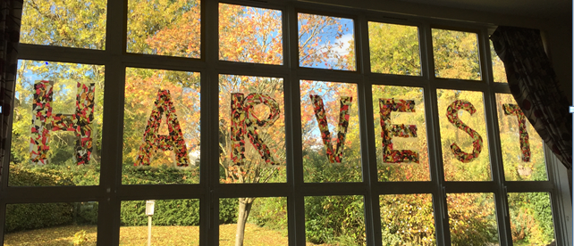
Harvest Performance
On 8th October Years 3 and 4 led a whole school assembly to celebrate Harvest 2018. Parents were invited too. and donations gratefully received on behalf of a local charity.
Through song , performance and the spoken word we learnt why harvest has been so celebrated across the ages.
Year 3 re-enacted and sang about a medieval English
farming tradition called ‘Calling the Mare’.

Slide 11
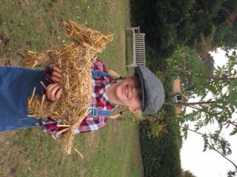
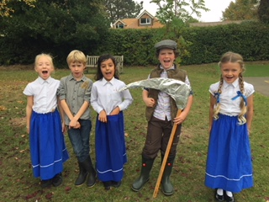
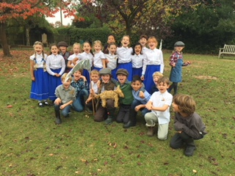
Harvest Performance
The
Harvest Song
Food, Glorious Food (BRS version)
Calling The Mare
Harvest Samba

Slide 12
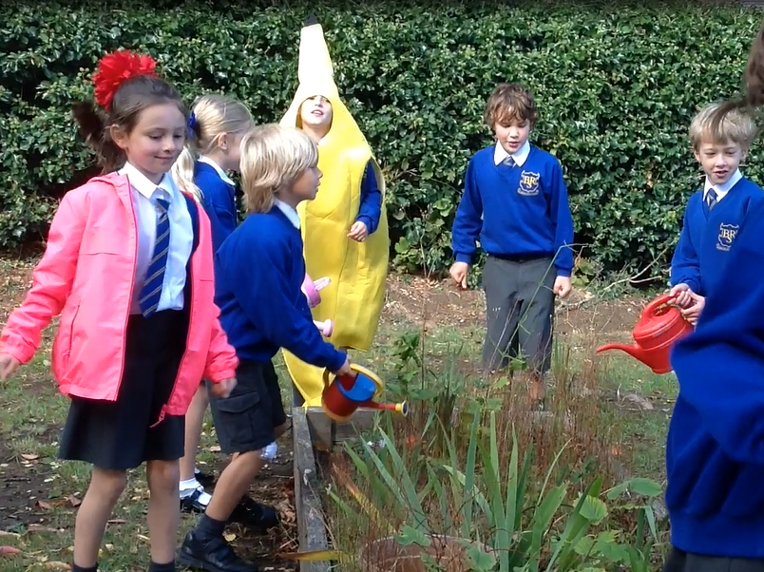
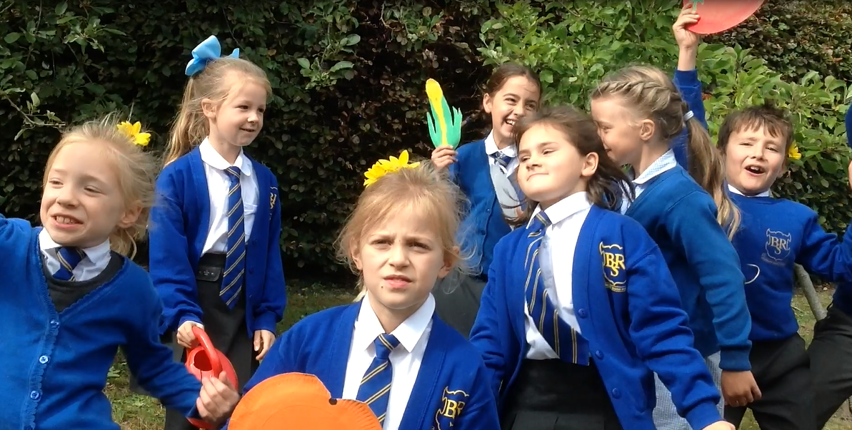
Harvest Performance
In the midst of the celebrations and song we took time to remember that there are
still people in the world for whom finding enough food is a daily challenge. We learnt
about the work of One Can Trust which helps local people who don’t have enough
money to buy food.
We ended with our latest video Harvest Samba!

Slide 13
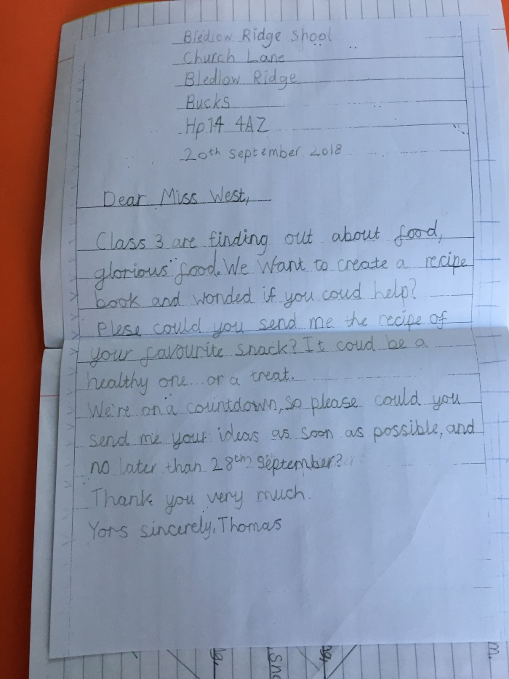
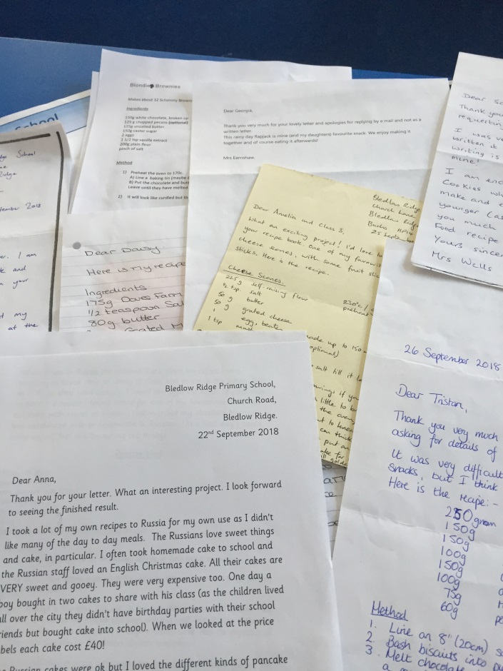
English- Food, Glorious Food
Creating a recipe book …
We wrote to members of staff, asking for their favourite snack recipes…
and then awaited their replies.

Slide 14
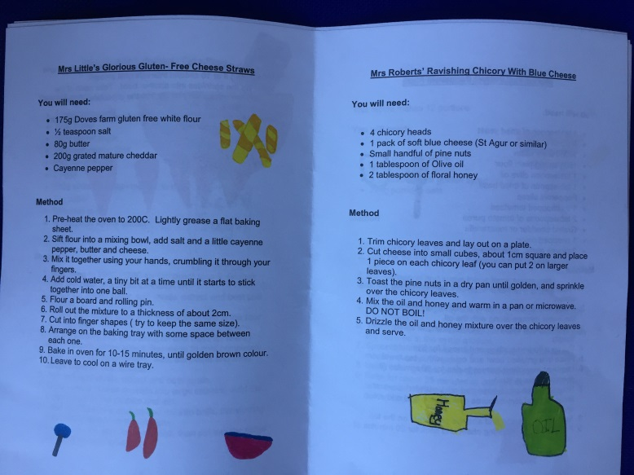
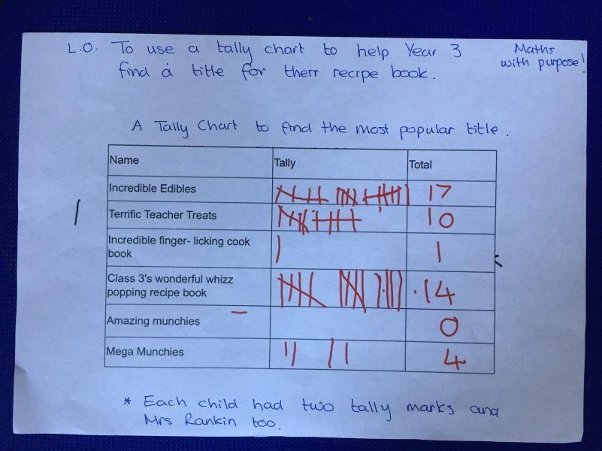
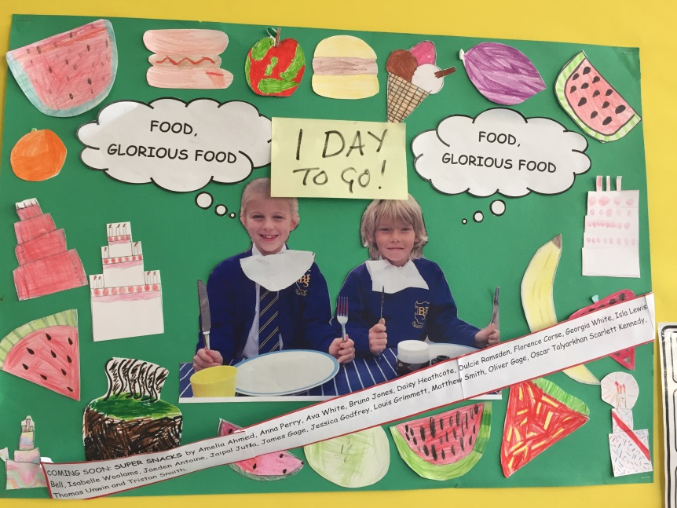
I.C.T/ Maths - Food, Glorious Food
The children typed and illustrated their recipe and the work was compiled into
booklet form.
We used a tally to
help us decide on a
title…
and counted down the
days to the book launch.

Slide 15
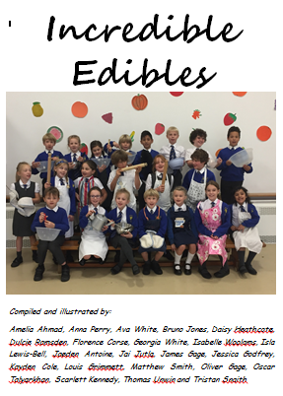
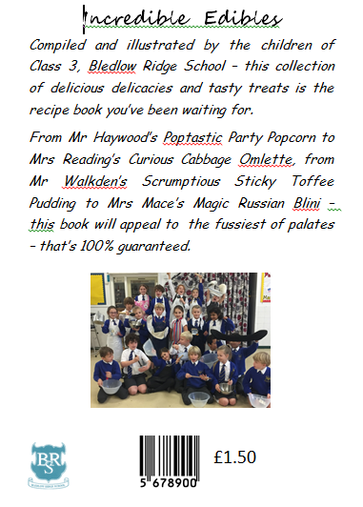
English- Food, Glorious Food

Slide 16
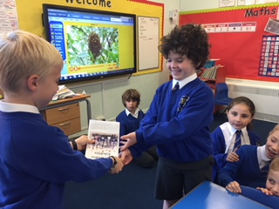
The First Sale - 19th October 2018 “That’ll be £1.50 please.”

