Slide 1

'Meet The Teacher'
September 2023
Welcome to Year 1
Miss Grimaldi and Miss Williams
Mrs Craven PPA Cover (Wed & Thu PM)
Notes:
Record

Slide 2
Arrival and Dismissal
Morning Drop Off: 8.30am to 8.40am (to allow a natural stagger) Pupils enter the school via front gate; make their way to their designated doors through the school playground, to their class.
Registration is at 8.40am, pupils arriving after 8.40am will be marked as late.
Afternoon Collection: 3.00pm All pupils will be collected from the outside door of their classroom.
Notes:
Record

Slide 3
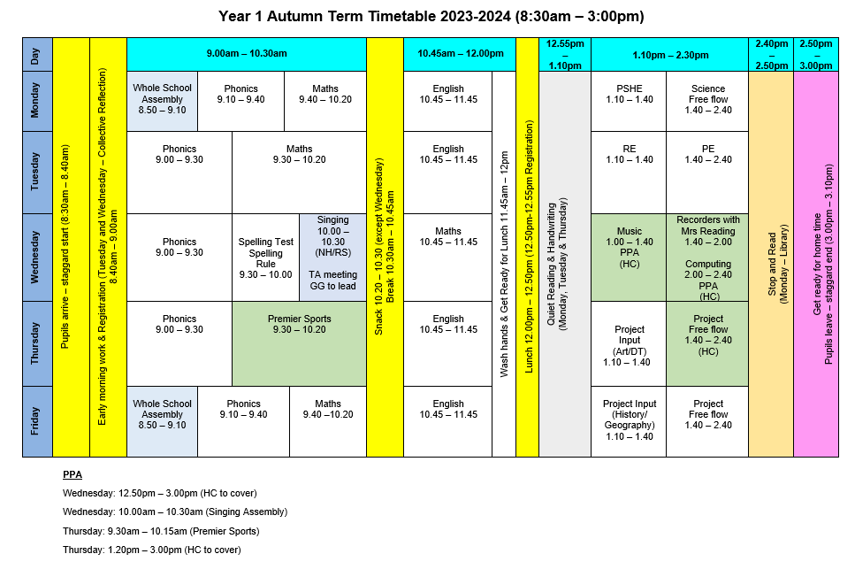
Timetable
Notes:
Record

Slide 4

Termly Curriculum Overview
Notes:
Record

Slide 5
Trips
Autumn Term trip: Museum of Natural History
Spring Term trip: Science Oxford
Summer Term trip: Cotswold Wildlife Park
Notes:
Record

Slide 6
Homework
Homework is set each Friday, this includes Spellings. Homework to be completed by the following Thursday. Spelling tests are on Wednesday mornings.
If you can, please read every day with your child and sign reading records 3x each week.
Maths homework will be set on Mathletics.
Please also use Numbots and Reading Eggs to support your child’s learning.
Notes:
Record

Slide 7
Equipment/what to bring to school
In Key Stage 1, we will provide the stationery your child needs – please bring in reading books, reading record, book bags and a water bottle every day.
A change of clothes can be left in a name bag on your children’s peg if you wish to do so or feel they may need them.
Notes:
Record

Slide 8
PE
PE lessons are taught on Tuesday and Thursday.
Children can wear their PE uniform to school and remain in their PE uniform for the duration of the day, only on the days that they have PE.
PE Uniform
  White polo shirt
  Navy blue shorts
  Trainers (not plimsoles)
  A royal blue round-necked school logo jumper or a plain navy-blue tracksuit top
  Plain navy blue tracksuit trousers
Notes:
Record

Slide 9
Teaching and Learning
Curricular targets for English (writing) and mathematics
Every child has targets for writing and mathematics.
Writing targets match the year group National Curriculum objectives.
Children have a copy of their targets in the back of their maths and English books.
When a target is met, the target sheet is ticked and dated to help each child understand the progress they are making.
Copies of your child’s targets will be shared and discussed at parent consultations in October.
Notes:
Record

Slide 10
Teaching and Learning
Teacher Feedback
Research shows that the most effective feedback is given verbally, ‘in the moment’ – this will be evidenced as a ‘VF’ in pupils’ books.
Adults may also sometimes provide written feedback and modelling in pupils’ books using a green pen.
We expect pupils to respond to feedback given by adults. We ask the pupils to do this in purple pen to help them and the adults see the corrections/edits they are making.
Notes:
Record

Slide 11
How can parents help?
In June, Year 1 pupils will complete a Phonics Screening Check (PSC).
The PSC is 40 words, 20 real words and 20 nonsense (alien words) which the children have to read.
This will take place one to one in a quiet room.
Pass mark has previously been 32/40, you will find out your child’s score when you receive their report at the end of the year.
We will conduct mock tests throughout the year to monitor progress.
Notes:
Record

Slide 12

How can parents help?
Read, read and read some more!
Statistic: Parents who read 1 picture book with their children every day provide their children with exposure to an estimated 78,000 words each a year. Cumulatively, over the 5 years, estimated that children from literacy-rich homes hear a cumulative 1.4 million more words during storybook reading than children who are never read to.​
Notes:
Record

Slide 13
How can parents help?
Number bonds and times tables – practise these everywhere.
Practise telling the time on a clock with hands.
Regular attendance is key – 95% is the minimum expectation. Pupils whose attendance is of concern will be invited to discuss this in order that the school can support parents and pupils as best possible.
Communication! Please come and talk to us if you have any concerns/questions.
Notes:
Record

Slide 14
Any questions
Notes:
Record

