Slide 1

'Meet The Teacher'
September 2023
Welcome to Year 6
Mrs Stanley
Mrs Lyon
Mrs Craven
Ms Picasso
Mrs Ahmad
Notes:
Record

Slide 2
Arrival and Dismissal
Morning Drop Off: 8.30am to 8.40am (to allow a natural stagger)
Pupils enter the school via front gate; make their way to their designated doors through the school playground, to their class
Registration is at 8.40am, pupils arriving after 8.40am will be marked as late
Afternoon Collection: 3.00-3.10pm
All pupils will be collected from the gate where either Mrs Stanley or Mrs Lyon will be waiting with them.
If you are happy for your child to walk all or part of the way home on their own, please send an email to the office.
Notes:
Record

Slide 3
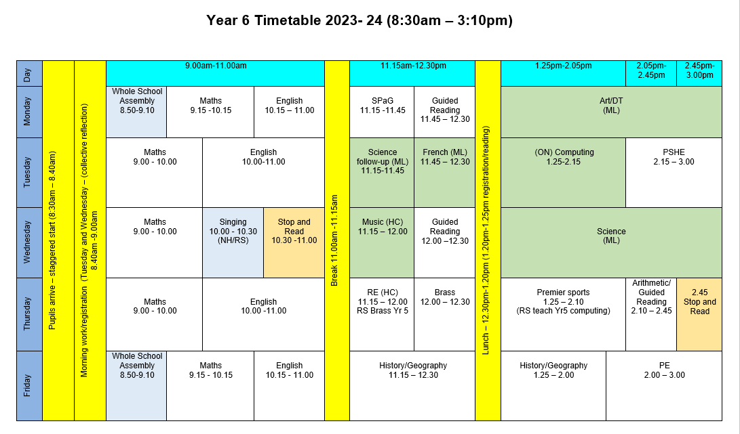
Timetable
Notes:
Record

Slide 4
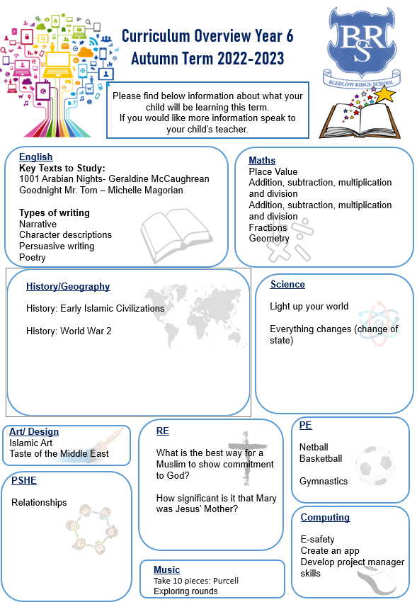
Termly Curriculum Overview
Notes:
Record

Slide 5
Trips
Autumn Term trip:
World War Two Trip (venue and date TBC)
Spring Term trip:
Harry Potter Studios (Date TBC)
Summer Term Trip 24.6.23-28.6.23
Team Building Day in School
Day in Longridge
Residential Trip to Norfolk
Notes:
Record

Slide 6
Homework
Homework is set each Friday (to be completed by the following Friday)
Maths homework will be set on Mathletics
Arithmetic sheet
Reading Comprehension sheet
Spelling activity or words to learn for a test
Please encourage your children to read each day.
Reading records should be signed at least 3 x each week. These can be signed by the children.
Termly House Competitions
Notes:
Record

Slide 7
Roles and Responsibilities
Head Boy/Head Girl
House Captain
Sports Leader
Junior Road Safety Officer (JRSO)
Eco-Council

Slide 8
Equipment/what to bring to school
In Key Stage 2 (Years 3-6) every child will need to bring in a small pencil case with the following stationery. Please name items where possible.
    two blue handwriting pens (not biro)
    HB pencils
    colouring pencils
    ruler
    a glue-stick
    a rubber
    a sharpener
Notes:
Record

Slide 9
PE
PE lessons are taught on Thursday and Friday.
Children can wear their PE kit to school and remain in their PE kit for the duration of the day, only on the days that they have PE.
PE Uniform
  White polo shirt
  Navy blue shorts
  Trainers (not plimsoles)
  Plain navy-blue tracksuit top
  Plain navy blue tracksuit trousers
Notes:
Record

Slide 10
Teaching and Learning
Curricular targets for English (writing) and mathematics
Every child has targets for writing and mathematics.
Writing targets match the year group National Curriculum objectives
Children have a copy of their targets in the back of their maths and English books.
When a target is met, the target sheet is ticked and dated to help each child understand the progress they are making.
Copies of your child’s targets will be shared and discussed at parent consultations in October.
Notes:
Record

Slide 11
Teaching and Learning
Teacher Feedback
Research shows that the most effective feedback is given verbally, ‘in the moment’ – this will be evidenced as a ‘VF’ in pupils’ books
Adults may also sometimes provide written feedback and modelling in pupils’ books using a green pen
We expect pupils to respond to feedback given by adults. We ask the pupils to do this in purple pen to help them and the adults see the corrections/edits they are
Notes:
Record

Slide 12
Baseline Assessments
We will be completing baseline assessments in reading and maths during the week beginning 25th September.
This will be to allow us to identify how we can best support the children during their time in year 6.

Slide 13

How can parents help?
Read, read and read some more!
Statistic: Parents who read 1 picture book with their children every day provide their children with exposure to an estimated 78,000 words each a year. Cumulatively, over the 5 years, estimated that children from literacy-rich homes hear a cumulative 1.4 million more words during storybook reading than children who are never read to.​
Notes:
Record

Slide 14
How can parents help?
Regular attendance is key – 95% is the minimum expectation. Pupils whose attendance is of concern will be invited to discuss this in order that the school can support parents and pupils as best possible.
Communication! Please come and talk to us if you have any concerns/questions
If you have any areas of our curriculum which you think you could help with, please let us know.
Notes:
Record

Slide 15
Any questions?
Notes:
Record

