Slide 1

Behaviour Expectations at Bledlow Ridge School

Slide 2
We will use the following vocabulary to talk about behaviour at Bledlow Ridge School…

Slide 3

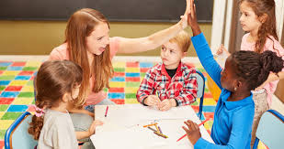
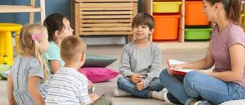
Pro-Social Behaviour
Pro-social behaviour is positive and helpful. The best examples include a demonstration of our school values of Empathy, Respect, Confidence, Health, Curiosity and Resilience. Pro-social behaviour will be recognised and celebrated by all staff.

Slide 4
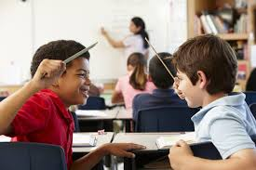
Unsocial Behaviour
Unsocial behaviour is often low-level behaviour which can distract others in the classroom.
Examples include not listening to instructions and refusing to get complete work set after you have had a reminder. Unsocial behaviour will be addressed by your teacher.

Slide 5
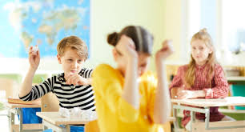
Anti-Social Behaviour
Anti-social behaviour can cause harm to an individual, group or the environment. It is likely to cause another person or a group of people to be hurt.
Examples include; answering back, name calling, refusal to carry out an adult’s request, distracting others, disrupting others’ learning, throwing small equipment, pinching, pushing, hitting etc. Anti-social behaviour will be addressed by class teacher and Mrs Stanley and Mrs Harrison will be informed.

Slide 6
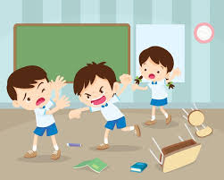
Dangerous Behaviour
Dangerous behaviour is anti-social behaviour that causes serious physical harm to another child/adult or the child concerned. Examples include; leaving the school premises without permission, throwing furniture and aggressive behaviour.
Dangerous behaviour is likely to need support from Mrs Harrison or Mrs Stanley.

Slide 7

Rewards
Being rewarded for demonstrating pro-social behaviour is really important!
We will recognise and reward pro-social behaviour through:
Verbal and non-verbal praise House points/Dojos recognise children demonstrating our School Values Headteacher Award recognises excellence in learning and/or positive role models Weekly ‘kindness’ certificate given in assembly Kindness box in the school hall where any member of the school community can write a message about another child/staff member to celebrate a random acts of kindness Praise in front of peers/adults, e.g assembly Positive postcard home (1st House competition of the year) Pro-social sticker given out to pupils by staff when pro-social behaviours are shown.

Slide 8
Consequences
If you show unsocial, anti-social or dangerous behaviours, you will receive a consequence from your teacher or Mrs Stanley or Mrs Harrison.
This consequence will be linked the behaviour your demonstrated.
For example, if you refuse to complete your work despite support and reminders, you may be given the opportunity to finish this during breaktime. If you make a big mess, you will be asked to clean this mess up. If you are unkind, you will be given some time at breaktime to discuss your actions with a teacher and decide on an appropriate response.
We want our school to be a happy and safe place for everyone.

Slide 9
How many ways can you think of to show Pro-Social Behaviour?

Slide 10
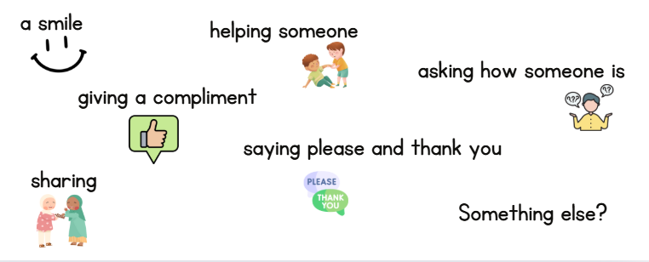
Did you think of any of these?

Slide 11

Showing Kindness is a big part of Pro-Social Behaviour
Listen to this story and think about what it tells us about kindness and pro-social behaviour.
📖 Kids Book Read Aloud: Be Kind by Pat Zietlow Miller

Slide 12
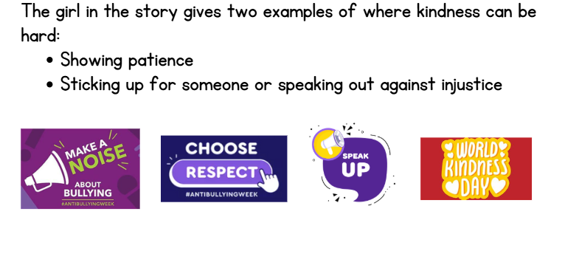
Is choosing to show Pro-Social Behaviour and kindness always easy?

Slide 13

Reflection
How will you show Pro-social behaviour in your classroom?
How will you show pro-social behaviour outside on the playground?
How can we start ripples of pro-social behaviour that spread out into our community?

