Slide 1
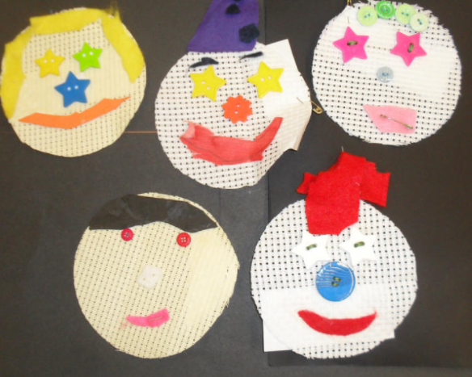
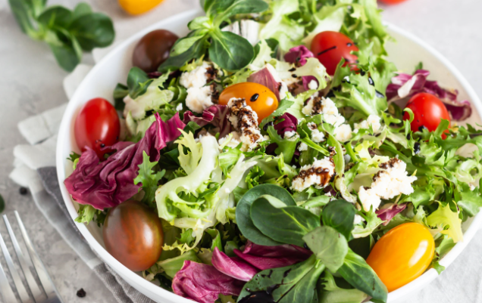
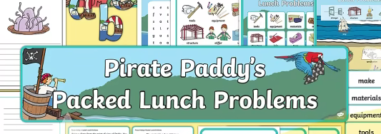
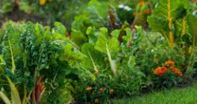
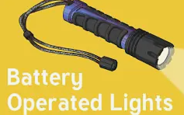
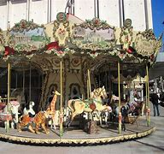
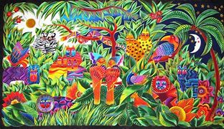
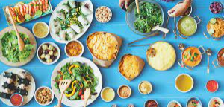
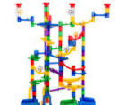
Fabric Faces
Pirate Paddy
Seasonal Salads
Moving Pictures Christmas Tales
Dips and dippers
Fabric Bunting
Year One
Year Two
Mechanical Systems
The Great Bread bake off
Lets go fly a kite
Juggling Balls
Year Three
Battery Operated Lights
Year Four
Edible Garden
Automata Animals
Super Seasonal Cooking
Hidden World
(Fabric & 3D Making)
Food inspired by the Middle East
Year Five
Year Six
Textiles
Fairground Ride (Electricity Application)
Bledlow Ridge Curriculum Road Map- DT

Slide 4
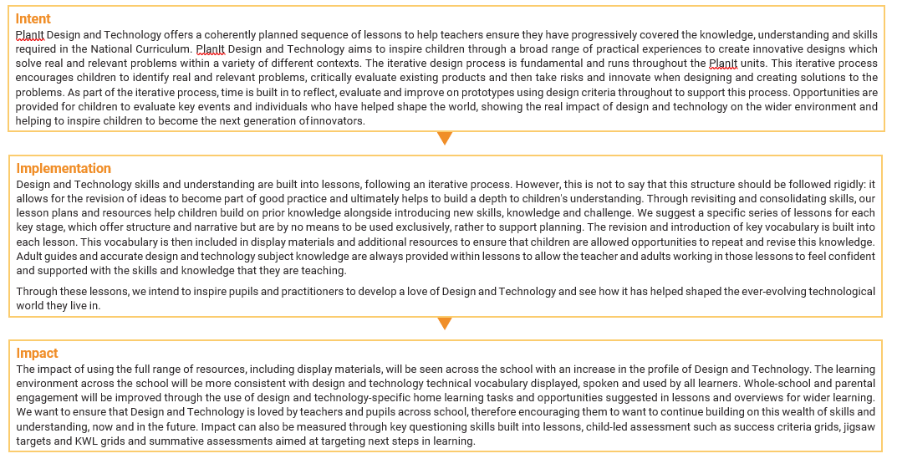

Slide 5
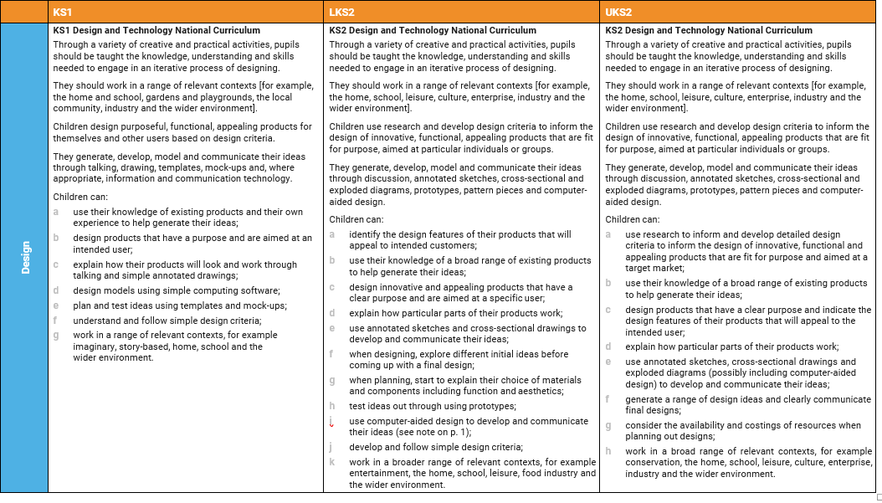

Slide 6
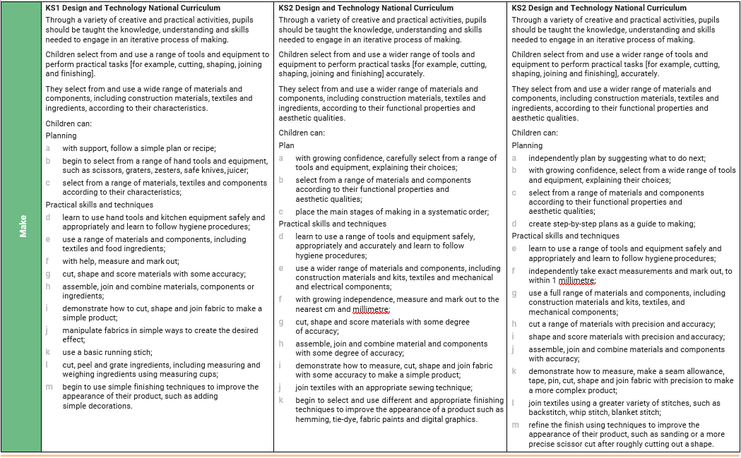

Slide 7
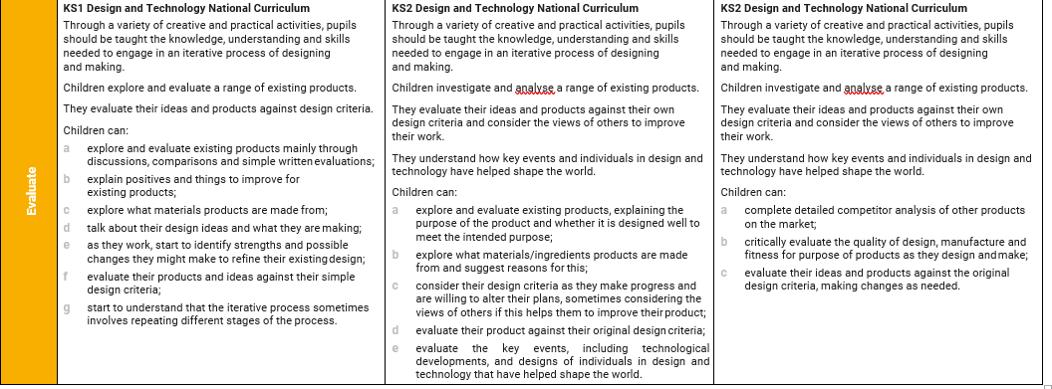

Slide 8
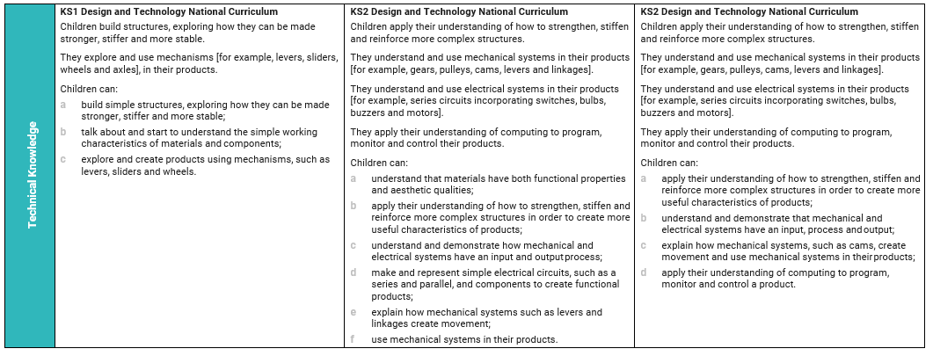

Slide 9
